Slide 1
GOLDILOCKS AND THE THREE BEARS

Slide 2
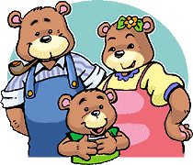
Here are the three bears: Mummy bear, Daddy bear, and Baby bear.

Slide 3
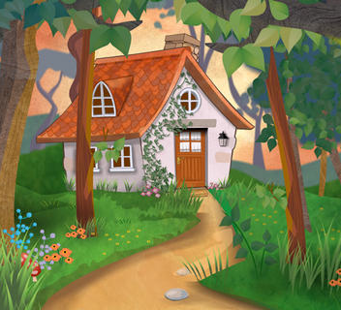
THEY ALL LIVE IN A LITTLE HOUSE

Slide 4
Mummy bear makes some porridge and she put the porridge into three bowls: big, medium, and small.

Slide 5
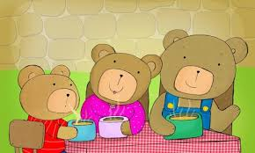
"What an aromatic smell!“ Daddy bear tastes the porridge: "Oh! This porridge is very hot.“
Mummy bear tastes the porridge: "Oh! This porridge is very hot.“ Baby bear tastes the porridge: "Oh! This porridge is very hot.“

Slide 6
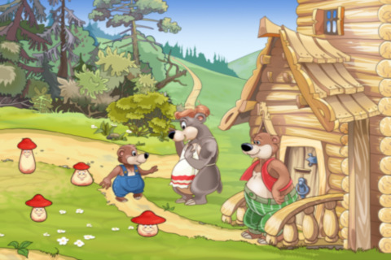
"Let’s go for a walk!“
We will eat the porridge after

Slide 7
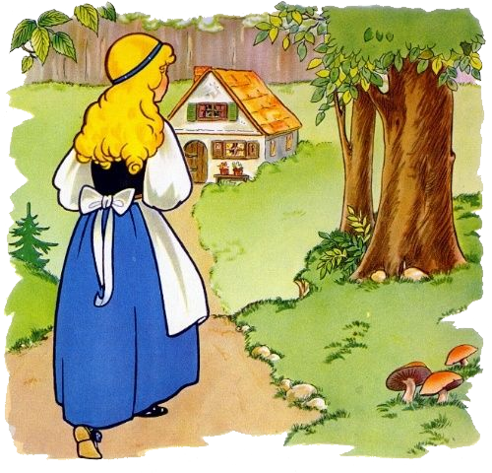
ONCE UPON A TIME THERE WAS A LITTLE GIRL. HER NAME WAS GOLDILOCKS. SHE HAD GOLDEN HAIR.

Slide 8
ONE DAY GOLDILOCKS WAS WALKING IN THE FOREST. SHE SAW A HOUSE AND KNOCKED ON THE DOOR.

Slide 9
Goldilocks opens the door and smells porridge: "I like porridge! Yum, yum.“ She went inside and nobody was there.

Slide 10
GOLDILOCKS SAW THREE BOWLS ON THE TABLE. SHE WAS VERY HUNGRY.

Slide 11
SHE TASTED THE PORRIDGE FROM THE BIG BOWL: “THIS PORRIDGE IS TOO HOT!” SAID GOLDILOCKS

Slide 12
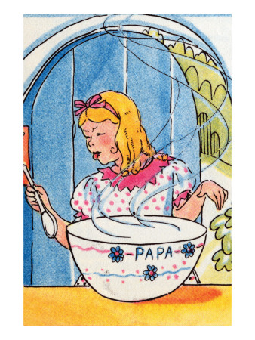
Goldilocks tastes the porridge from the medium bowl: ”I don’t like this “this porridge is too cold!” said Goldilocks

Slide 13
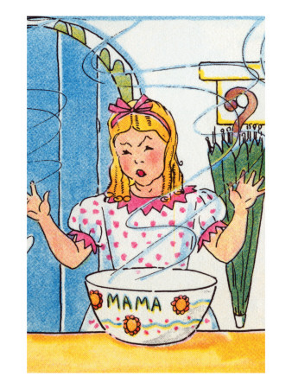
Goldilocks tastes the porridge from the small bowl: "Yum! I like this porridge. “THIS PORRIDGE IS GOOD” GOLDILOCKS ATE ALL THE PORRIDGE

Slide 14
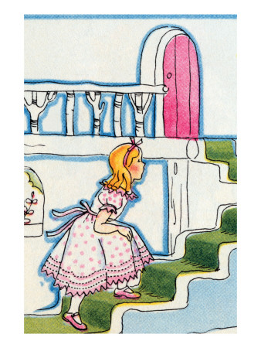
AFTER EATING THE PORRIDGE, GOLDILOCKS WAS VERY TIRED SHE WENT UPSTAIRS

Slide 15
GOLDILOCK SAW THREE BED, “OH BEDS!” SHE SAID.

Slide 16
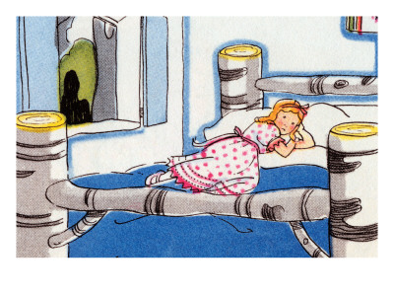
SHE TOUCHES THE BIG BED”OH I DON’T LIKE THIS BED. THIS BED IS TOO HARD”

Slide 17
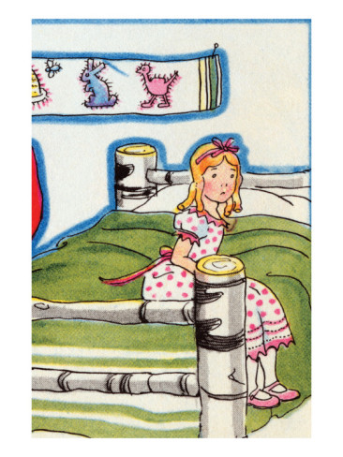
SHE TOUCHES THE MEDIUM BED”OH I DON’T LIKE THIS BED“THIS BED IS TOO SOFT!”

Slide 18
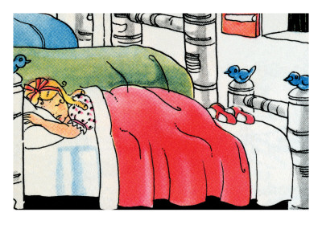
SHE TOUCHES THE SMALL BED“I LIKE THIS BED. THIS BED IS VERY GOOD!” SHE FALLS ASLEEP.

Slide 19
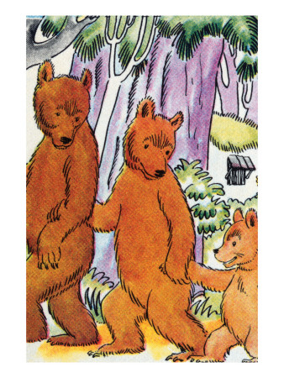
SOON THE BEARS CAME HOME.

Slide 20
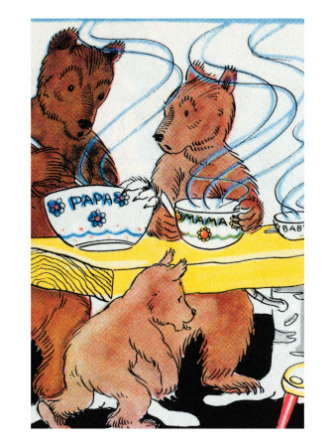
“LOOK AT MY PORRIDGE! SOMEONE HAS EATEN MY PORRIDGE!” SAID DADDY BEAR

Slide 21
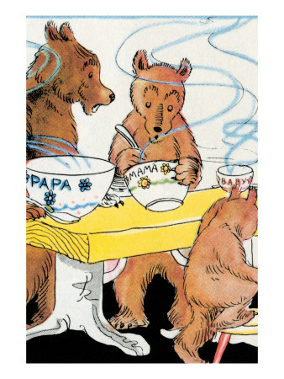
LOOK AT MY PORRIDGE! “SOMEONE HAS EATEN MY PORRIDGE TOO”. SAID MUMMY BEAR.

Slide 22
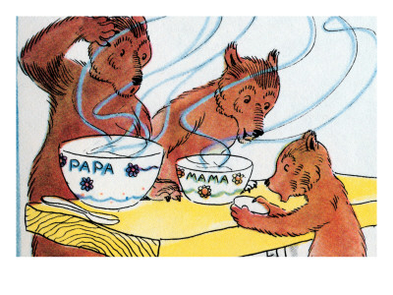
“LOOK! MY PORRIDGE, MY BOWL IS EMPTY..BUU BUU”, SAID BABY BEAR.

Slide 23
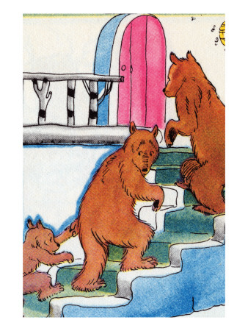
FAMILY BEAR WENT UPSTAIRS

Slide 24
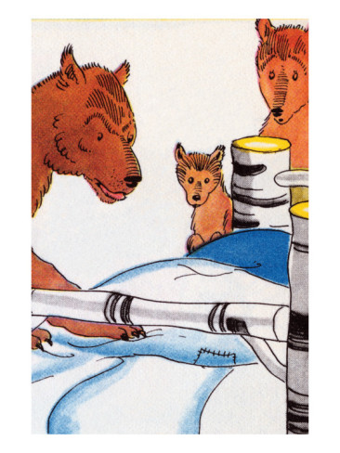
LOOK AT MY BED SOMEONE HAS BEEN SLEEPING IN MY BED! SAYS DADDY BEAR.

Slide 25
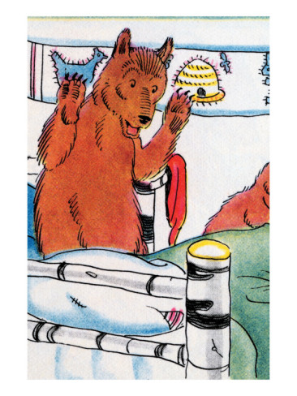
LOOK AT MY BED SOMEONE HAS BEEN SLEEPING IN MY BED! SAYS MUMMY BEAR.

Slide 26
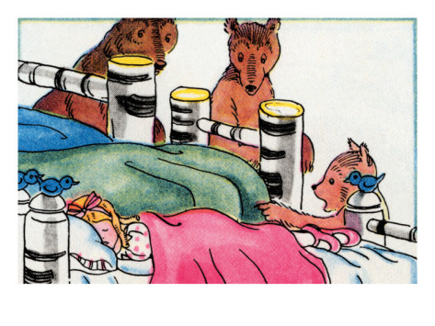
LOOK! SOMEONE’S BEEN SLEEPING IN MY BED. THERE IS A GIRL IN MY BED SAYS BABY BEAR

Slide 27
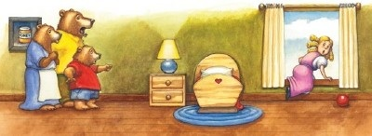
SHE WAKES UP AND SEES THE THREE BEARS.THEY SHOUTED “HELP!”. SHE JUMPED FROM THE WINDOW

Slide 28
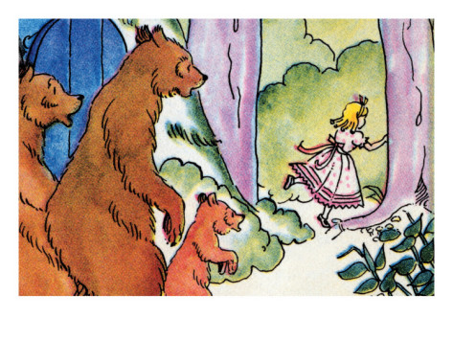
GOLDILOCK RAN INTO THE FOREST. SHE NEVER CAME BACK AGAIN.

Slide 29
Presented by Sonakshi Bali Kendriya Vidyalaya Shalimar Bagh Shift 1

