Slide 1
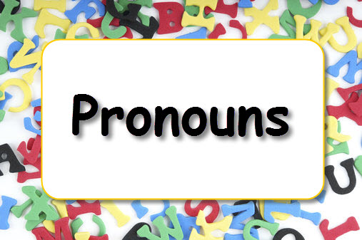
Definition
Pronoun is used in place of a specific noun mentioned earlier in a sentence so that you don’t have to keep saying/writing that particular noun. The word or phrase that a pronoun replaces is called the antecedent of the pronoun.

Slide 2
Types of Pronouns
Subject Pronouns
Object Pronouns
Possessive Pronouns
Reflexive Pronouns
Intensive Pronouns
Relative Pronouns
Demonstrative Pronouns
Interrogative Pronouns

Slide 3
Subject Pronouns
Subject pronouns work as the subject of the verb in a sentence. A subject pronoun normally replaces the subject/object (a noun) of the previous sentence.
Example:
Ajay can’t attend the party. He has gone to his grandparents.
Preeti is a good storyteller. She told a ghost story that scared everyone.

Slide 4
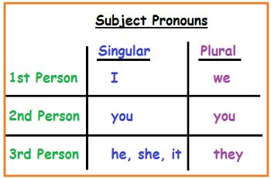
Subject Pronouns

Slide 5
Object Pronouns
Object pronouns work as the object or indirect object in a sentence replacing the antecedent object. This form of the pronoun is also used after prepositions.
Example:
I’ll give you a present on your birthday. I have a great idea for you. (after preposition)
Tell her that you’ll take the job. I have a gift for your boss. Give it to your boss. (Here, ‘it’ works as an object)

Slide 6
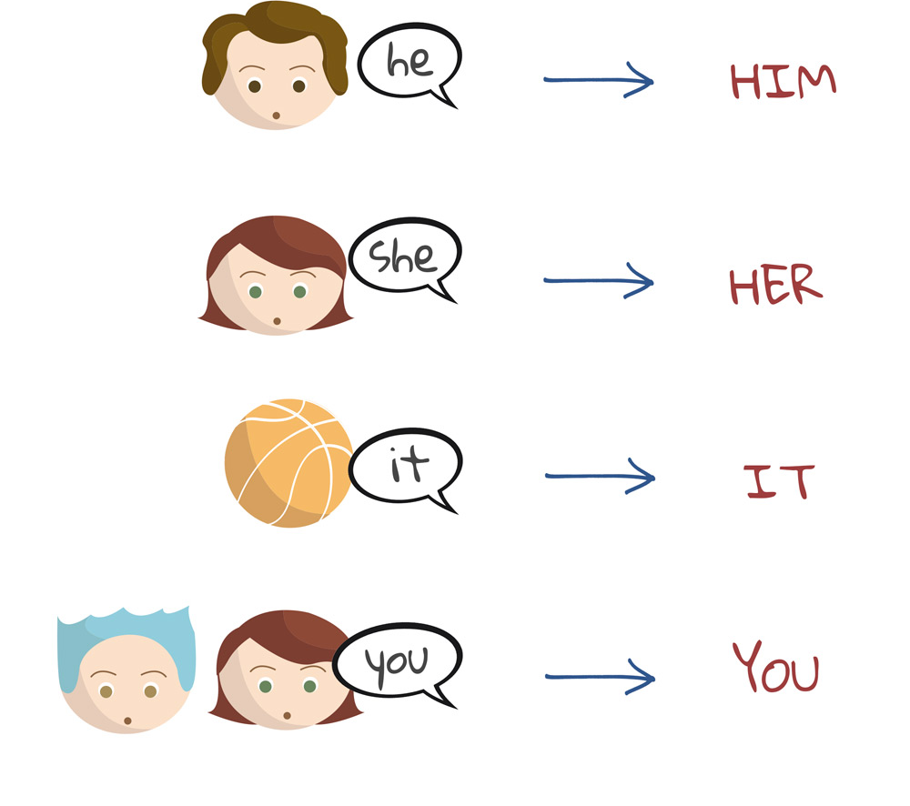
Object Pronouns

Slide 7
Possessive Pronouns
Possessive pronouns replace the nouns of the possessive adjectives: my, our, your, her, his, their. The possessive pronouns are mine, ours, yours, hers, his, its, theirs. The pronoun ‘who’ also has a possessive form, whose.
Example:
I thought my bag was lost, but the one Ram found was mine. (Here, ‘mine’ refers to ‘my bag’)
Their vacation will start next week. Ours is tomorrow. (Here, ‘ours’ refers to ‘our vacation’)

Slide 8
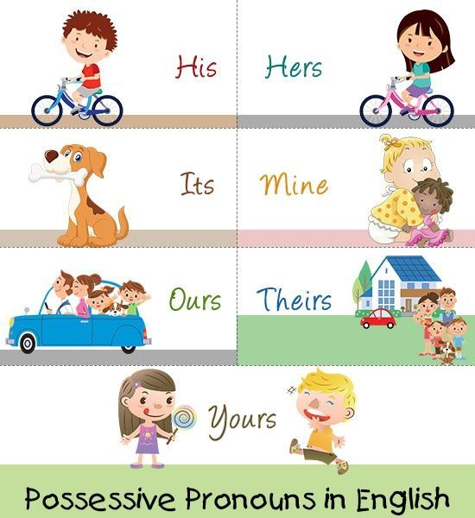
Possessive Pronouns

Slide 9
Reflexive Pronouns
Reflexive pronoun redirects a sentence or a clause back to the subject, which is also the direct object of that sentence. A reflexive pronoun comes when the subject performs its action upon itself. Here, ‘itself’ is a reflexive pronoun.
Example:
Since she is her own boss, she gave herself a raise. (Here, “herself” is the direct object of the clause and the same person is the subject)
We told ourselves that we were so lucky to be alive.

Slide 10
Reflexive Pronouns

Slide 11
Intensive Pronouns
An intensive pronoun is almost identical to a reflexive pronoun. It is defined as a pronoun that ends in self or selves and places emphasis on its antecedent by referring back to another noun or pronoun used earlier in the sentence. For this reason, intensive pronouns are sometimes called emphatic pronouns.
Example:
I have never yet failed to meet a deadline, I myself have set up.
I did it myself.

Slide 12
Intensive Pronouns

Slide 13
Relative Pronouns
Relative pronouns introduce the relative clause. They are used to make clear what is being talked about in a sentence. They describe something more about the subject or the object.
Example:
The car that was stolen was the one they loved most.
Whoever you are behind this great initiative, I want to thank you.

Slide 14
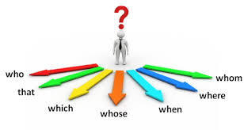
Relative Pronouns

Slide 15
Demonstrative Pronouns
Demonstrative pronouns normally indicate the closeness of or distance from the speaker, either literally or symbolically. This, these, that, and those are the demonstrative pronouns. They also work as demonstrative adjectives when they modify a noun. However, demonstrative pronouns do not modify anything rather replace the nouns/noun phrases.
Sometimes neither, none and such are also used as demonstrative pronouns.
Example:
That is a long way to go.
This is my car.

Slide 16
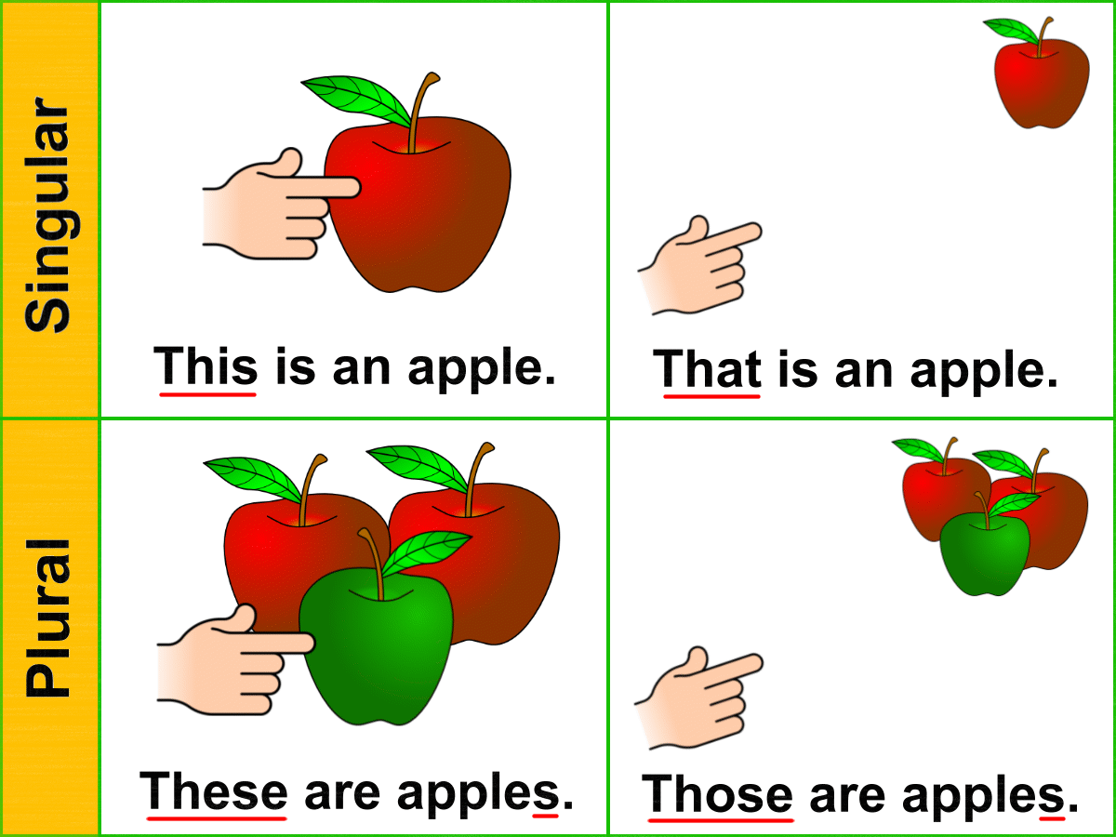
Demonstrative Pronouns

Slide 17
Interrogative Pronouns
Interrogative pronouns produce questions. They are what, which, who, whom, and whose. Who, whom, and whose refer to questions related to a person or animal; what refers to an idea, object, or event; and which can indicate either a person/s or a thing/s.
Example:
What was the name of your dog?
Which is your favorite movie?

Slide 18
Interrogative Pronouns

Slide 19
THANK YOU
HAVE A NICE DAY

