Slide 2
DAY--NIGHT

Slide 3
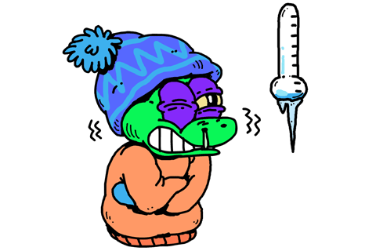
HOT---- COLD

Slide 4
HEAVY ----- THIN

Slide 5
BIG ---- SMALL

Slide 6
HAPPY---- SAD

Slide 7
TALL ----SHORT

Slide 8
DOWN----- up

Slide 9
YOUNG OLD

Slide 10
FULL-- EMPTY

Slide 11
EMPTY ---FULL

Slide 12
HEAVY --------- light

Slide 13
PULL------ PUSH

Slide 14
DRY----WET

Slide 15
ON—---OFF

Slide 16
BEAUTIFUL-----UGLY

Slide 17
INTRESTING ----- BORING

Slide 18
FEW------ MANY

Slide 19
AWAKE--- ASLEEP

Slide 20
SILENT---- NOISE

Slide 21
sit----- stand

Slide 22
SANGEETA SHARMA
PRT KV SEC 12 DWARKA

