Slide 1
INSERVICE TRAINING COURSE(PRT) 2020-2021 KV NO-2 DELHI CANTT.
BULLET POINTS BASED ON BACK TO BASICS

Slide 2
ENVIRONMENT
AN ENVIRONMENT IS EVERYTING THAT IS AROUND US, WHICH INCLUDES BOTH LIVING AND NONLIVING THINGS SUCH AS SOIL, WATER, ANIMALS AND PLANTS WHICH ADAPT THEMSELVES TO THEIR SURROUNDINGS.
ITS NATURE’S GIFT THAT HELPS IN NOURISHING THE LIFE ON THE EARTH.

Slide 3
FOR CHILD IT STARTS FROM HOME

Slide 4
PEER GROUP
CHILDREN LEARN FROM THEIR PEERS ALSOAND EXTENT THEIR ENVIRONMENT.

Slide 5
SCHOOL
THE PLACE WHERE CHILDREN GO TO EDUCATED.

Slide 6
NEIGHBOURS
HOSPITAL
POLICE STATION

Slide 7
TEMPLE
MAJZID

Slide 8
OUR HELPERS
DOCTORS
DRIVER

Slide 9
SOLDIER
TEACHER

Slide 10
SEASONS
THE PERIOD OF THE YEAR WHEN SOMETHING IS COMMON OR SOMETHING USEALLY HAPPENS.

Slide 12
FESTIVALS
A DAY OR COUPLE OF DAYS WHEN PEOPLE CELEBRATE SOMETHING.

Slide 13
OUR FESTIVALS

Slide 14
ANIMALS
WILD ANIMALS, DOMESTIC ANIMALS, AQUATIC ANIMALS, FARM ANIMALS

Slide 15
AQUATIC ANIMALS

Slide 16
DOMESTIC ANIMALS

Slide 17
FARM ANIMALS

Slide 18
ANIMALS AND THEIR YOUNG ONES

Slide 19
IMPORTANCE OF TREEES
TREES ARE VITAL
THEY GIVE US OXYGEN, STORE CARBON
THEY STABLISE THE SOIL AND GIVE LIFE TO THE WORLD’S WILDLIFE
They also provide us with the materials for tools and shelter.

Slide 20
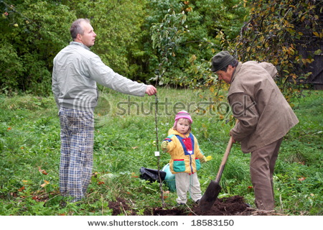
PLANTS:OUR BEST FRIEND

Slide 21
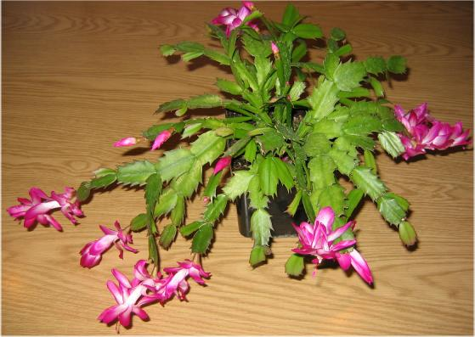
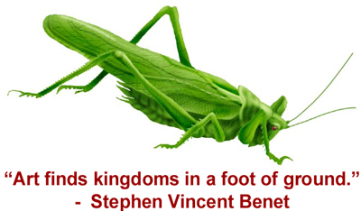
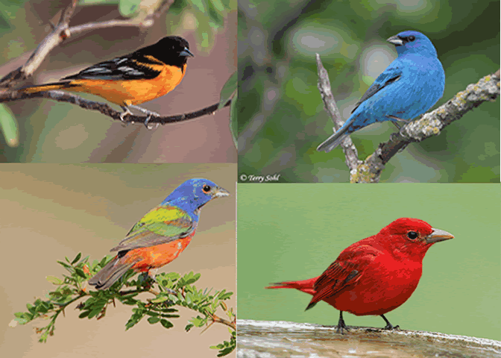
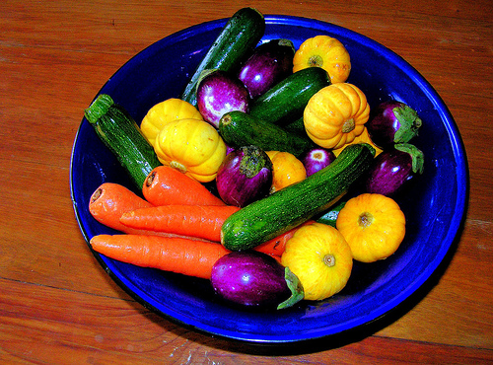
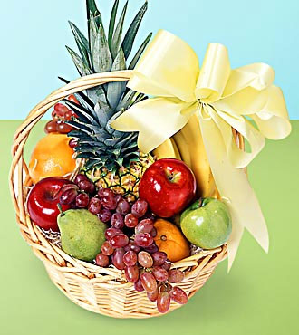
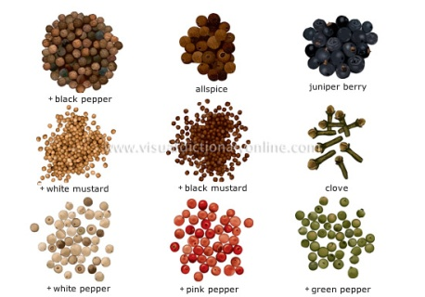
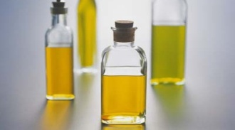
FOOD
PLANTS GIVE US FOOD TO EAT
BEINGS AND ANIMALS DEPENT ON PLANT FOR FOOD
PLANTS
GRASSHOPPER
BIRDS
THEY GIVE US
VEGETABLES
FRUITS
OIL
SPICE

Slide 22
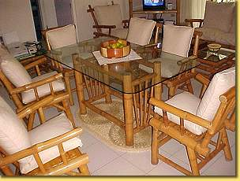
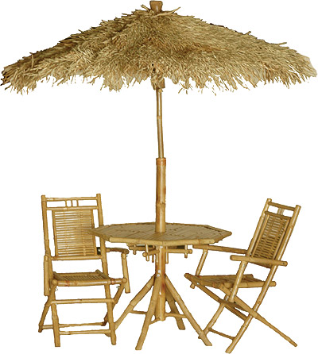
TIMBER
PLANTS LIKE BAMBOO GIVE US WOOD TO
MAKE DIFFERENT FURNITURE DEORS AND WINDOS ALSO MADE BY WOOD

Slide 23
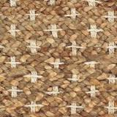
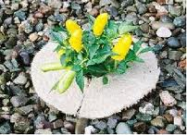
FIBRE
WE GET COTTON FIBRE FROM COTTON PLANTS.
Jute from jute plants. They are used for various purpose.
jUTE PLANT
COTTON

Slide 24
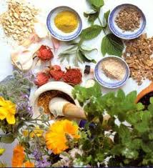
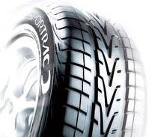
Medicines
Tulsi and Garlic are used to make different medicines.
Tulsi
Rubber
Rubber is used to make tyres and many useful things

Slide 25
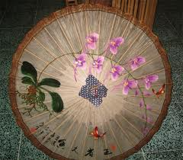
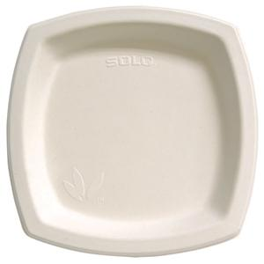
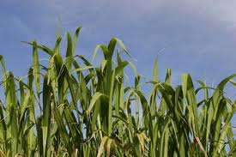
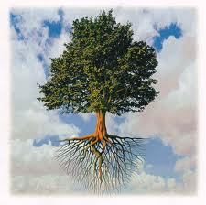
PAPER
PAPER IS MADE FROM THE PULP WE GET FROM BAMBOOS AND HUSK OF SUGGERCAN AFTER CRUSHING
SOIL INTACT
PLANTS KEEP THE SOIL INTACT

Slide 26
Smiling Sunflowers

Slide 27
Lovely lilac

Slide 28
A Shining New Day

Slide 29
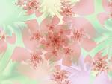
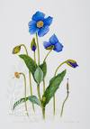
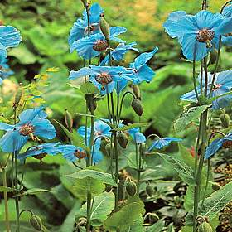
What will you find there? Himalayan Blue Poppy

Slide 30
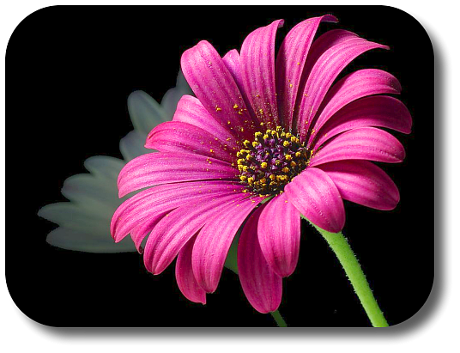
Daisies…. White… Yellow… Purple

Slide 31
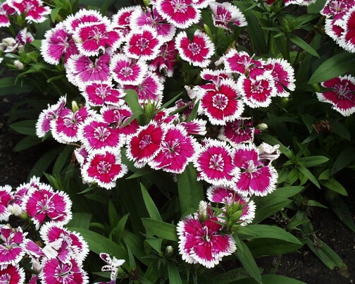
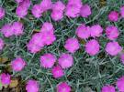
Dianthus

Slide 32
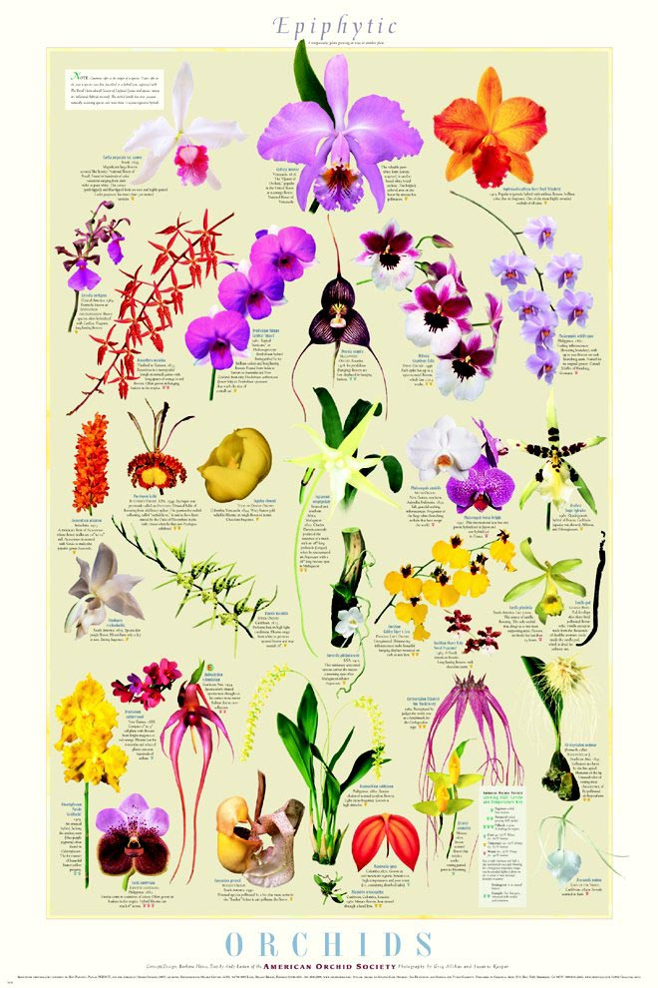
ORCHIDS

Slide 33
Some Flowers are eaten
Banana Flowers

Slide 34
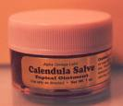
Some flowers are medicinal

Slide 35
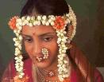
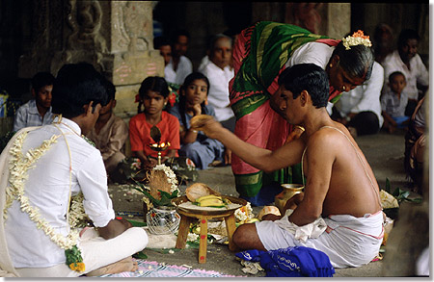
Flowers are used for many Occasions like…..

Slide 36
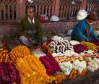
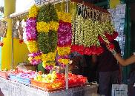
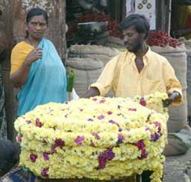
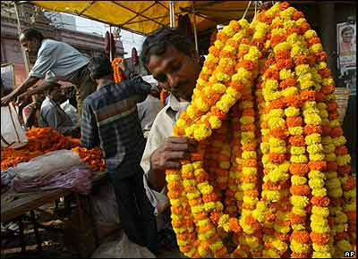
Who are these people?

Slide 37
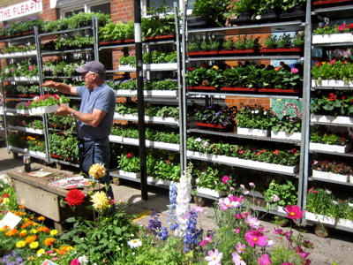
A Florist and his wholesale shop

Slide 38
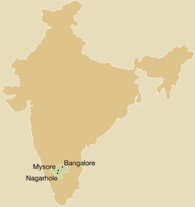
Our Country’s largest business in flowers is in these places

Slide 39
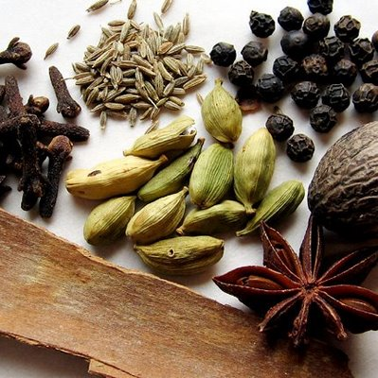
SPICES
A SPICE IS A DRIED SEED,FRUIT, LEAF, BARK OR ANY OTHER
PART OF A PLANT USED TO IMPROVE THE TASTE AND
FLAVOUR OF THE FOOD.
IT HAS NUTRITIONAL AND MEDICINAL PROPRTIES.

Slide 40
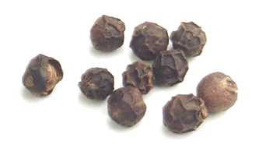
PEPPER
PEPPER IS SMALL AND ROUND LIKE A PEARL.
IT IS BLACK IN COLOUR.
IT HAS SHARP SPICY TASTE.
Notes:
Pepper is Small and round like a pearl. It isblack in colour. It has sharp spicy taste.

Slide 41
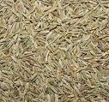
CUMIN SEEDS (JEERA)
CUMIMIN SEEDS ARE SMALL AND SKINNY.
IT GIVES FRAGRANCE WITH HOT OIL AND GHEE.
ROASTED CUMIN IS ADDED TO JALJEERA AND CURD.

Slide 42
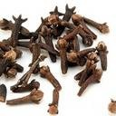
Cloves (lavang)
Cloves are buds with chocolate brown colour.
It has a strong smell.
It is good for tooth ache.

Slide 43
FENNEL (SAUNF)
.
.
IT LOOKS LIKE JEERA BUT ACTUALLY IT IS GREEN
IN COLOUR. IT MAKES OUR STOMACH HEALTHY
REFRESHES OUR MOUTH AFTER EVERY MEAL.

Slide 44
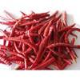
RED CHILLIES
Red chillies make the food hot and spicy.

Slide 45
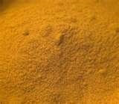
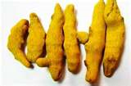
TURMERIC (Haldi)
POWDER
TURMERIC MAKES THE FOOD LOOK YELLOW AND
HEALS THE WOUNDS WHEN APPLIED WITH OIL.

Slide 46
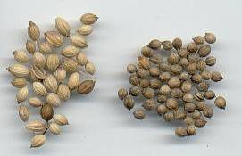
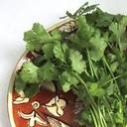
CORIANDER (DHANIYA)
CORIANDER CONTAINS HIGH FIBRE RICH IN IRON AND
MAGNISIUM.IT REDUCES THE LEVEL OF SUGAR IN
BLOOD.

Slide 47
FENUGREEK (METHI)
FENUGREEK IMPROVES DIGESTION.
IT REDUCES BLOOD CHOLESTROL AND
BLOOD SUGAR.
IT IS USED IN CURIES AND PICKLES.

Slide 48
WE SHOULD PROTECT FOREST
Learning from forests is like learning from books.
From forests we get ,
Wood for furniture, fuel,
Medicinal plants,
Different types of trees etc.
Forests protect animals and birds.
Forests protect soil erosion.
Forests reduce air pollution.
Forests help flood control.
Forests help to get rain fall

Slide 49
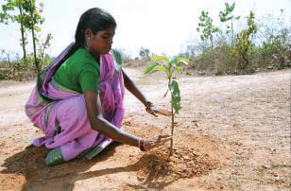
THANK YOU

