Slide 1
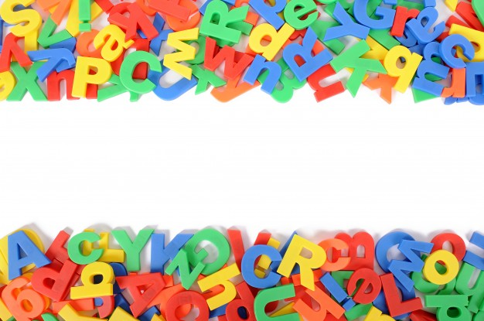
HOMOPHONES

Slide 2
A homophone is a word that is pronounced the same as another word but differs in meaning and spelling.

Slide 3
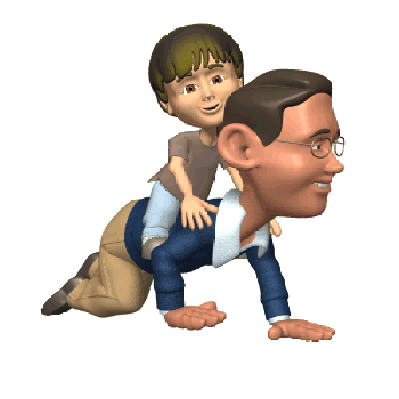
SUN
Sun is shining brightly in the sky.
SON
Father and son are having fun together.

Slide 4
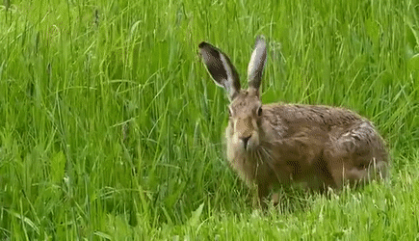
HAIR
That girl has long hair.
HARE
There was a hare in my backyard yesterday.

Slide 5
RIGHT
The temple is on my right.
WRITE
We should write neatly.

Slide 6
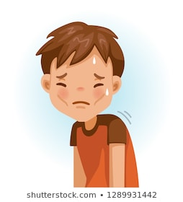
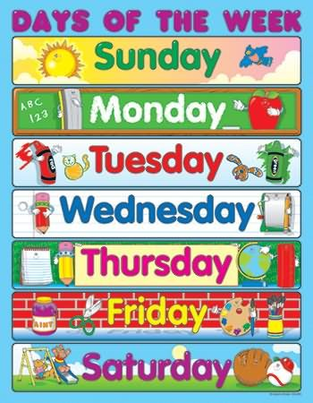
WEAK
The boy is feeling weak due to fever.
WEEK
There are seven days in a week.

Slide 7
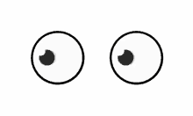
SEE
I can see a rainbow in the sky.
SEA
Sea water is salty.

Slide 8
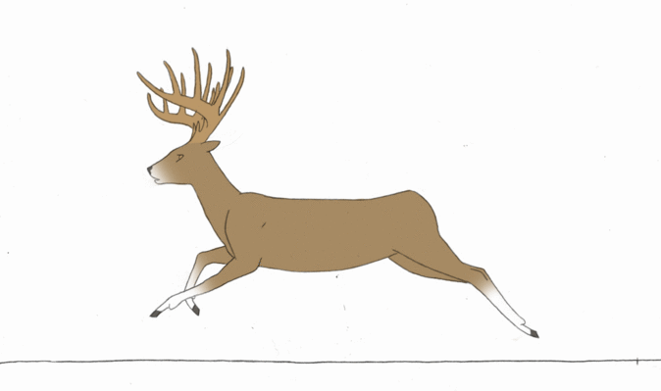
DEAR
My sister is very dear to me.
DEER
Deer runs very fast.

Slide 9
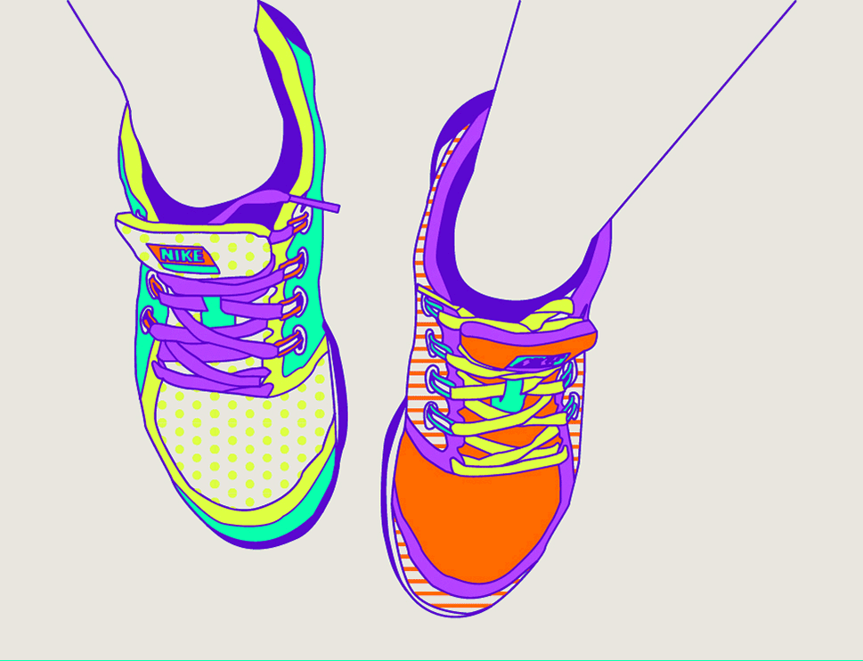
PAIR
Rahul has colourful pair of shoes.
PEAR
Pear is good for health.

Slide 10
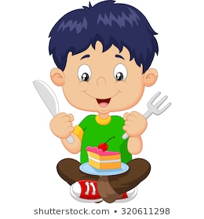
ATE
John ate cake yesterday.
EIGHT
Siri got eight marks out of ten in English.

Slide 11
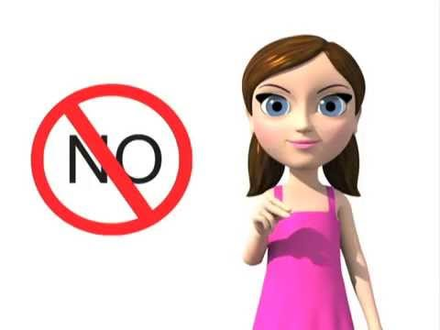
KNOW
Students of my class know how to add numbers.
NO
Do not park your car if there is a No parking signboard.

Slide 12
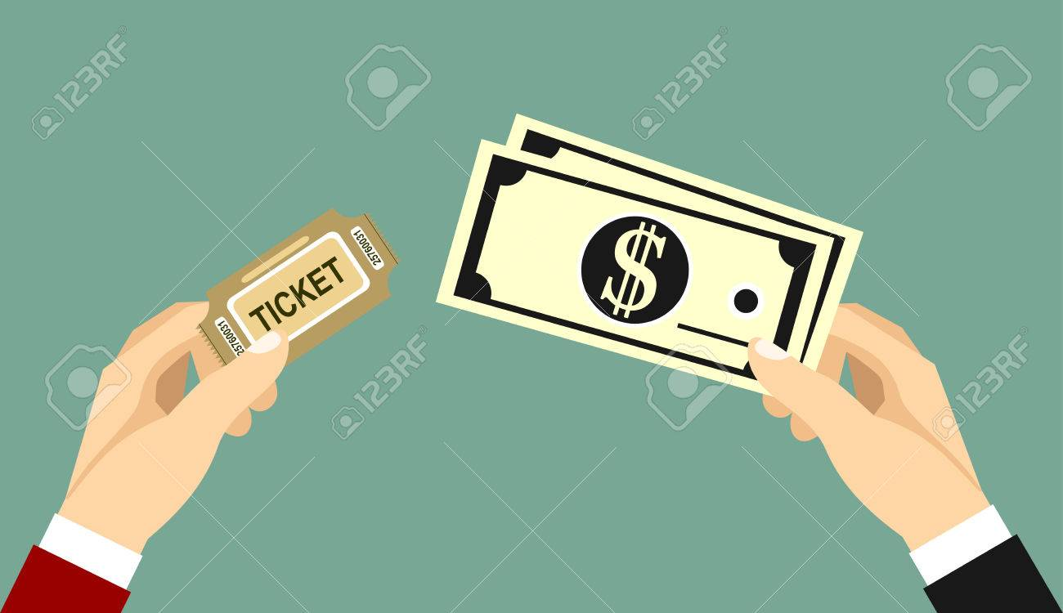
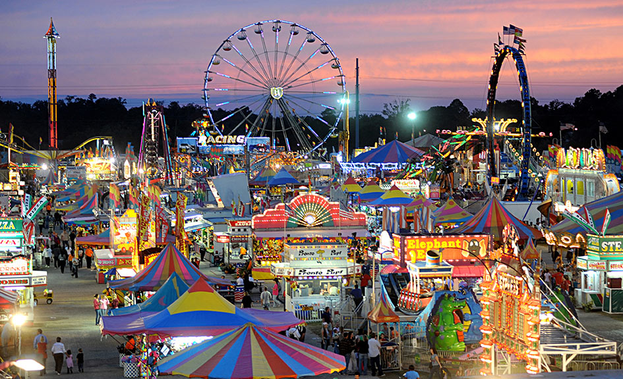
FARE
Flight fare is increasing.
FAIR
There are many rides in fair.

Slide 13
WEAR
Wear the mask properly.
WHERE
“Where is my car?”

Slide 14
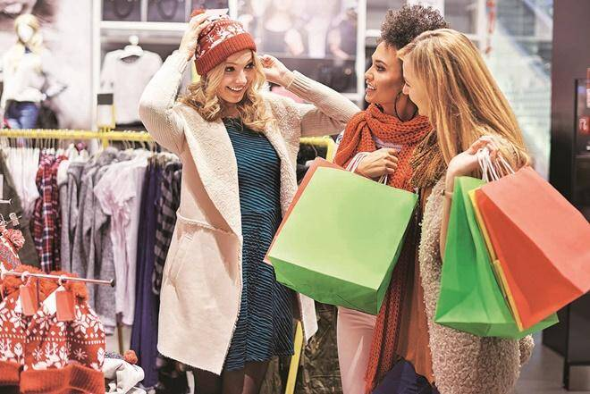
BUY
They went market to buy clothes.
BYE
Uncle said bye while leaving.

Slide 15
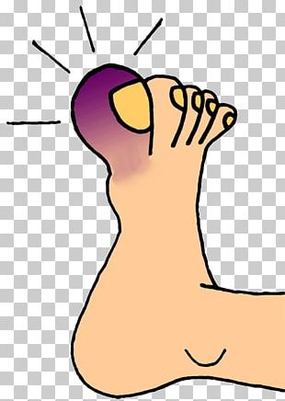
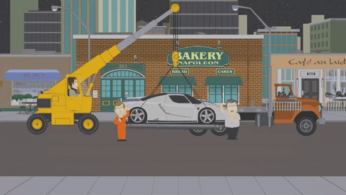
TOE
My toe is hurting.
TOW
Pulley is towing my car.

Slide 16
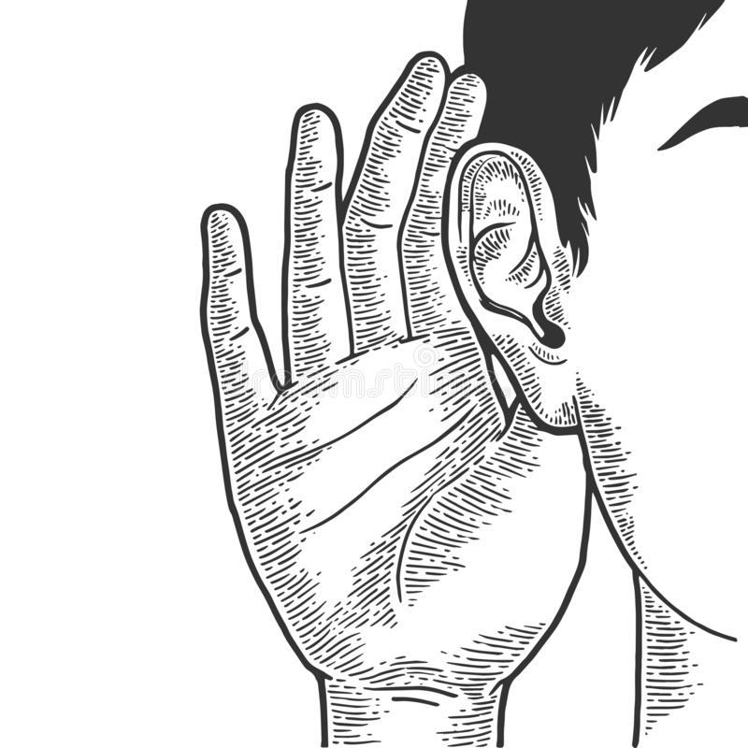
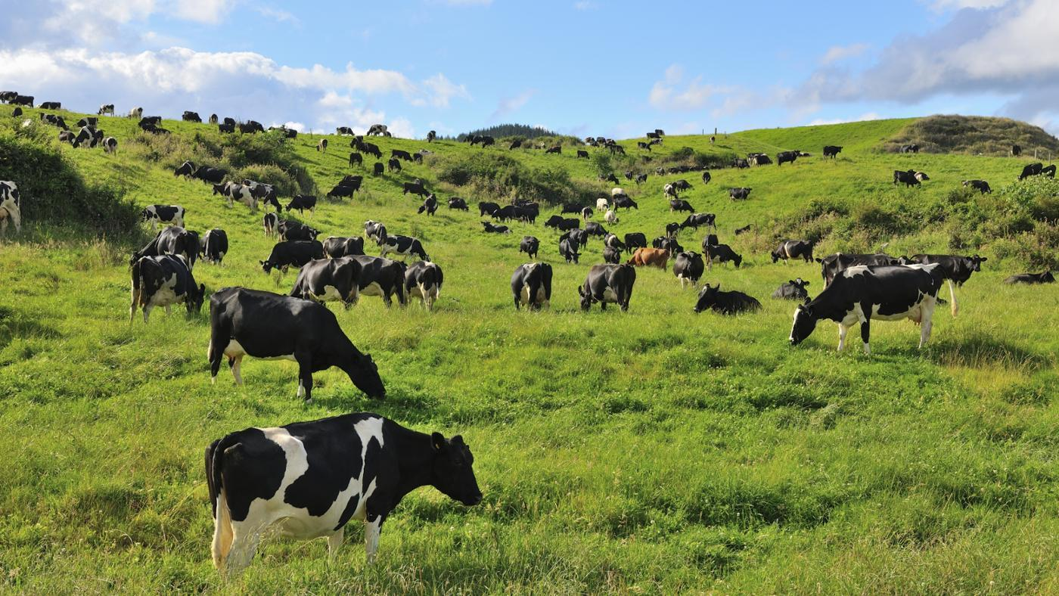
HEARD
I heard my brother talking to my friend.
HERD
Group of cows is called a herd.

Slide 17
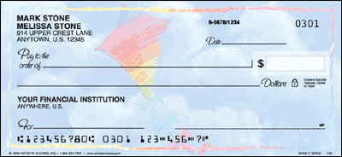
CHECK
Parents check my bag daily.
CHEQUE
Uncle gave a cheque of thousand rupees to my father.

Slide 18
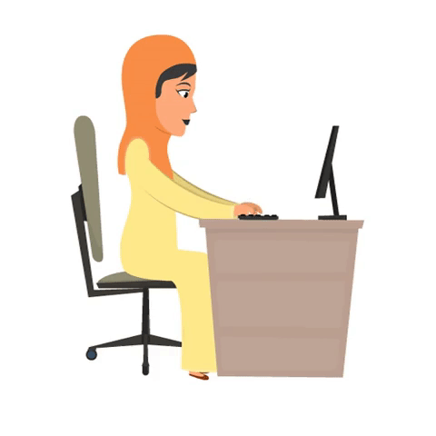
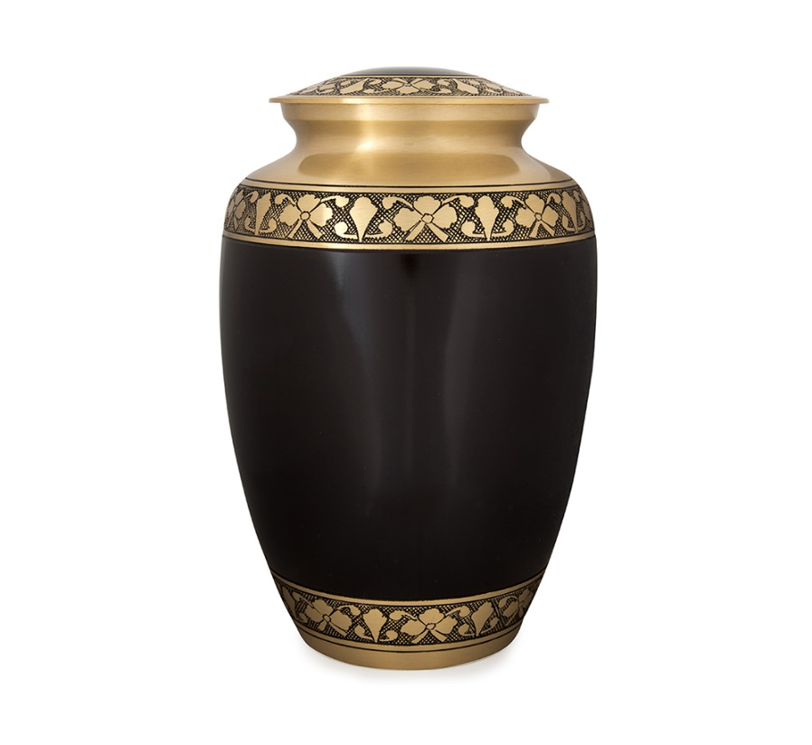
EARN
My aunt works so hard to earn money.
URN
I have three beautiful urns at home.

Slide 19
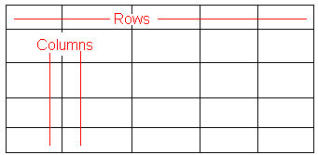
ROSE
Roses are red.
ROWS
There are five rows in the table.

Slide 20
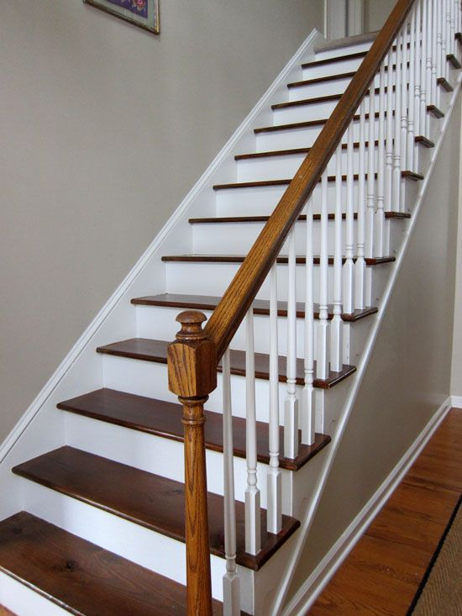
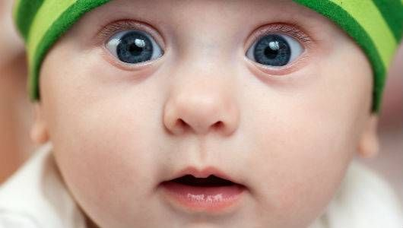
STAIR
I can climb up a stair quickly.
STARE
Do not stare strangers.

Slide 21
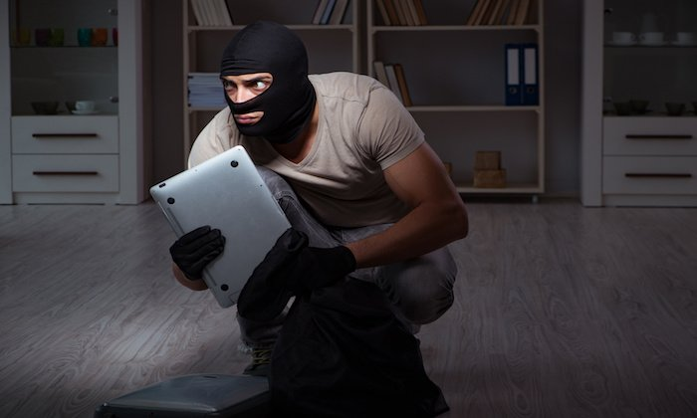
STEAL
We should not steal things. It’s a bad habit.
STEEL
We use steel utensils.

Slide 22
THANK YOU.
Presented by :
POWER AND GLORY GROUP

