Slide 1
Kendriya Vidyalaya No. 2 Delhi Cantt
FOOD,HEALTH AND HYGIENE
JAPANJOT KAUR SANDHU

Slide 2
SCOPE
INTRODUCTION
BALANCED DIET
10 WAYS TO MAINTAIN A BALANCED
DIET CHART
NUTRITIONIST RECOMMENDED
BALANCED DIET FOR
TODLERS,WOMEN AND MEN
HYGIENE

Slide 3
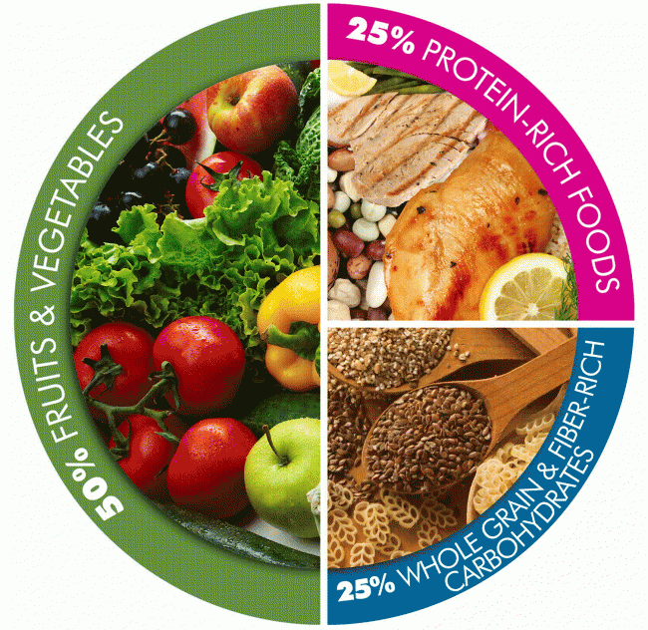
BALANCED DIET
A balanced diet is a
diet that gives your body
all the nutrients required
by it in order to function
correctly.

Slide 4
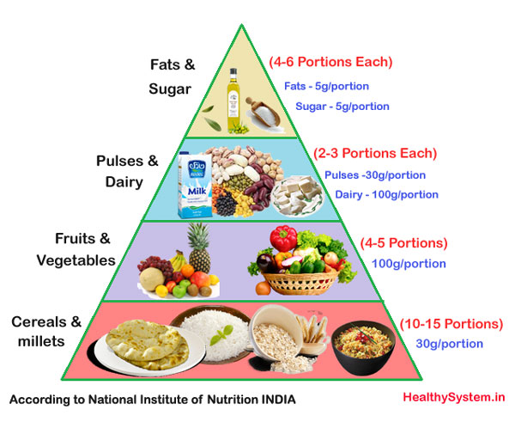

Slide 5
10 Ways to Maintain a Balanced Diet Chart
The simplest ways to work on your meals,
lifestyle and eating habits in order to enjoy
a balanced healthy life.

Slide 6
Follow the correct mealtime
A diet chart comprises of
5 small meals in a day with a gap of 3 hours btw each meal.
A gap > 3 hours will increase the stress hormones cortisol.
Food eaten at the right time will also help in better digestion.

Slide 7
2. Be physically active during the day
Help you in reducing weight
Feel less lethargic.
3. Maintain a list of healthy foods
Research and gather knowledge about the foods that contain protein or carbs, and so on.

Slide 8
4. Replace processed foods with fruits and veggies
Fruits and vegetables are the natural foods that will help to maintain a healthy diet chart for the body.
Processed foods are unhealthy and contain added sugar, salt, and fat. So, include fruits and vegetables that are low in fat content aiding in weight loss.

Slide 9
JUICE YOUR VEGGIES, EAT YOUR FRUITS
1.Vegetable juices contain less sugar than fruit juices.
2.Vegetable juices retain nutrients that can be lost in the cooking process.
3.Vegetable juices allow access to nutrients in “not-so-munchable” veggies.
4.Vegetable juices offer a way to use extra or old veggie parts.
5.Vegetable juices are [generally] more alkaline than fruit juices.

Slide 10
5. Include more Proteins
If you want to lose weight, add more proteins to your diet as protein takes more time and energy to break down in the body.
Top high protein picks for people who follow an vegetarian diet:
#1 Chickpeas -7.3 gm per 1/2 cup serving
#2 Kidney beans 7.5 gm per 1/2 cup serving
#3 Milk 8 gm per 1 cup serving
#4 Cottage Cheese 14 gm per 1/2 cup serving
#5 Lentils 9 gm per 1/2 cup serving
#6 Green Peas 7 gm per 1 cup serving

Slide 11
Incorporate these in your diet today:
300 ml skimmed milk/100 gm curd, 25 gm oats/porridge with 10 gm peanuts and 2 gm sesame/sunflower/flax seeds – Protein 19 gm
30 gm sprouts – Protein 7 gm
30g chickpeas/kidney beans, 100 gm curd, 1 oats chapati – Protein 16 gm
Besan paneer cheela – Protein 12 gm
Rajma salad, oat bran chapati, paneer bhurji – Protein 16 gm

Slide 12
6. Include milk and milk products
Best source of calcium - healthy bone
Regulates muscle contraction.
If your calcium intake is inadequate
Suffer from osteoporosis and various bone diseases.
7. Have the required carbs
Choose wisely the amount of carb.
Most of the carbohydrates are present in plant foods
like pulses, cereals, and millets.
complex carbohydrates - whole grains, brown rice,
oats, lentils, fruits, and veggies.They are also rich in
fiber which keeps you feeling fuller for a longer period
of time.

Slide 13
8. Reduce the fat intake
The required amount of fats needed for the body totally depends on the foods that you are consuming.
Know the fats that contain essential fatty acids that protect the heart and improve the functions of the immune system.
9. Cut down sugar in your tea/coffee
Sugar is the lead villain to increase your waistline in the body.
Too much consumption of sugar may cause diabetes, insulin resistance, heart disease, obesity among many lifestyle disorders.

Slide 14
10. Remove ‘Salt’ from your table
Eating too much salt, causes the extra water to store in your body that raises the blood pressure.
So, the more salt you eat, the higher your blood pressure and the greater the strain on your heart, arteries, kidneys and brain.
This can lead to heart attacks, strokes, dementia, and kidney disease.

Slide 15
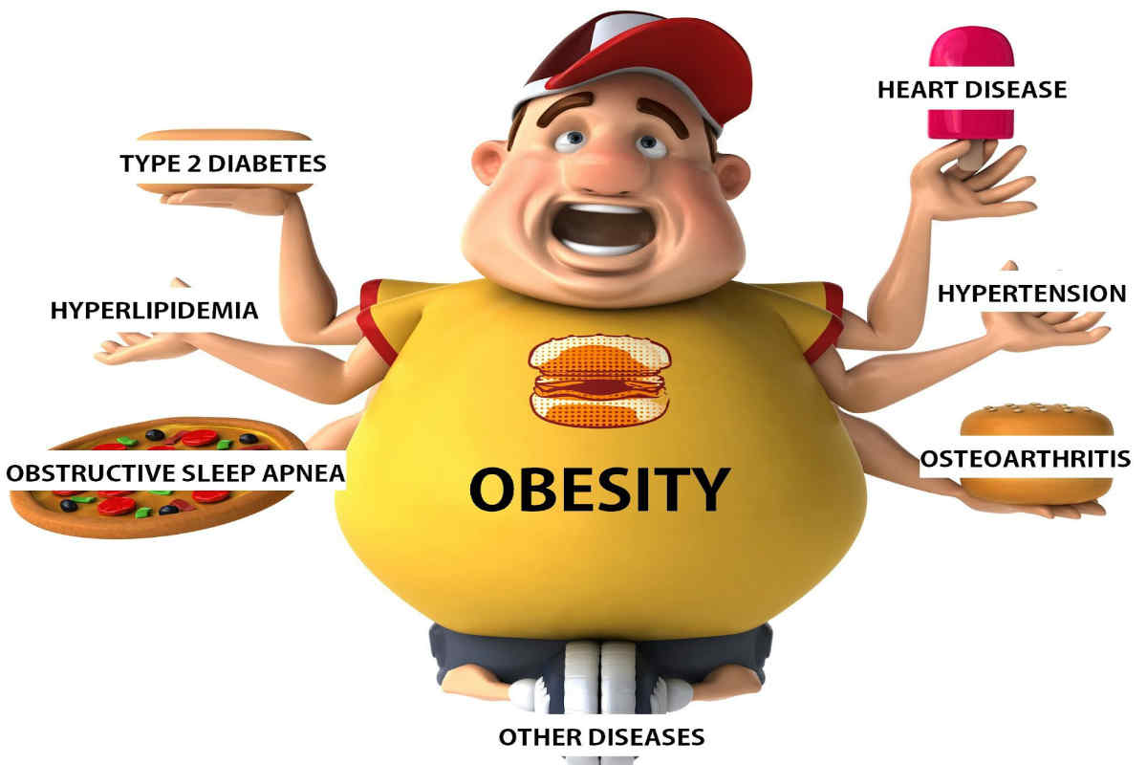
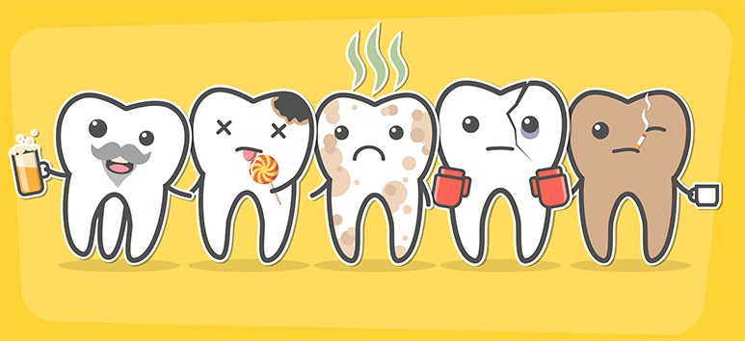
Diseases caused by lack of balanced diet

Slide 16
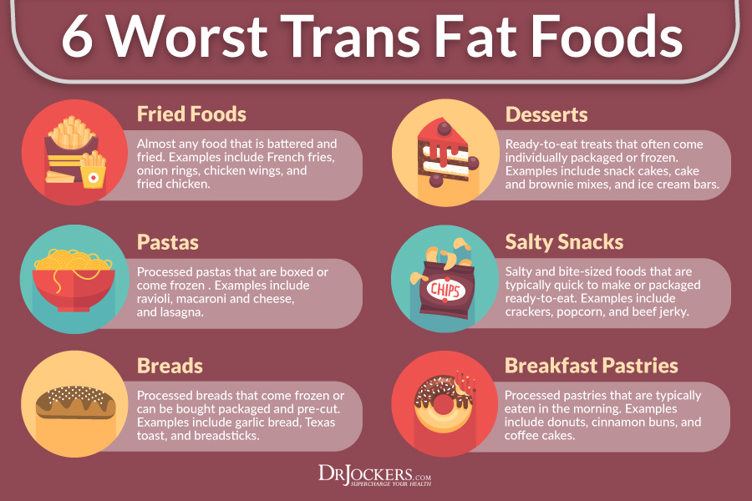

Slide 17
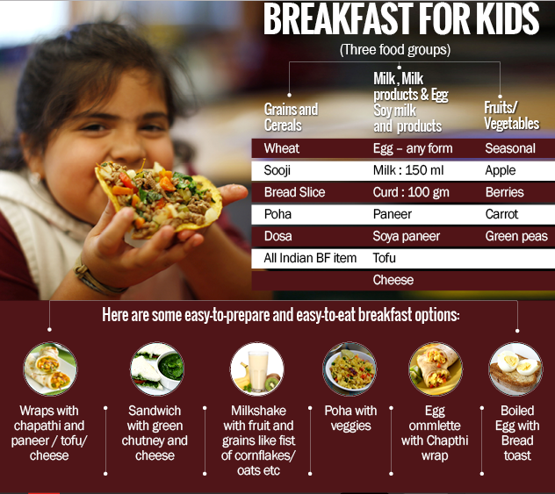

Slide 18
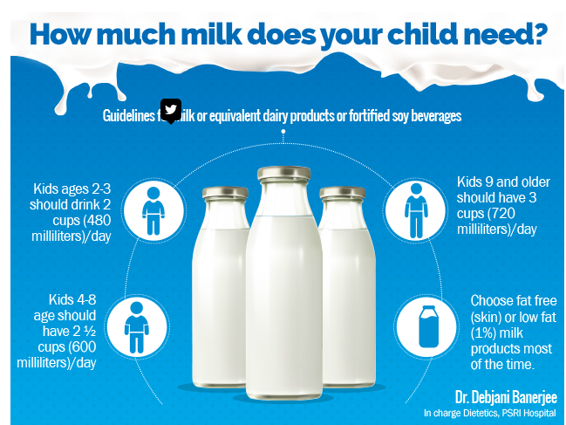

Slide 19
Sample meal plan
Here is a sample meal plan by Dr Ambily, Lead Nutritionist, Truweight for growing children between the age of 5 - 12 years. Waking up : A glass of warm low fat milk
Breakfast : Vegetable egg omelet with onion, tomato, spinach, whole grain bread slices, one apple
Mid Morning : Fruit salad with strawberry flavored low-fat yoghurt
Lunch : Lean chicken- capsicum-onion -zucchini stir fry - whole grain roll, mango lassi
Evening : Spinach- mushroom-peas cutlet, a handful of almonds, fresh mixed fruit juice (Apple Guava, lime)
Dinner : Whole multigrain phulkas, dal, paneer-peas-mushroom mixed vegetable curry.
Bed time : A glass of warm low fat milk.
Caution: Dr Kashissh A Chhabriaa feels that one can do away with wheat completely from a kid's diet. "It contains gluten which makes intestines sticky and hard to pass food through them. Many kids are today diagnosed of being gluten intolerant and it's better to remove wheat from the diet."

Slide 20
Gender | Sedentary Lifestyle | Active Lifestyle
Mature Women | 1800 calories | 2200 calories
Mature Men | 2200 calories | 2800 calories
It is vital to explain the terms sedentarily and active used in the table above
order to get a better idea about the daily routine and level of physical activity
of the group of people mentioned in this table.
“Sedentary” – The word sedentary here signifies a lifestyle that encompasses only light physical activity associated with regular day-to-day life with no additional exercise or workouts.
“Active” – The word active here signifies a lifestyle that comprises at least daily walking of more than 3 miles per day at the speed of 3 to 4 miles per hour or involvement in sports along with light physical activity related to usual day-to-day life.

Slide 21
Prescribed Diet Chart for Indian Women: (In Calories and Grams)
 | % | Weight (gms) | Kcal
Energy
Carbohydrates | 70% | 328gms | 1313 kcal
Protein | 15% | 70 gms | 281 kcal
Fat | 15% | 31 gms | 281 kcal
Division of Calories Into Meals
Breakfast | 400 kcal
Midmorning | 150 kcal
Lunch | 600 kcal
Tea | 100 kcal
Late evening | 125 kcal
Dinner | 500 kcal
TOTAL CALORIES | 1875 kcal

Slide 22
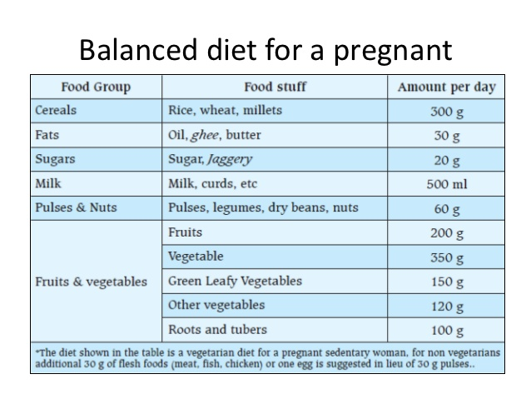

Slide 23
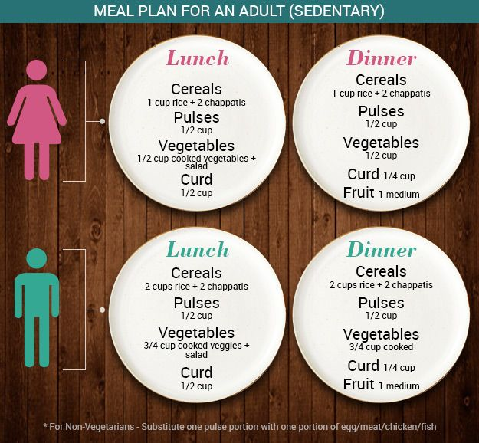

Slide 24
Nutritionist Recommended Balanced Diet for Women
Breakfast – Breakfast is the most important meal of the day.
Protein like 2-3 scrambled egg whites with a whole grain toast and a fruit of your choice or a bowl of fruit oats porridge with sprouts salad.
Protein kickstarts your metabolism and keeps you feeling fuller for longer during the day.
Mid-morning Snack –
A fistful of dried fruit combined with nuts or seeds, provides protein and healthy fats to keep you satisfied till lunch.
Combining the dried fruits with nuts helps in controlling the release of sugars in the body.
Lunch – Choose carb-rich foods that will supply energy and protein like
A bowl of dal/chicken/fish curry with brown rice or roti and a veg salad.
You could also include beans or chicken sandwich with plenty of veggies.

Slide 25
Snack– Having a snack will keep your energy levels up and you can choose from a variety of nourishing options like Apple cinnamon granola bar or Nature Valley’s granola bar or you can have a fistful of nuts.
Dinner– The supper of the day should be a combination of protein and carbs. You can include oily fish which are rich in omega 3 fatty acids like mackerel, salmon which is beneficial for healthy hair and skin. Fill up your dinner bowl with a variety of colourful veggies. Chicken/fish/paneer with roti /chila/ quinoa preparations and soup or salad with veggies.
Bedtime – A glass of low-fat milk with a pinch of elaichi.

Slide 26
Nutritionist Recommended Balanced diet for men
Breakfast – Kickstart your metabolism by starting the day with breakfast filled with protein. If you are a gym person, you should definitely have a protein-rich breakfast for muscle repair and recovery.
You can include veg poha with eggs or chila with chutney or khichdi /upma with veggies and sprouts salad.
Eggs are the best choice as it will give you energy for the whole day.
Snack – Craving for savoury foods? Opt for nuts and seeds or you can have a fruit bowl with nuts

Slide 27
Lunch – You can make a mix of foods with carbs and protein. Opt for rice with dal, chicken or paneer.
You can also have a sandwich topped with chicken or fish with plenty of salads and boiled veggies.
Snack-You can choose snacks that are vital for satisfying your energy levels. You can have an avocado salad or Apple cinnamon granola bar.
Dinner – Combine carbohydrates with essential fats which your body can use for overnight growth and repair.

Slide 28
Recommended Dietary Allowance of Calcium -
(100 grams milk and milk products)
Men: 600 mg/day
Female: 600 mg/day
Recommended Dietary Allowance of Iron -
Men: 17 mg/day
Female: 21mg/day
*All figures have been recommended by the National Institute of Nutrition

Slide 29
Public health importance of personal hygiene
The knowledge and practice of personal hygiene are vital in all our everyday activities. The purposes are:
Preventing faeco-orally transmitted diseases
The fingers may get contaminated with one’s own faeces, either directly or indirectly.
Activities during defecation and child bottom-washing are additional opportunities for the contamination of the fingers that facilitate the transmission of infections.

Slide 30
Aesthetic values of personal hygiene
A person with clean hands is proud while eating because they feel confident of preventing diseases.
A teacher in a school is always happy to see their students with clean faces and eyes, and dressed in clean clothes.
A mother is mentally satisfied to feed her infant with clean hands because she ensures the preservation of her child’s health.
Generally, cleaning oneself produces pride, comfort and dignity at home and in public places.
Caring about the way you look is important to your self-esteem.
Social impact
A person with poor personal hygiene might be isolated from friendship because telling the person about the situation might be sensitive and culturally difficult.
The success of a job application or the chance of promotion could be affected by poor personal hygiene; no company wants to be represented by someone who does not appear to be able to look after themselves.

Slide 31
Communicable diseases or conditions and the recommended frequency of washing or cleaning for the following respective components of personal hygiene.
Components | Diseases/conditions | Recommended frequency of cleaning
Eye hygiene | Conjunctivitis | Daily every morning and when the face is dirty
Hair hygiene | Dandruff, infestation (lice, nits) | Twice weekly; preferably once every other day
Body hygiene | Bad smell, scabies | Once or twice a week
Oral hygiene | Tooth decay, gum infection, bad breath | Brushing twice a day; rinsing after each meal
Feet hygiene | Athlete’s foot, wound | Every day
Hand hygiene | Diarrhoea, typhus fever | Every time after touching contaminated surfaces; every time before eating and touching clean surfaces
Clothes hygiene | Bad smell, unclean, relapsing fever, typhus | Once or twice a week

Slide 32
HAND WASHING
Hygienic handwashing involves the mechanical removal of microorganisms from contaminated hand surfaces using soap or detergent.
Handwashing should involve more than a quick rinse under a tap (faucet) or in running water.

Slide 33
THANK YOU

