Slide 1
FLASH CARD
In service training (prt), 2020-21
KV NO. 2, DELHI CANTT.
Class – 1st
Subject – environmental studies

Slide 2
MY FAMILY

Slide 3
TYPES OF FAMILY
NUCLEAR FAMILY
JOINT FAMILY

Slide 4
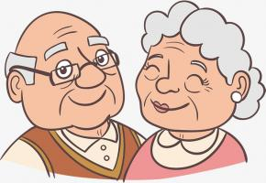
MEMBERS OF FAMILY
GRAND PARENTS IN FAMILY
COUSINS IN FAMILY

Slide 5
ROOMS IN THE HOUSE

Slide 6
TYPES OF ROOM IN THE HOUSE
BED ROOM
DRAWING ROOM
KITCHEN
BATHROOM

Slide 7
OUR NEIGHBOURHOOD

Slide 8
SCHOOL
PARK

Slide 9
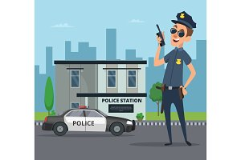
HOSPITAL
POST OFFICE
POLICE STATION

Slide 10
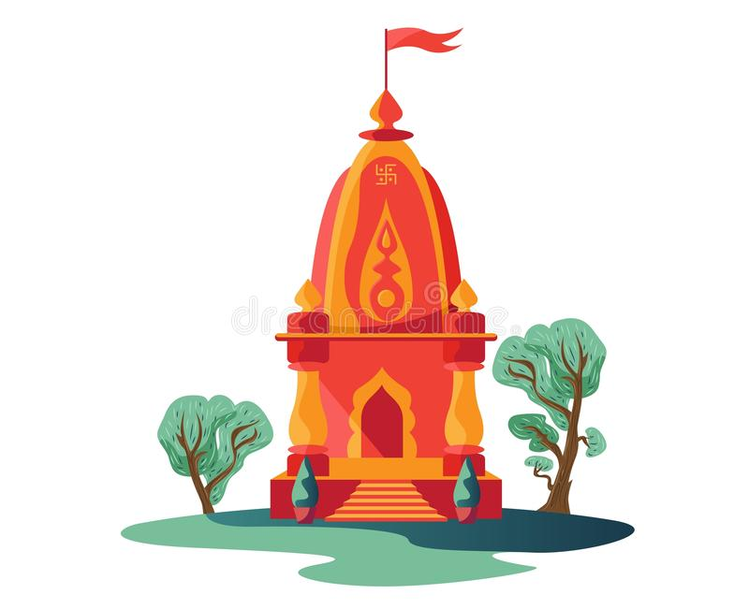
PLACE OF WORSHIP

Slide 11
OUR BODY

Slide 12
PARTS OF BODY

Slide 13
SENSE ORGANS

Slide 14
TYPES OF EMOTIONS

Slide 15
FOOD

Slide 16
FRUITS

Slide 17
BIGGEST FRUIT

Slide 18
VEGETABLES

Slide 19
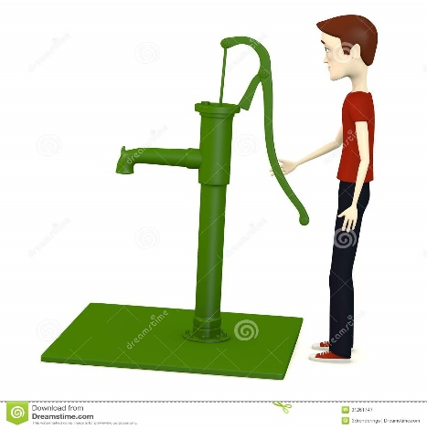
SOURCES OF WATER

Slide 20
USES OF WATER

Slide 21
RAINBOW (VIBGYOR)

Slide 22
THANK YOU

