Slide 1
In service training (prt) kv delhi cant-2 2020-2021 1st spell
THEME- TRAVEL ( CLASS V )
TOPIC- BULLET POINTS & TIPS BASED ON BACK TO BASICS
SUBJECT- ENVIROMENTAL STUDIES
BHAVANA KUMARI- PRT (R.K.PURAM-SEC-8) 2nd SHIFT

Slide 2
WHAT DO YOU UNDERSTAND BY TRAVEL?
Travel is the movement of people between distant geographical locations. Travel can be done by foot, bicycle, automobile, train, boat, bus, airplane, ship or other means with or without luggage, and can be one way or round trip.

Slide 3
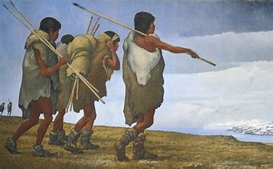
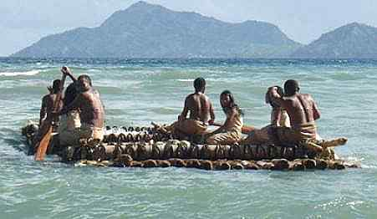
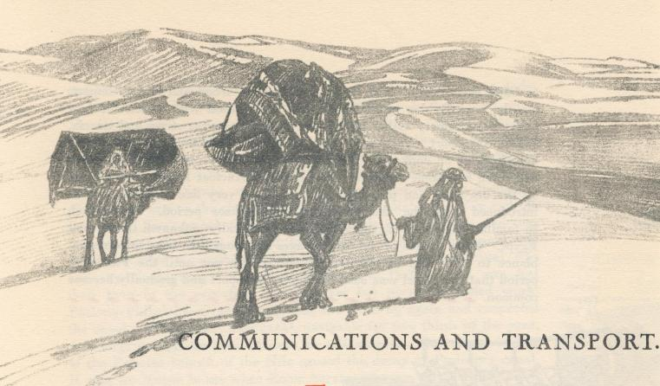
HOW WE USED TO TRAVEL IN EARLIER TIMES?
Road travel: People mostly walked during the medieval times but there were other ways too like a horse in plains, mules in hilly regions , yaks in the Himalayas , camels in deserts etc.
Water travel: Boats were common modes of transport then, evidences show that people traveled the world mostly through water.

Slide 4
TRANPOSTATION HISTORY- EVOULTION OF TRAVEL

Slide 6
TIME SPAN OF TRANSPORT

Slide 7
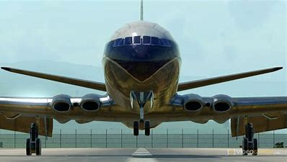
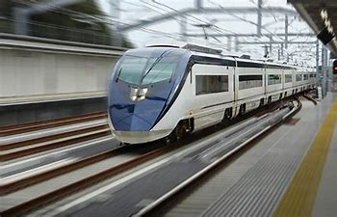
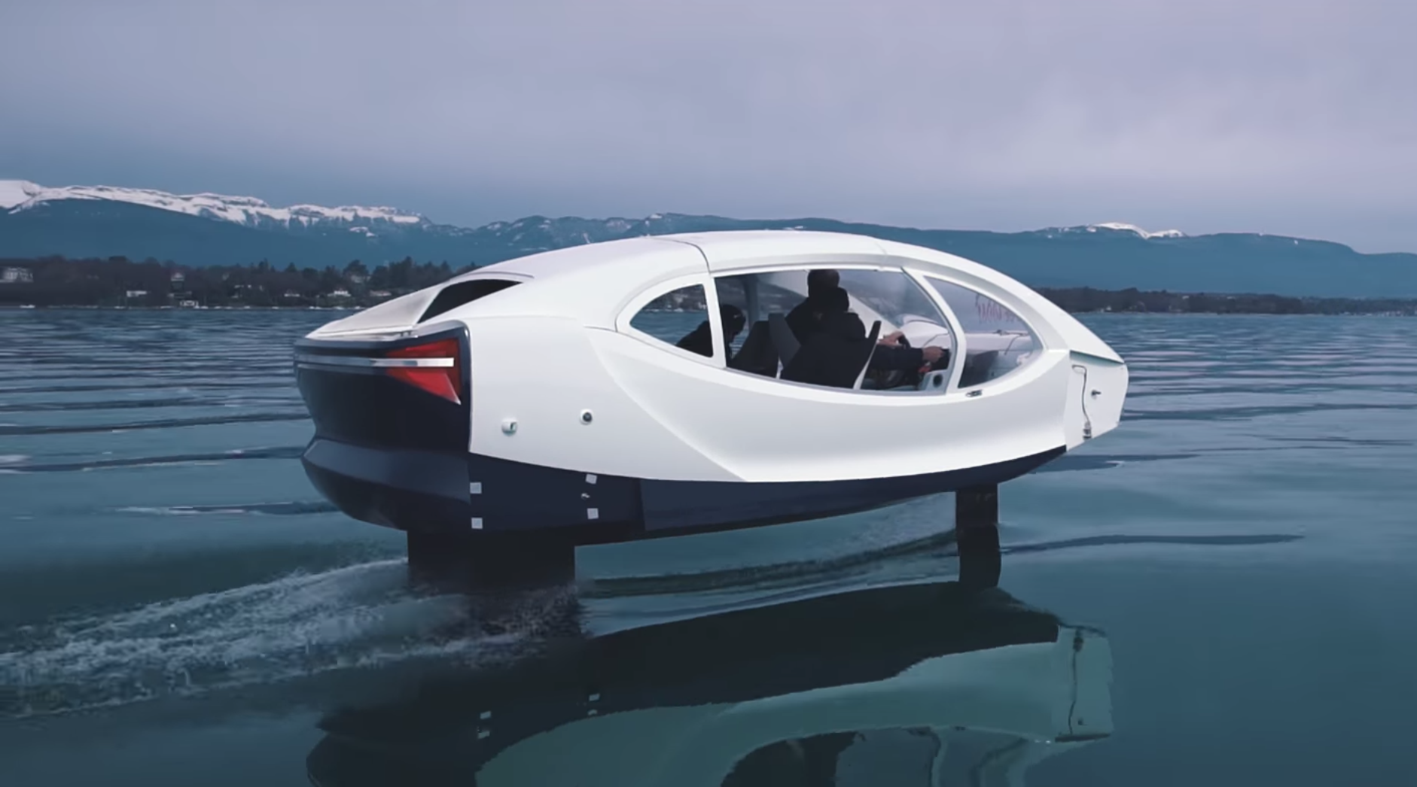
Modern day transportation
Today with modern means of transport, we can reach any part of the world at any time. The first invention that transformed the transport industry was the steam engine that led to the invention of railways. With the advancement of science there are better and quicker means of transport like buses, modern planes and steam ships.

Slide 8
LET US KNOW OUR COUNTRY BETTER…

Slide 9
INDIA’S TRANSPORTATION SYSTERM
India's road network is the second-largest and one of the busiest in the world.
India's rail network is the fourth largest and second busiest in the world.
India's waterways network in the form of rivers, canals, backwaters and creeks is the ninth largest waterway network in the world.
Roads in India are maintained by (NHAI)-National Highway Authority Of India.

Slide 10
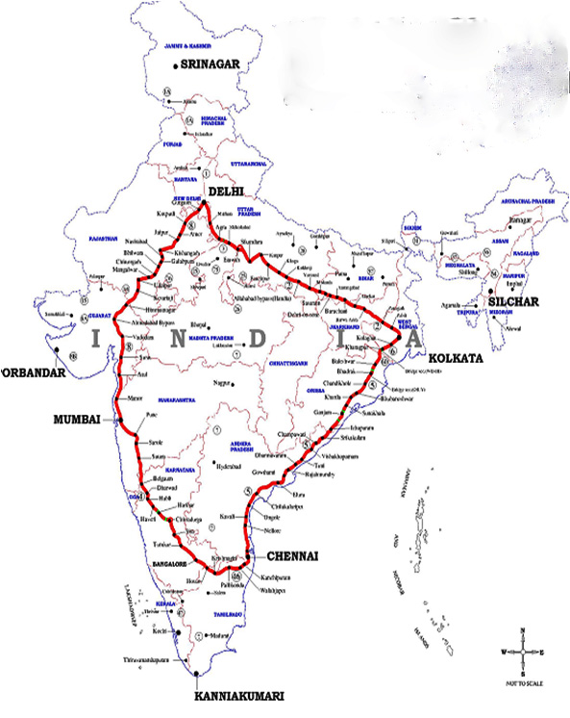
THE GOLDEN QUADRILATERAL (CHAPTER-13)
The Golden Quadrilateral is a national highway network connecting most of the major industrial, agricultural and cultural centers of India. It forms a quadrilateral connecting the four major metro cities of India, viz., Delhi, Kolkata, Mumbai and Chennai.

Slide 11
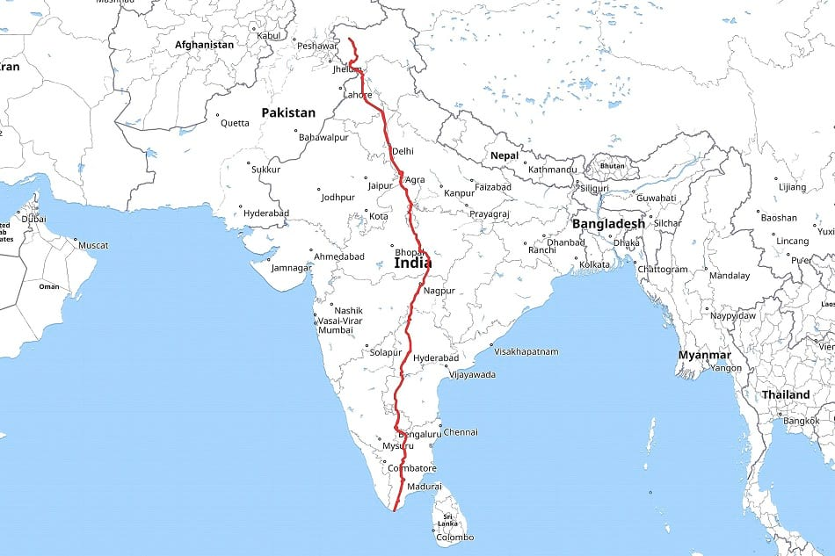
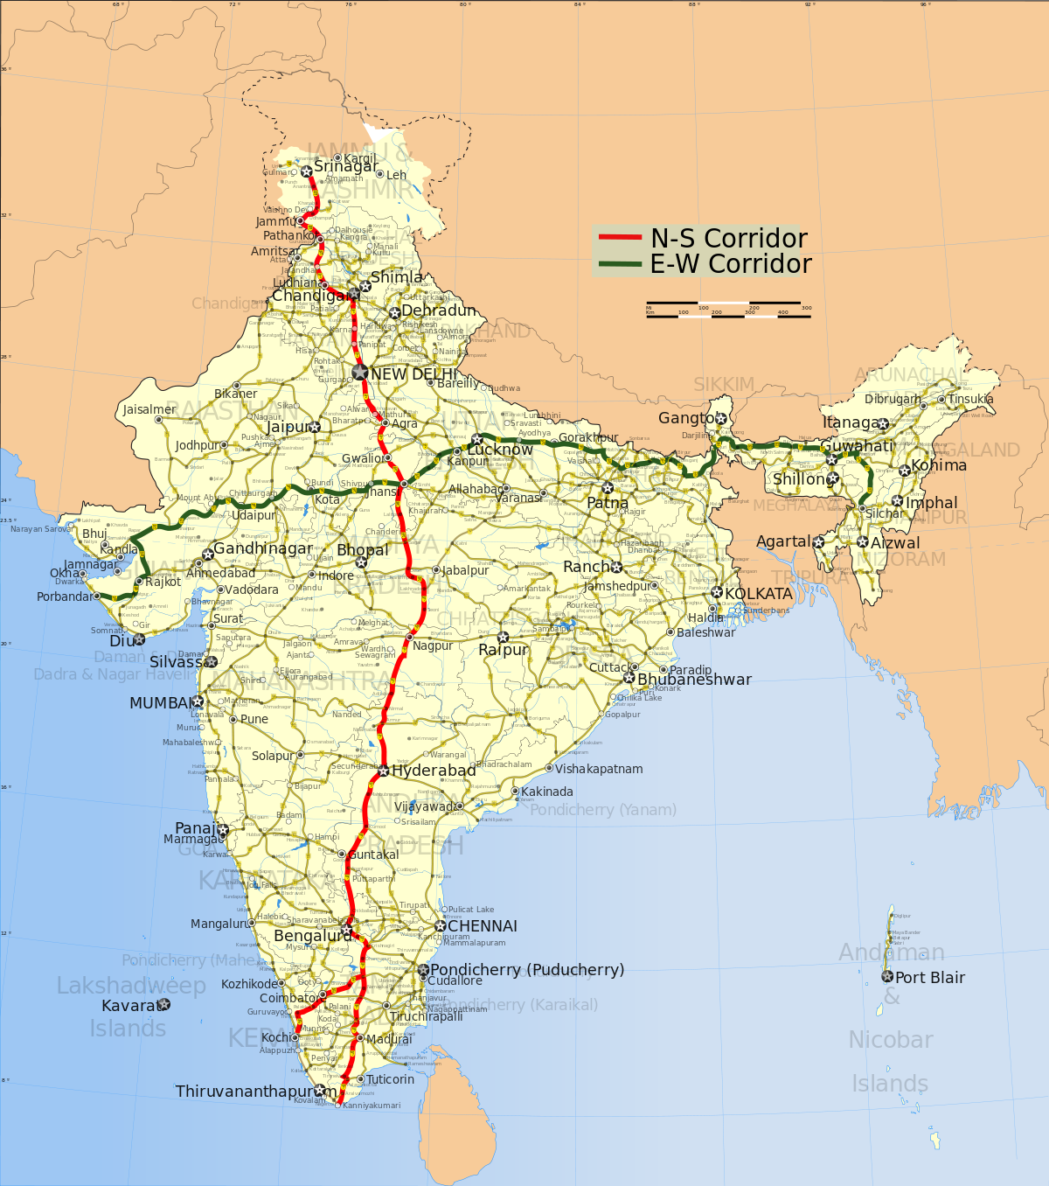
NORTH-SOUTH CORRIDOR (CHAPTER-20)
The North–South–East–West Corridor is the largest ongoing highway project in India. It is the second phase of the National Highways Development Project, and consists of building 7300 kilometers of four/six lane expressways associating Srinagar, Kanyakumari, Kochi, Porbandar and Silchar

Slide 12
INTERESTING FACTS ABOUT OUR COUNTRY 1.JAMMU & KASHMIR( CHAPTER 1 & 13)

Slide 13
FACTS ABOUT J & K
Jammu and Kashmir is famous for its natural beauty since time immemorial and has been aptly described as "heaven on earth“
Some of the major tourist attractions in the state are Gulmarg, Pahalgam, Leh, Patnitop, and Ladakh., Dal lake.
Dogri/Pahari music, Hafixa, Bacha/Nagma dance
National park in J&K- Dachigam
Crops grown in J & K -Paddy, wheat, fruit, saffron
Capital- Srinagar (summer), Jammu (winter)

Slide 14
2. HIMACHAL PRADESH ( CHAPTER-13)

Slide 15
FACTS ABOUT HIMACHAL PRADESH
The state boasts of numerous picturesque tourist destinations. As such tourism is an important industry and is a major contributor to the economy of the state.
Languages- Hindi, Punjabi, Kinnauri, Pahari
Major crops grown- Wheat, rice, maize, barley
Capital-Shimla
Major dance form- Mala dance, Rakshas Dance

Slide 16
3. PUNJAB (CHAPTER-13)

Slide 17
Facts about Punjab
Main Monuments- Golden Temple, Jallianwalla Bagh, Rock Garden, Leisure Valley
Main crops grown- Wheat, gram, barley, oil seeds
Major dance form- Bhangra and Gidda
Festivals -Lohri, Baisakhi, Gurpurab

Slide 18
4. RAJASTHAN( CHAPTER 1,2,6 & 13)

Slide 19
FACTS ABOUT RAJASTHAN
Rajasthan has a rich history and culture. The state is known for its numerous attractions which include majestic forts, decorated Havelis and carved temples.
Some popular places of attraction are the Jantar Mantar in Jaipur; Jodhpur's Mehrangarh Fort and Stepwell; the amazing Dilwara temples
Major crops - Sugarcane, pulses, oilseeds, cotton and tobacco are the major crops of the region. Rajasthan is also the largest producer of marble and sandstone. These minerals are excavated at Makrana near Jodhpur.
Dance form- Ghoomar and Kalbeliya dances; Kathputali puppet theatre,Bhopal.
National park/ Wildlife Sanctuaries- Sariska Tiger Reserve, Keoladeo Ghana NP, Ranthambore
Capital-Jaipur is the capital of the state

Slide 20
5. Gujarat (CHAPTER- 1,7,13,14,16 & 19)

Slide 21
FACTS ABOUT GUJARAT
Gujarat or "the land of the legends" is one of the most important states situated in the western part of the country.
Being the birthplace of many Indian legends like Mahatma Gandhi and Vallabhbhai Patel, this place has a rich heritage of culture and traditions which glorifies the state. Summers are dry and hot whereas winters are mild and pleasant.
Capital- Gandhinagar
Languages- English, Gujarati, Sindhi, Marwari, Kutchi, Urdu, Hindi, Sourashtra, Vasavi
National Park- Gir National Park

Slide 22
6.Maharasthra (CHAPTER 13,17,18&22)

Slide 23
Facts about maharasthra
The state which is home to one of the largest film industries of the world, i.e. Bollywood, also boasts of being the most significant contributor to India's National Industrial Output
Monuments-World Heritage Sites of Ajanta and Ellora, Elephanta Caves
Dance forms-Vasudev Dance, Lavni Dance, Dhangari Gaja, Tamasha
Major Crops- Paddy, wheat, sugarcane, oranges
National Parks- Nagzira National Park
Capital- Mumbai

Slide 24
7.Kerala

Slide 25
Facts about kerala
The state is often referred as "God's Own Country“
It has the highest literacy rate in the country, lowest infant mortality rate and the highest female to male population ratio. T
Kerala, which is famous for the Kovalam beach, one of the top beaches in the world
Captial- Thiruvananthapuram
National Parks- Periyar National Park, Wayanad Wildlife Sanctuary, Silent Valley National Park
Languages spoke- Malayalam, English
Dance form-Kathakali

Slide 26
8. Uttarakhand (CHAPTER- 9 &13)

Slide 27
Facts about uttarakhand
Formerly known as Uttaranchal,Also referred to as the Land of Gods, Uttrakhand is believed to be one of the most naturally bestowed states in India.
Uttrakhand is home to some of the finest Hindu temples and religious destinations in India
Capital-Dehradun, Gairsain (Summer)
Natonal Park-Corbett NP, Nainital, Almora Valley of Flowers, Nanda Devi Park
Languages-Hindi, Garhwali, Kumaoni
Main Crops- Rice, wheat, arley, jowar, oilseed
Major Attractions-Kedarnath temple, at a height of 3584 m, is devoted to Shiva.

Slide 28
9.Andhra Pradesh (CHAPTER-4 &10)

Slide 29
FACTS ABOUT ANDHRA PRADESH
Andhra Pradesh is rich in historical monuments and many holy temples. Tirupati in the Chittoor district houses one of the most famous temples in India.
The state is known for crafting of stones, doll-making, carving of idols, beautiful paintings, folk dances like Yaksha Ganam.
Main crops- are rice, maize, millets, pulses, castor, tobacco, cotton, sugarcane, groundnut and bananas.
Languages -Telugu is the official language of Andhra Pradesh.
Capital- Amravatti
Forests & National Parks-Nagarjunasagar-Srisailam Wildlife Sanctuary

Slide 30
10.North- eastern states(eight states) (CHAPTER -1,5&20)

Slide 31
Facts about north- eastern states
The North Eastern Region (NER) comprises of eight States viz. Arunachal Pradesh, Assam, Manipur, Meghalaya, Mizoram, Nagaland, Sikkim and Tripura.
Languages spoken- Assamese Bodo Garo Khasi Kokborok Mizo Apatani Nyishi Galo Adi Meitei Nepali
Guwahati city in Assam is called the Gateway to the North East and is the largest metropolis in North East India.
This region has some of the Indian subcontinent's last remaining rainforests, which support diverse flora and fauna and several crop species. Reserves of petroleum and natural gas in the region are estimated to constitute a fifth of India's total potential.
Most of the North Eastern states have more than 60% of their area under forest cover,
Northeast India is also the home of many Living root bridges.

Slide 32
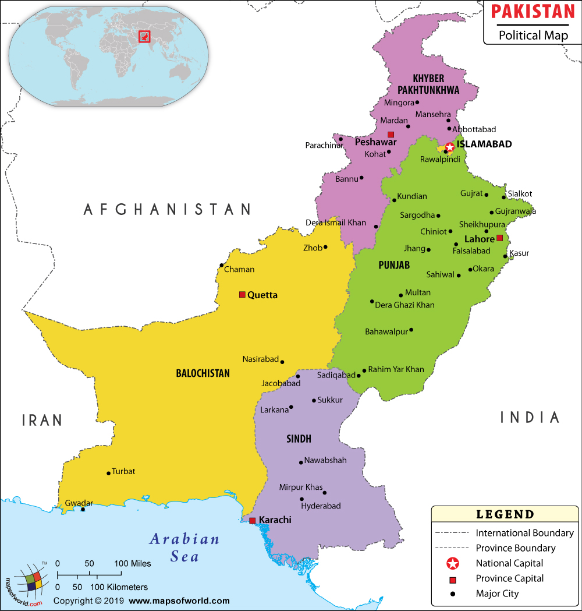
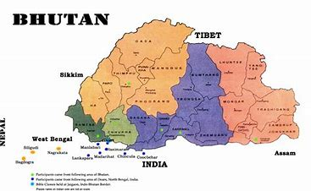
Neighbouring countries(CHAPTER 9 &12)

Slide 33
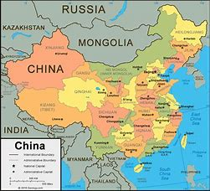
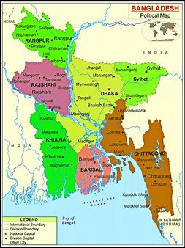
Neighbouring countries

Slide 34
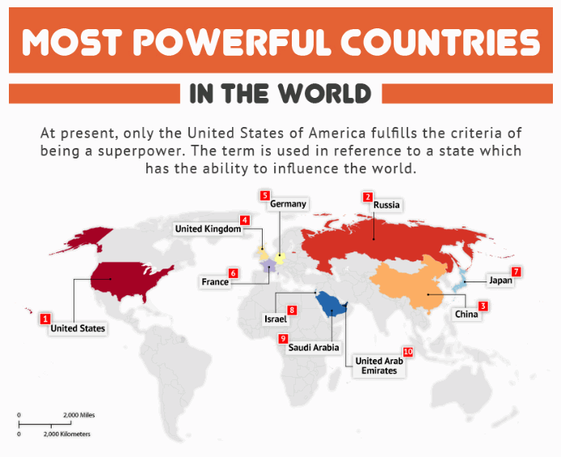

Slide 36
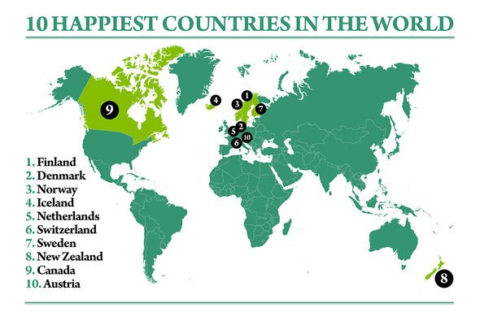

Slide 37
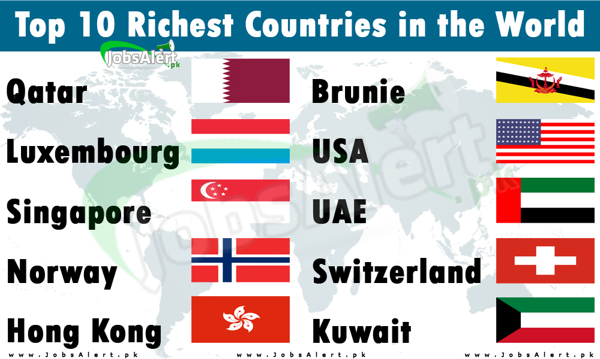

Slide 38
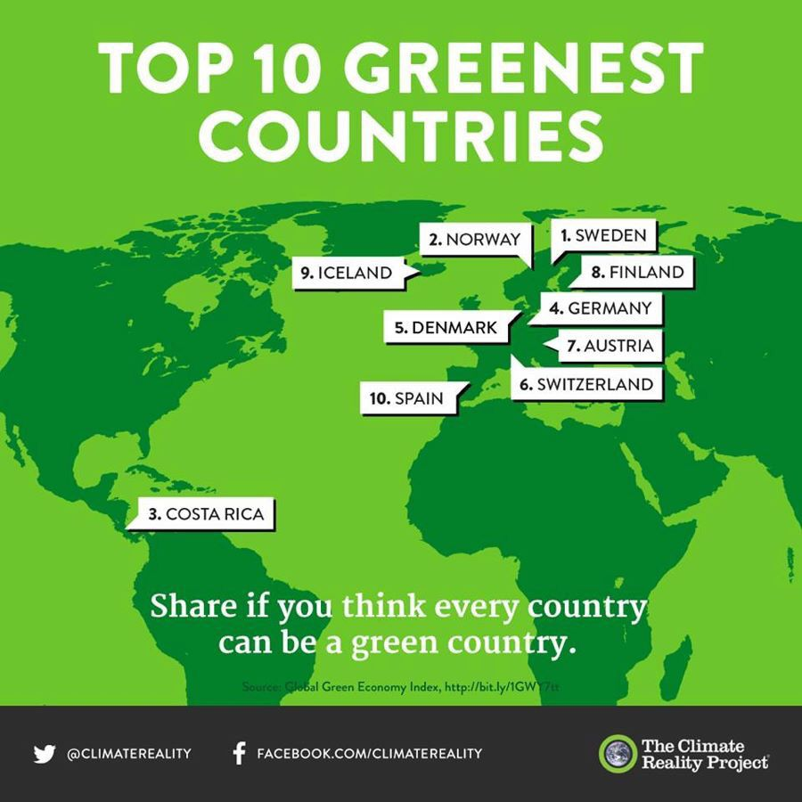

Slide 39
TRAVEL IN SPACE (chapter- 11)
Space tourism is human space travel for recreational purposes. There are several different types of space tourism, including orbital, suborbital and lunar space tourism.

Slide 40
Solar system
The planets of the solar system include Mercury, Venus, Earth, Mars, Jupiter, Saturn, Uranus and Neptune. Pluto was previously thought of as a planet. It is now thought of as a dwarf planet. It sits in the Kuiper belt, which includes comets, dust and other dwarf planets. The Kuiper belt lies on the edge of the solar system.
The planets nearest the Sun – Mercury, Venus and Earth – lie in the inner solar system. The other planets, as well as asteroids and space junk, lie in the outer solar system.
The planets nearest the Sun are called terrestrial planets because they are made of solid matter. Jupiter, Saturn, Uranus and Neptune are called the gas giants. They don’t have a solid surface.

Slide 41
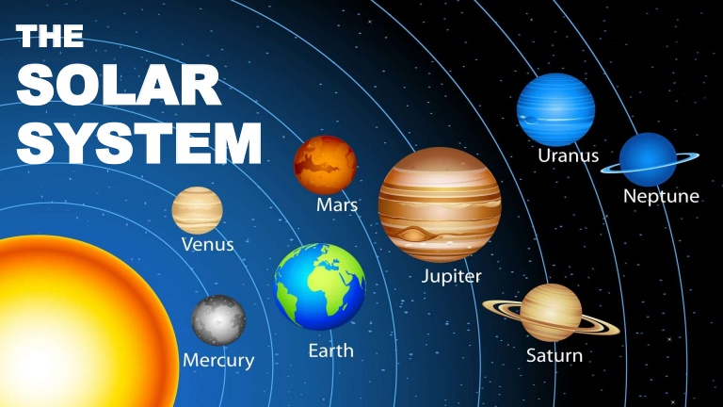

Slide 42
ROTATION & REVOLUTION
While rotation means the movement in circle round an axis, revolution is when an object moves in a circular path around another object or center. Many people often misinterpret these two concepts as they think that these two are same.

Slide 43
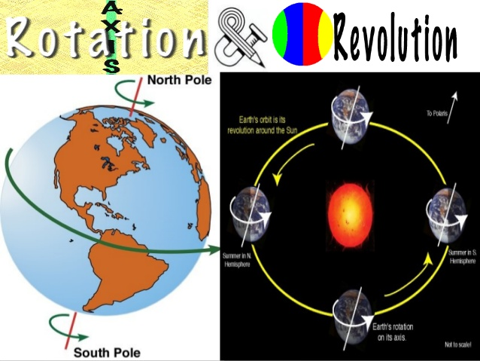

Slide 44
LONGTITUDE & LATITUDE
The main difference in the definitions of latitude and longitude is the direction. The lines of latitude run east to west. Consider them to be the steps on a ladder that fits snugly around the entire world. The lines of longitude run from north to south. They are the poles that hold the ladder steps together.
Latitude alludes to the horizontal lines that represent the distance of any point, north or south of the equator, its direction is east to west. On the other hand, longitude implies the vertical lines indicating the distance of any point, east or west of the prime meridian, its direction is north to south.

Slide 45
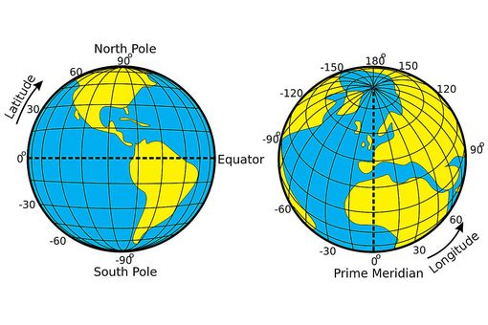

Slide 46
EARTH SHOWING TROPICS
The tropics are the region of the Earth surrounding the Equator. They are delimited in latitude by the Tropic of Cancer in the Northern Hemisphere at 23°26′11.8″ (or 23.43661°) N and the Tropic of Capricorn in the Southern Hemisphere at 23°26′11.8″ (or 23.43661°) S, these latitudes correspond to the axial tilt of the Earth. The tropics are also referred to as the tropical zone and the torrid zone (see geographical zone). The tropics include all the areas on the Earth where the Sun contacts a point directly overhead at least once during the solar year (which is a subsolar point) - thus the latitude of the tropics is roughly equal to the angle of the Earth's axial tilt.

Slide 47
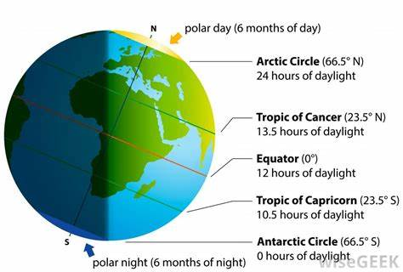

Slide 48
Natural & artificial satellite
Natural satellite is an object that orbits a planet or other body larger than itself and which is not man-made. Such objects are often called moons.
An artificial satellite is an object that people have made and launched into orbit using rockets. There are currently over a thousand active satellites orbiting the Earth.

Slide 49
