Slide 1
Back to basics
EVS
CLASS 4
Home And Abroad
Theme (Travel/Weather)
BY
NIDHI SHARMA
PRT
Kv ina colony

Slide 2
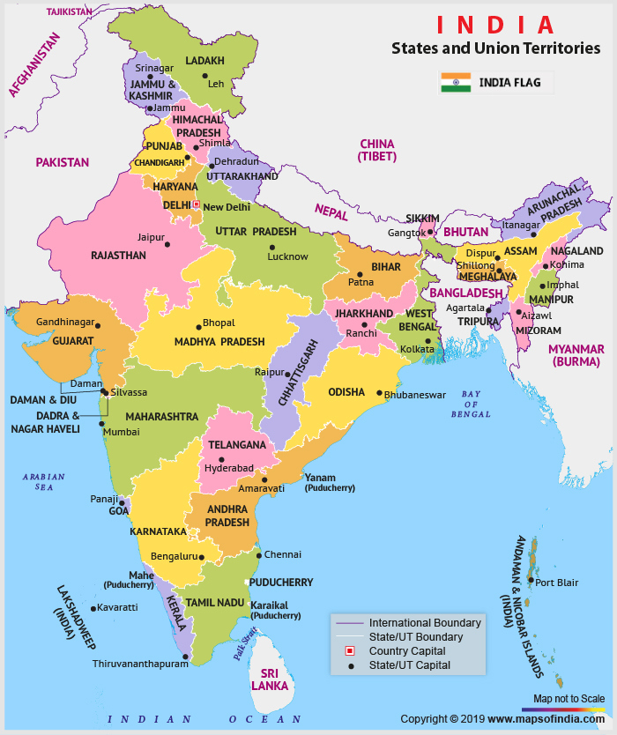
Where does Mallu live?
Mallu lived in Kochi city of Kerala.

Slide 3
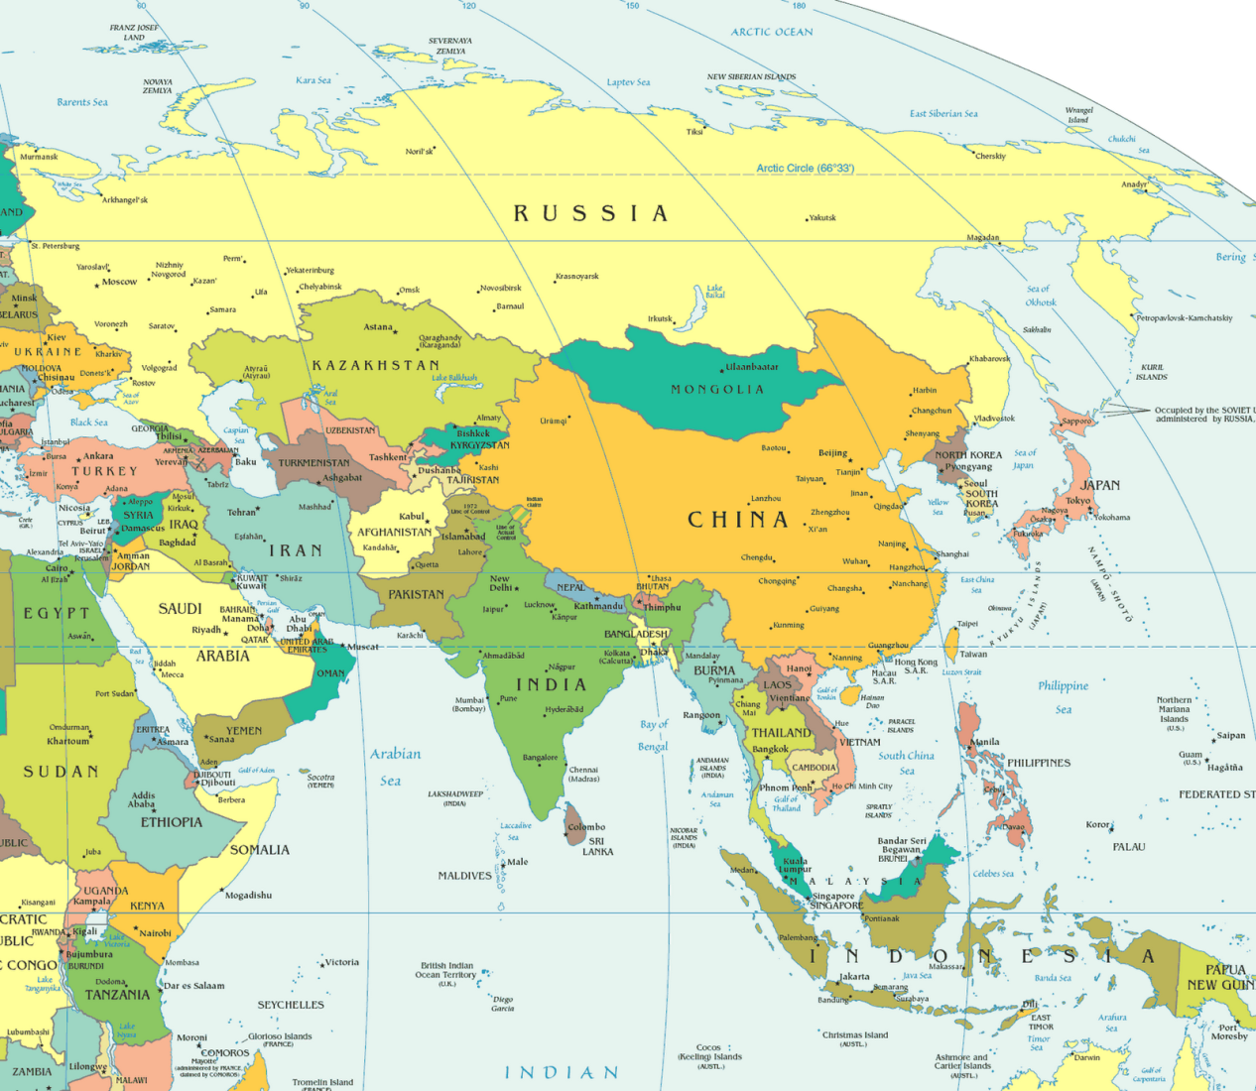
Do you know where is India on the map of Asia?
INDIA

Slide 4

Where are Maalu’s cousins living?
Abu Dhabi, the capital of United Arab Emirates(UAE)
UAE

Slide 5
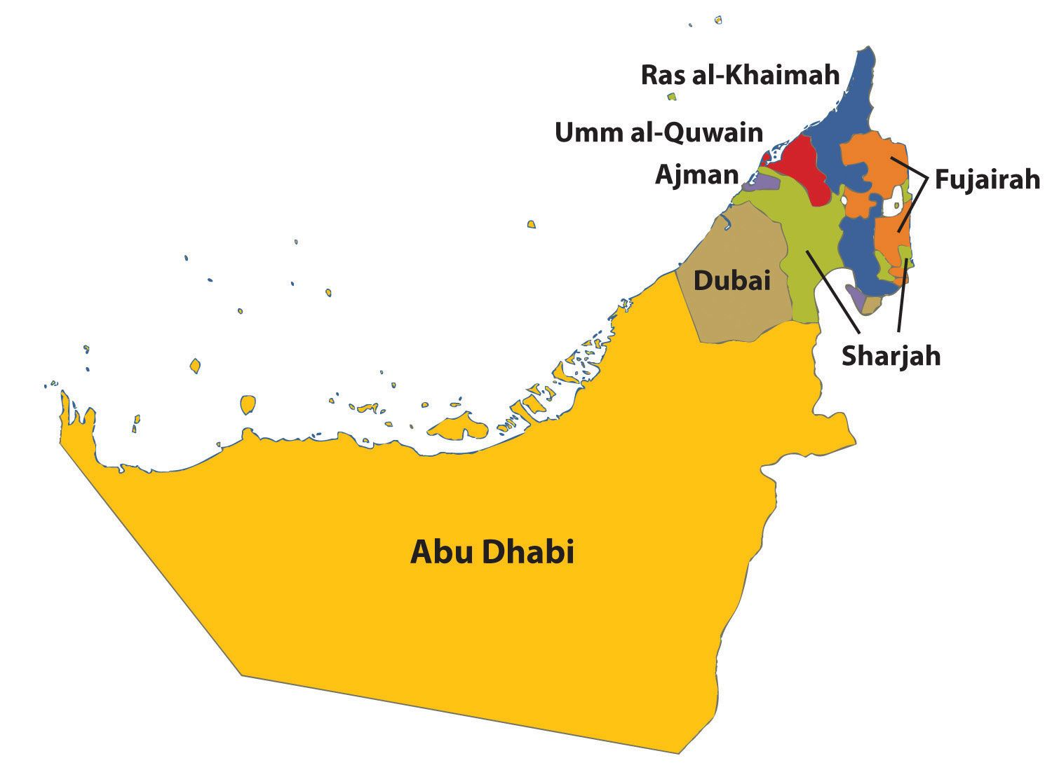
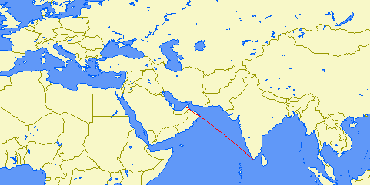
HOW FAR ARE ABU DHABI AND KERALA?
UAE ( 7 states as one)
ABU DHABI TO KOCHI
2818 kms
(2 hours flight)

Slide 6
Can you locate India and UAE on a globe?

Slide 7
Comparing Abu Dhabi and Kerala.
Landscape
Climate
Plantation
Clothing
Food
Language
Currency
Lifestyle

Slide 8
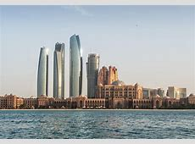
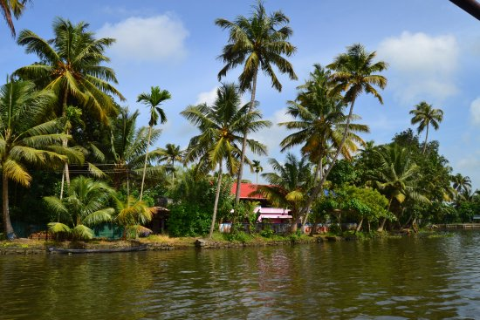
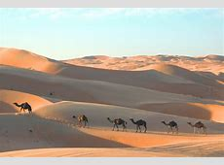
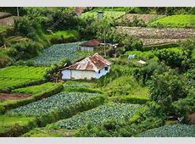
CLIMATE
ABU DHABI
KERALA
VERY HOT
HUMID
NO RAIN
HIGH RAIN

Slide 9
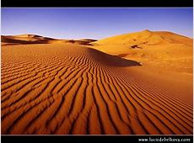
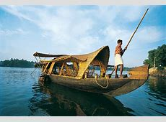
LANDSCAPE
ABU DHABI
KERALA
SAND DUNES
NO WATER
UNDERGROUND OIL RESERVES
THICK GREENERY.
RIVERS, LAKES, PONDS.

Slide 10
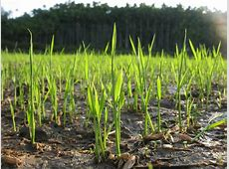
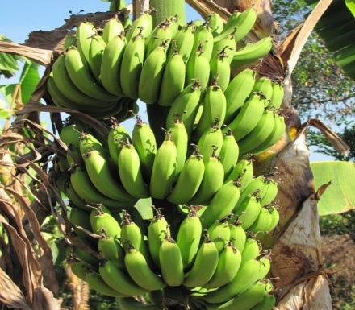
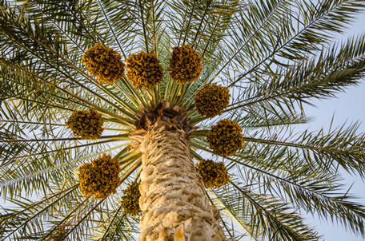
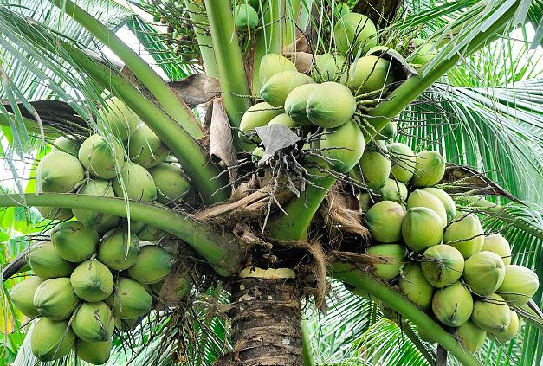
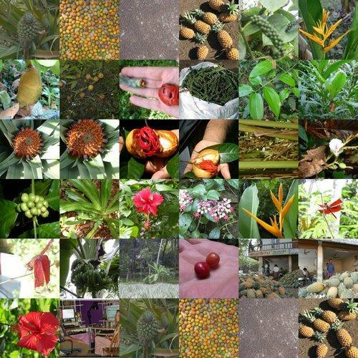
PLANTATION
ABU DHABI
KERALA
COCONUTS, BANANAS, PADDY, TEA, SPICES
DATE PALMS

Slide 11
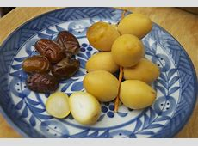
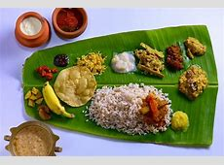
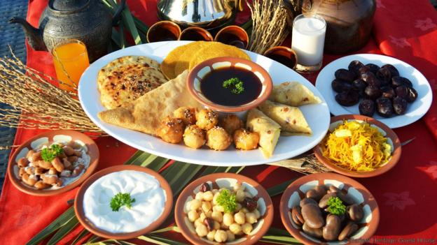
FOOD
ABU DHABI
KERALA

Slide 12
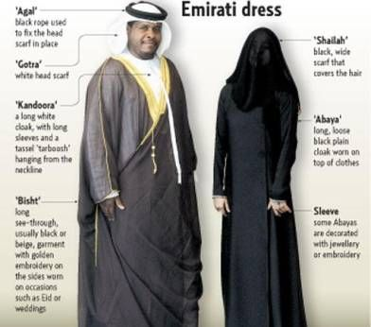

CLOTHING
ABU DHABI
KERALA

Slide 13
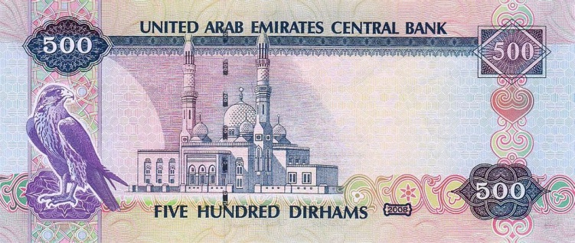
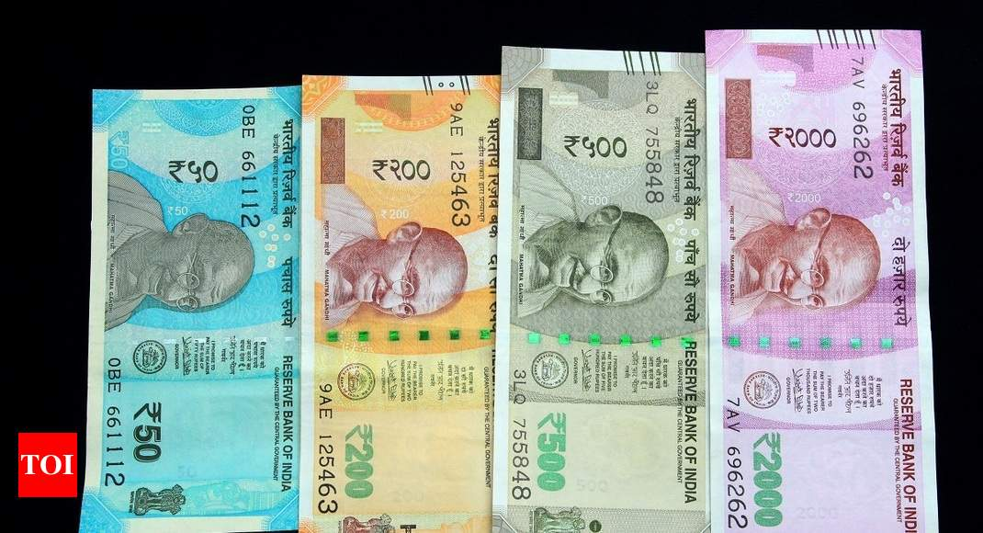
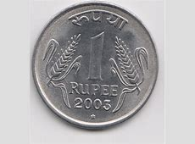
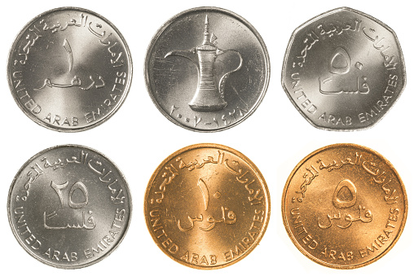
CURRENCY
ABU DHABI
KERALA
DIRHAM
RUPEE

Slide 14

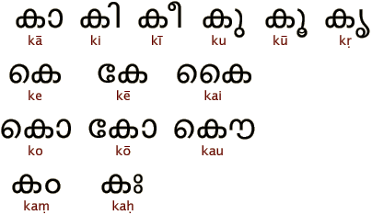
LANGUAGE
ABU DHABI
KERALA
ARABIC
MALAYALAM

Slide 15
WHAT DID YOU LEARN?
ABU DHABI HAS VERY HOT AND DRY CLIMATE AND NO RAINFALL.
THERE ARE SAND DUNES EVERY WHERE.
ABU DHABI GROWS DATE PALMS.
PEOPLE THERE WEAR LOOSE COTTON CLOTHES.
THE CURRENCY OF ABU DHABI IS DIRHAM.
IT IS RICH IN OIL RESOURCES.
MANY INDIANS WORK IN ABU DHABI AND UAE.

Slide 16
HOW IS IT DIFFERENT FROM KERALA?
KERELA HAS HIGH RAINFALL AND FERTILE LAND.
MANY CROPS GROW HERE.
THERE ARE LOTS OF RIVERS, PONDS, LAKES.
HOUSES IN KERALA ARE CLSE TO NATURE.
INDIAN CURRENCY IS RUPEE.

Slide 17
INDIA IS A LAND OF MANY SEASONS AND VARIED LANDSCAPES.
HIGH MOUNTAINS
HOT DESSERT LIKE ABU DHABI IN RAJASTHAN
RAIN FORESTS
COLD DESSERT
DENSE FORESTS

Slide 18
ASSIGNMENT
LIST 10 STATES OF INDIA AND WRITE NAMES OF LANGUAGES SPOKEN THERE.

