Slide 1
ONLINE IN-SERVICE TRAINING COURSE – PRTs (Ist SPELL)
DIGITAL
FLASH
CARDS
CLASS – II
EVS

Slide 2
TOPICS
PLANTS
ANIMALS
HEALTH.HYGIENE & EXERCISE
PLACES OF WORSHIP
OUR FESTIVALS
MEANS OF TRANSPORT
ROAD SAFETY
MEANS OF COMMUNICATION

Slide 3
PLANTS

Slide 14
ANIMALS

Slide 15
ANIMALS’ SOUNDS
https://youtu.be/YCvzPBUPZ9w

Slide 16
OBSERVE
AND
IDENTIFY

Slide 18
CAT

Slide 20
HORSE

Slide 22
COW

Slide 24
TIGER

Slide 26
ELEPHANT

Slide 28
FISHES

Slide 30
ZEBRA

Slide 32
RHINOCEROS

Slide 43
HOMES OF ANIMALS
https://youtu.be/xzOV4euyv1A

Slide 44
HEALTH
HYGIENE &
EXERCISE

Slide 45
LINK TO VIDEOS
https://youtu.be/a3fTkawDCyY
https://youtu.be/21s8-SMOSTY

Slide 48
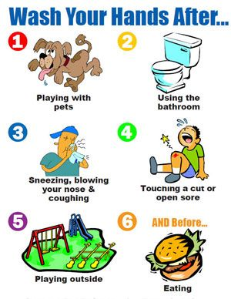

Slide 49
PLACES
OF
WORSHIP

Slide 51
TEMPLE

Slide 52
CHURCH

Slide 53
GURUDWARA

Slide 54
MOSQUE

Slide 55
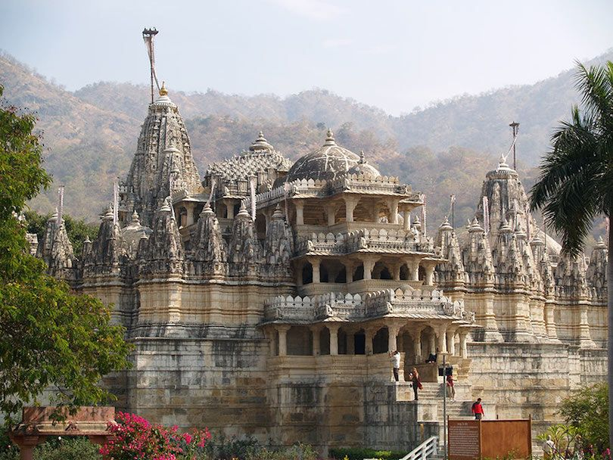

Slide 57
OUR FESTIVALS

Slide 58
DIWALI

Slide 59
HOLI

Slide 60
CHRISTMAS

Slide 61
EID

Slide 62
GURU PARV

Slide 63
ONAM

Slide 70
THREE-WHEELER

Slide 71
TWO-WHEELER

Slide 72
TRAIN

Slide 74
ZEBRA CROSSING

Slide 75
TRAFFIC LIGHTS

Slide 80
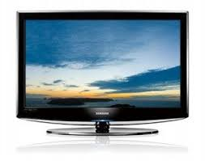
TELEVISION

Slide 81
NEWSPAPER

Slide 82
INTERNET

Slide 83
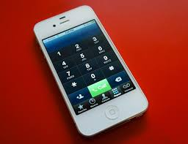
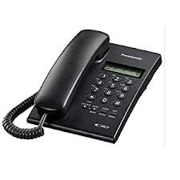
PHONES

Slide 84
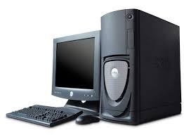
COMPUTER

Slide 85
TELEGRAM

Slide 86
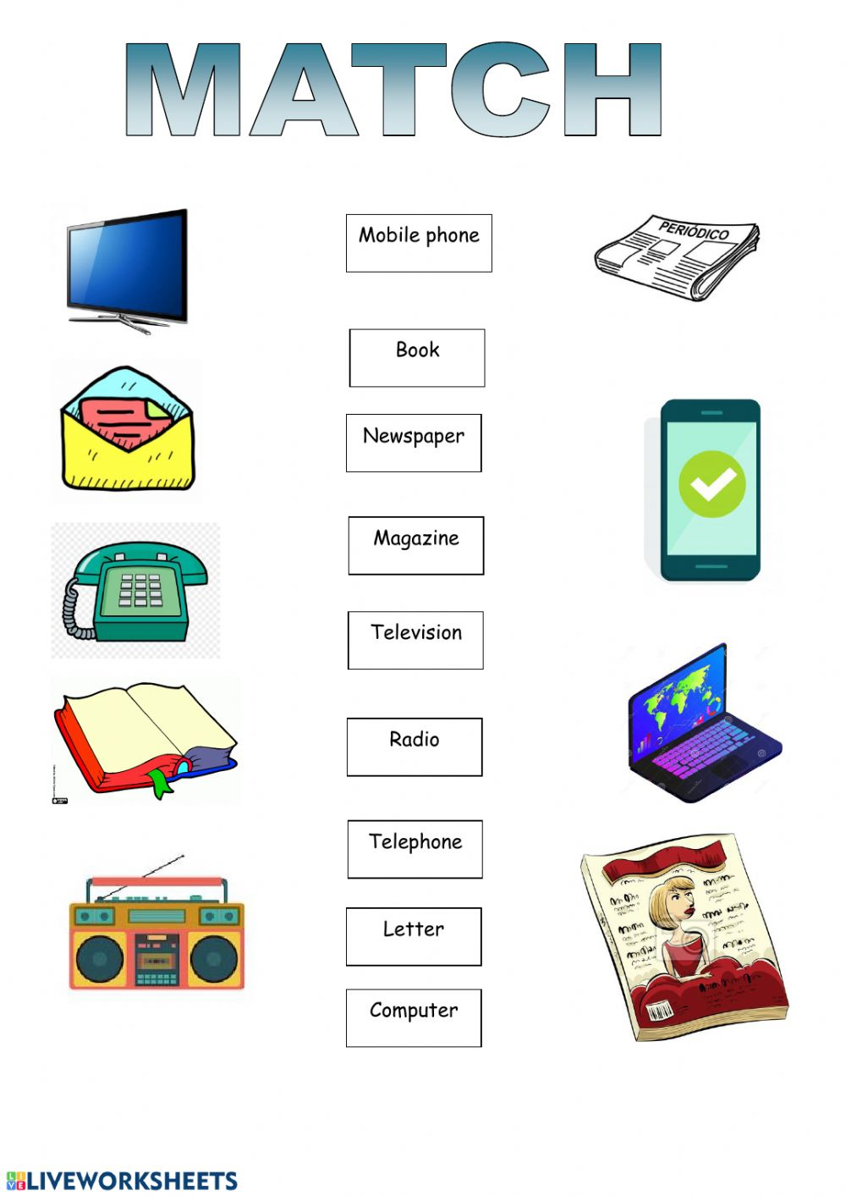

Slide 87
THANK YOU

