Slide 1
Evs back to basics Water world
Evs (class-I & ii)
(theme water)
Nidhi Sharma, prt
Kv INA COLONY

Slide 2
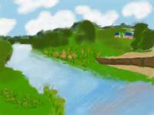
Where do you see water?
WATERFALL
RAIN
SEA
TAP
PUDDLE
DRAIN
POND
SWIMMING POOL
RIVER

Slide 3
WHO LIVES IN WATER?
FISHES

Slide 4
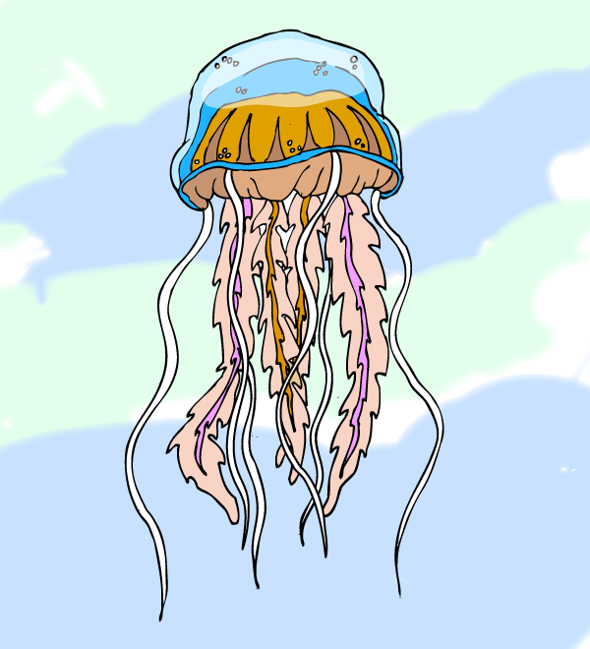
We are not fishes!!
WHALE
OCTOPUS
DOLPHIN
OYESTER
TURTLE
CRAB
JELLY FISH
STAR FISH

Slide 5
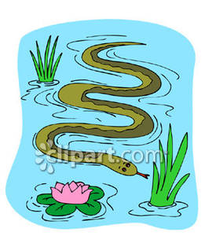
WE CAN LIVE IN WATER AND LAND BOTH!!
SEAL
ALLIGATOR
DUCK
FROG
WATER SNAKE
PENGUINS

Slide 6
WHAT ELSE IS FOUND IN WATER?
STONES
SHELLS
PLANTS
PEARLS

