Slide 1
IN SERIVE TRAINING PRT 2020-2021 KV DELHI CANTT-2 1st SPELL
CLASS V – FLASH CARDS
SUBJECT- ENVIROMENTAL STUDIES
BHAVANA KUMARI ( R.K.PURAM, SEC-8 ) 2nd SHIFT

Slide 2
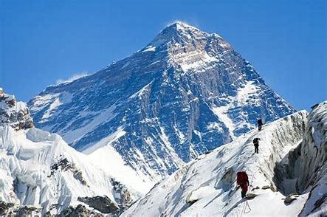
CHAPTER 9- UP YOU GO
BULLET POINTS
GEOGRPHICAL DIVERSITY OF INDIA
RESPONSIBILTIES OF A LEADER
PROBLEMS DURING MOUNTAINEERING
TOOLS USED IN MOUNTAINEERING

Slide 3
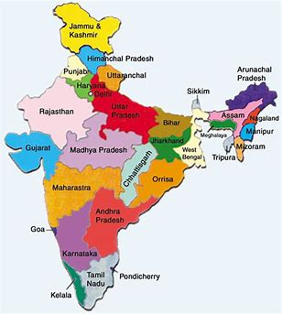

Slide 4
Q1.WHAT IS THIS? ANS. MAP OF INDIA
India, officially the Republic of India, is a country in South Asia. It is the seventh-largest country by area, the second-most populous country, and the most populous democracy in the world.

Slide 5
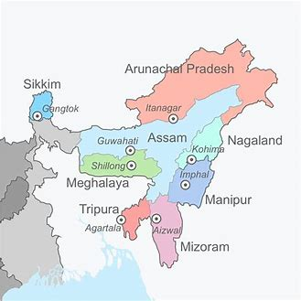

Slide 6
Q2. HOW MANY STATES ARE THERE IN THE PICTURE? ANS. EIGHT STATES
Northeast India (officially North Eastern Region, NER) is the easternmost region of India representing both a geographic and political administrative division of the country. It comprises eight states – Arunachal Pradesh, Assam, Manipur, Meghalaya, Mizoram, Nagaland, Sikkim and Tripura.

Slide 7
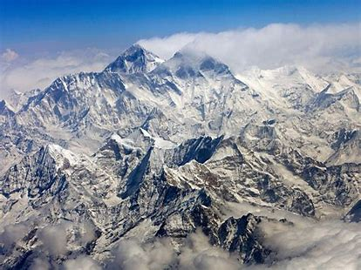

Slide 8
Q3. OBSERVE THE PICTURE AND TELL. ANS. MOUNTAINS
A large natural elevation of the earth's surface rising abruptly from the surrounding level; a large steep hill.

Slide 10
Q4. WHO IS THE PERSON IN RED? ANS. A LEADER/CLASS MONITOR ETC.
As a leader, you combine your personal competencies with the competencies of others into a smoothly functioning team that can outplay and outperform all its competitors.

Slide 11
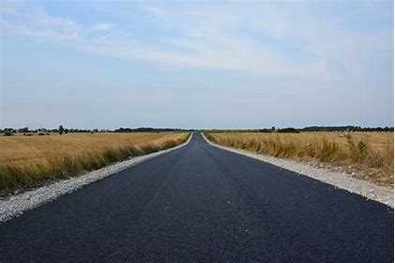

Slide 12
Q5.What kind of road is this? ANS. PLAIN ROAD
A road is a thoroughfare, route, or way on land between two places that has been surfaced or otherwise improved to allow travel by foot or some form of conveyance, including a motor vehicle, cart, bicycle, or horse.

Slide 13
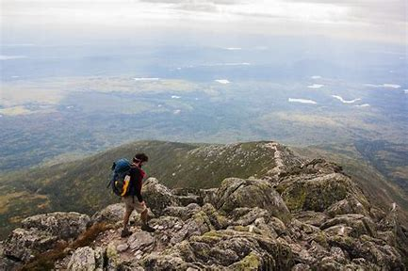

Slide 14
Q6. WHAT KIND OF ROAD IS THIS? ANS. ROUGH ROAD/ROUGH SURFACE
Having a coarse or uneven surface, irregularities, or break, not smooth rough.

Slide 15
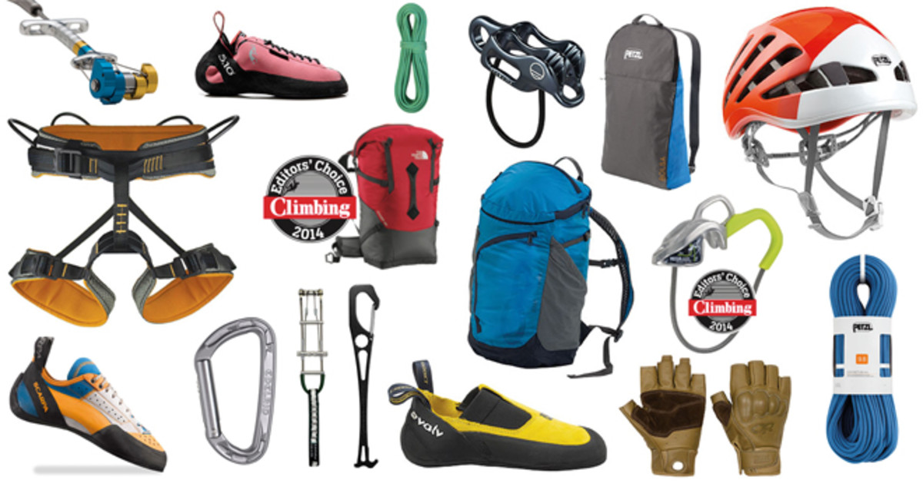

Slide 16
Q7.WHAT IS SHOWN IN THE PICTURE? ANS. MOUNTAINEERING TOOLS
Mountaineering is the set of activities that involves ascending mountains. Mountaineering-related activities include traditional outdoor climbing.
These are the tools used during mountaineering climbing.

Slide 17
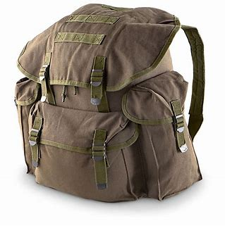

Slide 18
Q8. WHAT IS THIS? ANS. BAG/RUCKSACK
A large bag, usually having two straps and a supporting frame, carried on the back and often used by climbers, campers, hikers, bicyclists, etc.

Slide 19
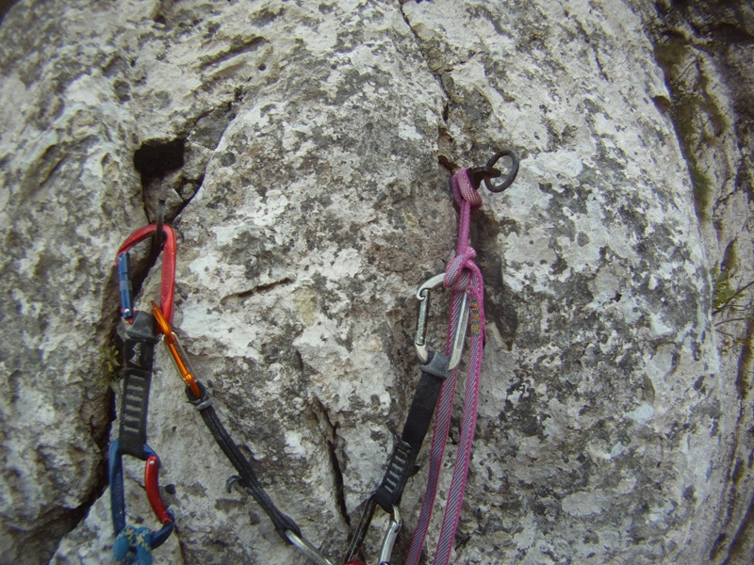

Slide 20
Q9.What is this? Ans. PEGS/PITONS
In climbing, a piton/peg is a metal spike (usually steel) that is driven into a crack or seam in the climbing surface with a climbing hammer, and which acts as an anchor to either protect the climber against the consequences of a fall or to assist progress in aid climbing.

Slide 21
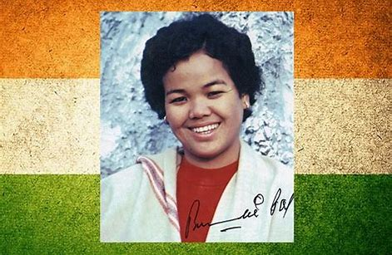

Slide 22
Q10. WHO IS SHE? Ans.BACHENDRI PAL
Bachendri Pal (born 24 May 1954) is an Indian mountaineer, who in 1984 became the first Indian woman to reach the summit of Mount Everest. She was awarded the third highest civilian award Padma Bhushan by Government of India in 2019.

Slide 23
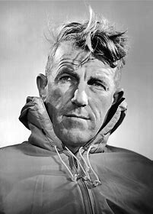

Slide 24
Q11. WHO IS HE? Ans. EDMUND HILLARY
Sir Edmund Hillary (20 July 1919 – 11 January 2008) was a New Zealand mountaineer and explorer.
On 29 May 1953, Hillary and Sherpa mountaineer Tenzing Norgay became the first climbers confirmed to have reached the summit of Mount Everest.

Slide 26
Q12. WHICH MOUNTAIN IS IT? Ans. MOUNT EVEREST
Mount Everest is a peak in the Himalaya mountain range. It is located between Nepal and Tibet, an autonomous region of China. At 8,850 meters (29,035 feet), it is considered the tallest point on Earth. In the nineteenth century, the mountain was named after George Everest, a former Surveyor General of India.
Mount Everest is Earth's highest mountain above sea level.

