Slide 1
IN SERVICE TRAINING PRT 2020-2021 K.V DELHI CANTT-2 1st SPELL
CLASS V – FLASH CARDS
Subject- ENVIROMENTAL STUDIES
BHAVANA KUMARI(R.K.PURAM,SEC-8) 2nd SHIFT

Slide 2
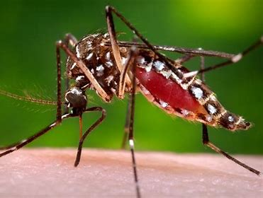
CHAPER 8- A TREAT FOR MOSQUITOES
BULLET POINTS
DISEASE CAUSED BY MOSQUITOES
DANGERS OF STAGNANT WATER
HOW TO READ BLOOD REPORT
PREVENTIVE MEASURES
RONALD ROSS AND HIS EXPERIMENT

Slide 4
Q1. What do you see in the picture? Ans. LARVAE
Like all flies, mosquitoes go through four stages in their life cycles: egg, larva, pupa, and adult or imago. The first three stages—egg, larva, and pupa—are largely aquatic.
After the eggs hatch, the larvae will receive the necessary nutrition by feeding on the organic organisms present in the water.

Slide 5
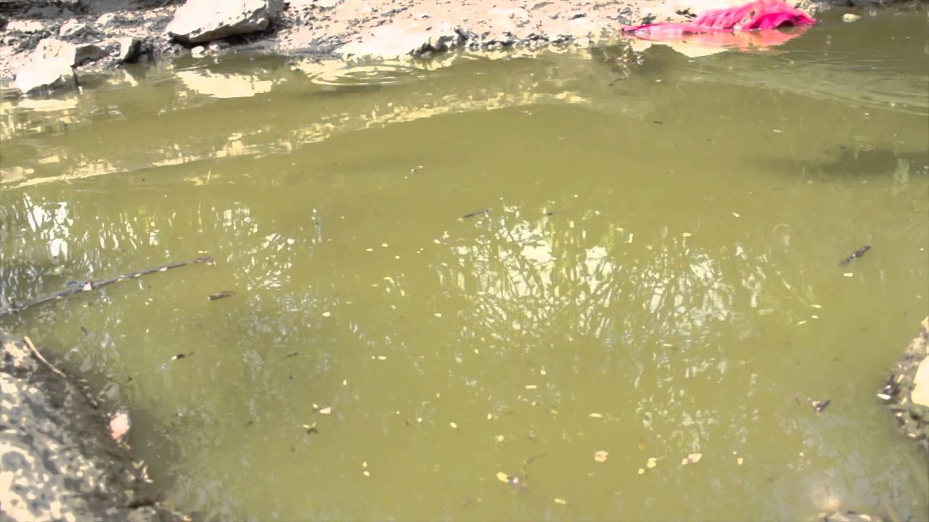

Slide 6
Q2. WHAT DO YOU SEE IN THE PICTURE? Ans. dirty water/stagnant water
Water stagnation occurs when water stops flowing. Stagnant water can be a major environmental hazard.
Stagnant water is contaminated with human and animal feces, particularly in deserts or other areas of low rainfall. Stagnant water may be classified into the following basic, although overlapping, types: Water body stagnation (stagnation in swamp, lake, lagoon, river, etc.) Trapped water stagnation.

Slide 8
Q2.Which mosquito is this ? Ans. FEMALE ANOPHELES MOSQUITO
The female Anopheles mosquito, which is the transmitter of malaria disease usually lives two weeks but can sometimes live up to a month depending on the weather conditions, climate, blood meals available and other factors, however, male mosquitoes live only about a week.

Slide 10
Q3.What do you observe in this picture? Ans. ALGAE
Algae is an informal term for a large and diverse group of photosynthetic eukaryotic organisms. It is a polyphyletic grouping, including species from multiple distinct clades. Included organisms range from unicellular microalgae, such as Chlorella and the diatoms, to multicellular forms, such as the giant kelp, a large brown alga which may grow up to 50 m in length.

Slide 12
Q4. WHICH MEDICAL INSTRUMENT IS THIS? aNS. MICROSCOPE
A microscope is an instrument that makes an enlarged image of a small object, thus revealing details too small to be seen by the unaided eye. The most familiar kind of microscope is the optical microscope, which uses visible light focused through lenses.

Slide 14
Q5.Which report is this ? Ans. Blood REPORT
A blood test helps assess a health problem. Doctors generally order a blood test to confirm the diagnosis. Other tests like urine test, stool test, ultrasonography, etc. are also ordered along with a blood test, as these tests help detect the exact cause of the illness.

Slide 16
Q9.What is this? ANS. Mosquito nets
A mosquito net is a type of meshed curtain that is circumferentially draped over a bed or a sleeping area, to offer the sleeper barrier protection against bites and stings from mosquitos, flies, and other pest insects, and thus against the diseases they may carry. Examples of such preventable insect-borne diseases include malaria, dengue fever, yellow fever, zika virus and various forms of encephalitis, including the West Nile virus.

Slide 18
Q10. Which mosquito repellent is it? Ans. Mosquito coil
A mosquito coil is a mosquito-repelling incense, usually made into a spiral, and typically made using dried paste of pyrethrum powder. The coil is usually held at the center of the spiral, suspending it in the air, or wedged by two pieces of fireproof netting to allow continuous smoldering. Burning usually begins at the outer end of the spiral and progresses slowly toward the center of the spiral, producing a mosquito-repellent smoke.
Mosquito coils are widely used in Asia, Africa, South America, Canada and Australia.

Slide 20
Q11. who is he ? ANS. RONALD ROSS
Sir Ronald Ross (13 May 1857 – 16 September 1932) was a British medical doctor who received the Nobel Prize for Physiology or Medicine in 1902 for his work on the transmission of malaria, becoming the first British Nobel laureate, and the first born outside Europe.
His discovery of the malarial parasite in the gastrointestinal tract of a mosquito in 1897 proved that malaria was transmitted by mosquitoes, and laid the foundation for the method of combating the disease

Slide 22
Q12. What is this ? Ans. Preventive measures about disease/poster for controlling malaria, dengue, zika virus
Large printed picture, photograph, or notice that you stick or pin to a wall or board, usually for decoration or to advertise something: The children put up posters on the classroom walls.

Slide 23
