Slide 1
In SERVICE TRAINING (PRT) 2020-2021 K V DELHI CANTT-2, 1st SPELL
CLASS V ( FLASH CARDS)
Subject: Enviromental studies
BHAVANA KUMARI(PRT) R.K.PURAM,SEC-8 2nd SHIFT

Slide 2
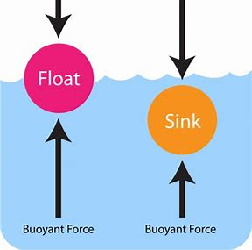
CHAPTER 7- EXPERIMENTS WITH WATER
BULLET POINTS
Forms of water
Soluble & insoluble materials
Sink & float concept
Dandi march
Dead sea

Slide 3
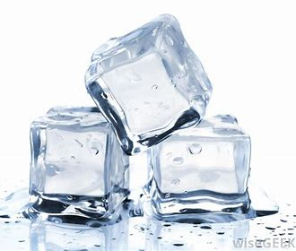

Slide 4
Q1.Which form of water is it ? Ans. Solid State/form
Ice is water frozen into a solid state. Depending on the presence of impurities such as particles of soil or bubbles of air, it can appear transparent or a more or less opaque bluish-white color.

Slide 5
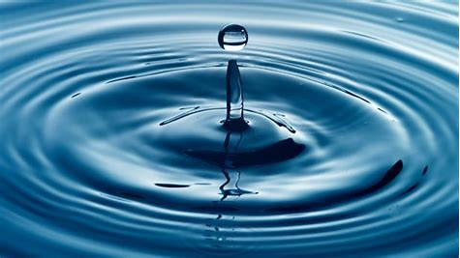

Slide 6
Q2.Which form of water is it ? Ans. LIQUID STATE/FORM
The Liquid State. The liquid state of a material has a definite volume, but it does not have a definite shape and takes the shape of the container, unlike that of the solid state.

Slide 8
Q3.Which form of water is it? ANS. GASEOUS/STEAM STATE
Gas, one of the three fundamental states of matter, with distinctly different properties from the liquid and solid states. The remarkable feature of gases is that they appear to have no structure at all.

Slide 9
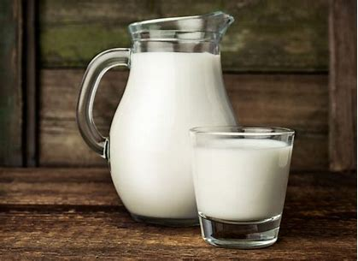

Slide 10
Q4. Is Milk soluble in water?
Ans. YES ! Milk is mostly water (82%) and all the remaining constituents (the organic part) forms a colloidal solution with it. Therefore mixing Milk with water is more like mixing water with water. So they are soluble.

Slide 12
Q5. IS SOIL SOLUBLE IN WATER?
ANS. NO ! Some components of soils are soluble in water, some components the majority, are insoluble.

Slide 13
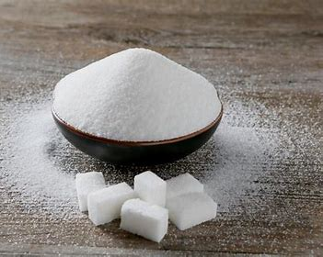
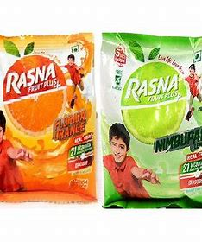
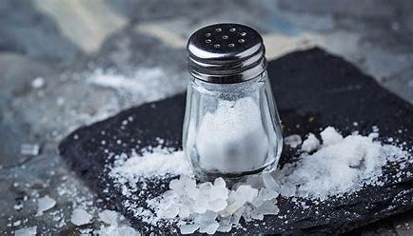
Some examples of things “soluble in water”
SALT
SUGAR
RASNA/HORLICKS ETC.

Slide 14
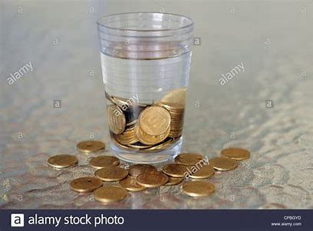

Slide 15
Q6. What happened to the coins in a glass of water?
Ans. The coins sank in water . The displaced water around a coin weighs less than the coin, so the coin will sink.

Slide 16
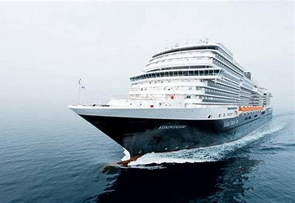

Slide 17
Q7. WHY DID THE SHIP DIDN’T SINK IN WATER?
ANS. A ship or any other object that floats doesn't sink because it's able to displace an amount of water equal to its weight before it becomes submerged. For example, a ship that weighs 1,000 kgs sinks until 1,000 kgs(litres) of water are displaced, and then it floats.

Slide 18
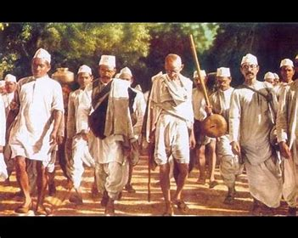

Slide 19
Q8. CAN YOU TELL SOMETHING ABOUT THIS INCIDENT?
ANS. The Salt March also known as the Salt Satyagraha Dandi March and the Dandi Satyagraha was an act of nonviolent civil disobedience in colonial India led by Mohandas Karamchand Gandhi. The 24-day march lasted from 12 March 1930 to 6 April 1930 as a direct action campaign of tax resistance and non violent protest against the British salt monopoly.THEY BEGIN THERE YATRA FROM AHMEDABAD TO DANDI SEASHORE IN GUJRAT.

Slide 20
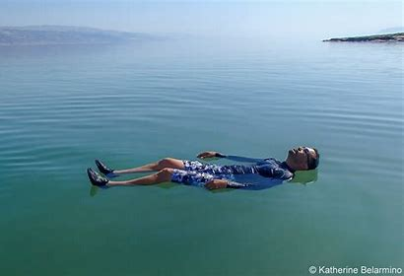

Slide 21
Q9. NAME THIS SEA.
ANS. DEAD SEA. Floating in the Dead Sea is an amazing experience the water feels completely different it's like a smooth cream & you can float in an about a foot of water. It's really weird but amazing at the same time. The other thing is that you are at the lowest point on earth .

Slide 22
THANK YOU!!!

