Slide 1
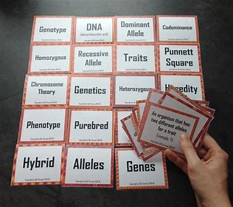
IN SERVICE TRAINING (PRT) 2020-2021 K V DELHI CANTT-2 Ist SPELL BHAVANA KUMARI-PRT (R.K.PURAM, SEC-8)2nd SHIFT
CLASS V – FLASH CARDS
Subject: Environmental Studies

Slide 2
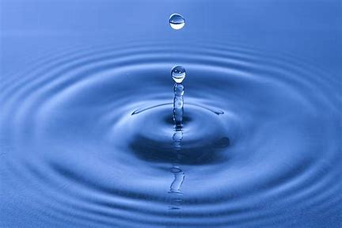
CHAPTER 6- EVERY DROP COUNTS
BULLET POINTS
SOURCES OF WATER
WATER CYCLE
RAIN WATER HARVESTING
FESTIVALS RELATED TO WATER
MAPS

Slide 3
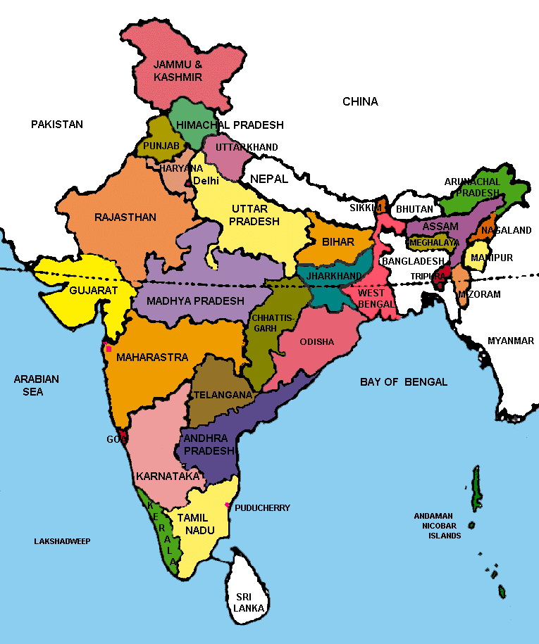

Slide 4
Q1. What is given in the first slide? Ans- MAP OF INDIA
We will study about the states of India especially about Rajasthan where we will begin our chapter with a story of King Gadsi, who lived in Jaisalmer ( a city in Rajasthan ) and how he tackled the problem of shortage of water in olden days.

Slide 5
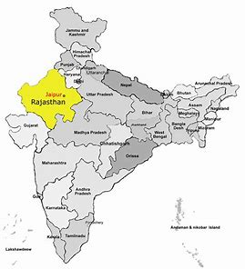

Slide 6
Q2.Which state is marked with yellow colour? Ans. RAJASTHAN
Rajasthan is a state in northern India. It is the largest Indian state by area and the seventh largest by population.

Slide 7
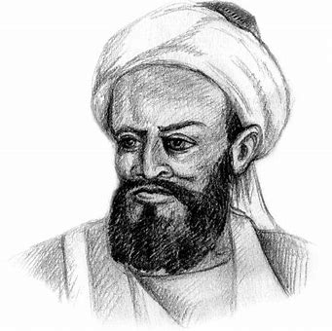

Slide 8
Q3. Who is he ? Ans.AL-BIRUNI
Abu Rayhan al-Biruni was an Iranian scholar and polymath during the Islamic Golden Age. He has been variously called as the "founder of Indology", "Father of Comparative Religion", "Father of modern geodesy“.
And he wrote may things about India like “The people here are very skilled at making ponds. My countrymen would be surprised to see them. They pile up huge rocks and join them with iron rods to build chabutaras (raised platforms) all around the lake. Between these, there are rows of long staircases, going up and down. The steps for going up and coming down are separate. So there is less crowding.”

Slide 9
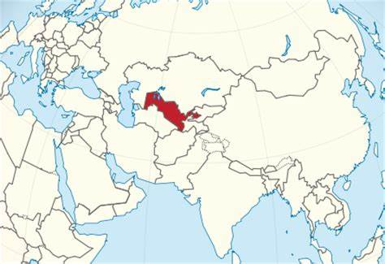

Slide 10
Q3.Which country is marked with red color? Ans. UZBEKISTAN
The place from where Al-Biruni belong to.

Slide 11
SOURCES OF WATER
NATURAL SOURCES
ARTIFICAL SOURCES

Slide 12
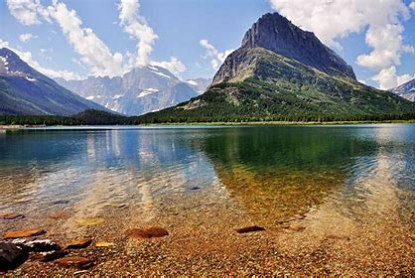

Slide 13
Q4.Which source water is it and name it. Ans. Natural source and it is Lake
Lake is a large area of water surrounded by land.

Slide 14
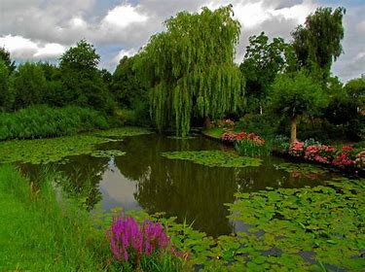

Slide 15
Q5.Which of source of water is it and name it. Ans. Natural Source and it is a Pond.
A pond is an area filled with water, either natural or artificial, that is smaller than a lake.

Slide 16
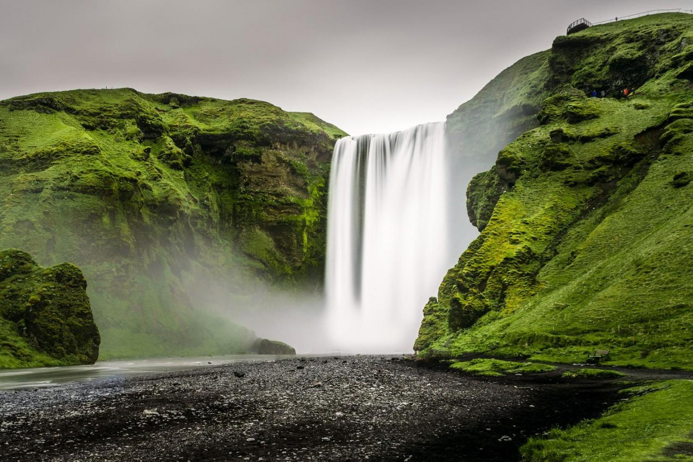

Slide 17
Q6. Which source of water is it and name it? Ans. Natural source and it is a Waterfall.
A cascade of water falling from a height, formed when a river or stream flows over a precipice or steep incline.

Slide 18
Some examples of natural Sources of water
OCEANS
HOT WATER SPRING

Slide 19
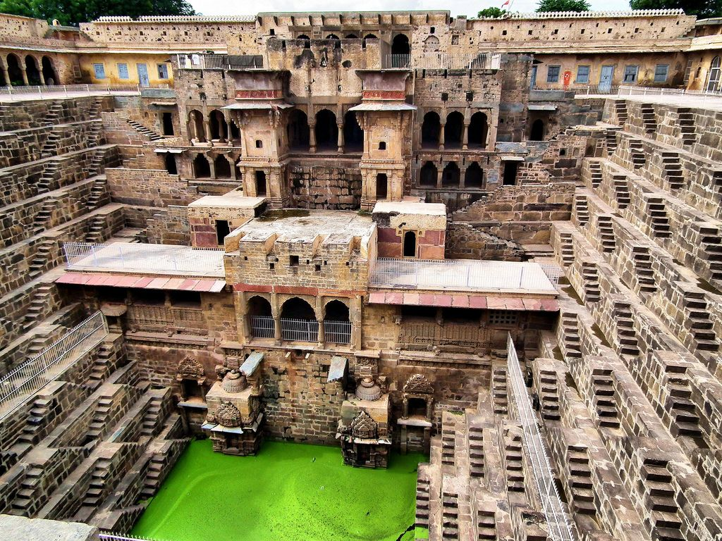

Slide 20
Q7.Which source of water is it and name it. Ans. Man Made source and it is a Stepwell.
Stepwells are wells or ponds in which the water is reached by descending a set of steps to the water level. They may be multi-storied.
They are most common in western India and are also found in the other more arid regions of the Indian subcontinent, extending into Pakistan. The construction of stepwells is mainly utilitarian, though they may include embellishments of architectural significance, and be temple tanks.

Slide 21
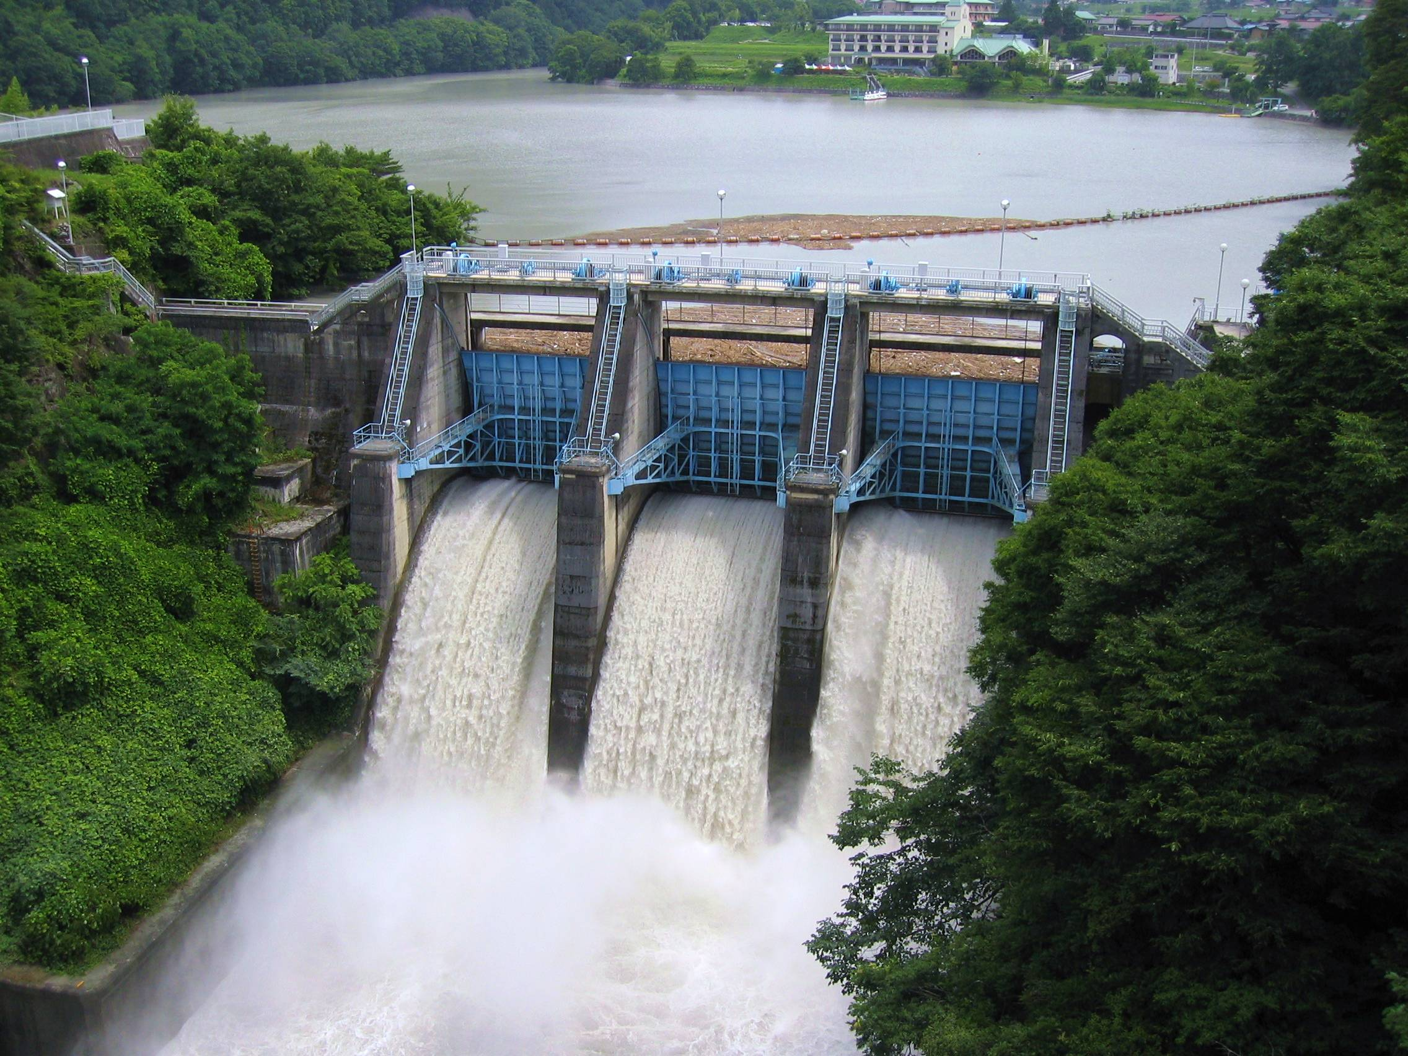

Slide 22
Q8.Which source of water is it and name it. Ans. ManMade source and it is a Dam.
A dam is a barrier that stops or restricts the flow of water or underground streams. Reservoirs created by dams not only suppress floods but also provide water for activities such as irrigation, human consumption, industrial use.

Slide 23
Some examples of Man Made sources of water
TUBEWELLS
WELLS

Slide 24
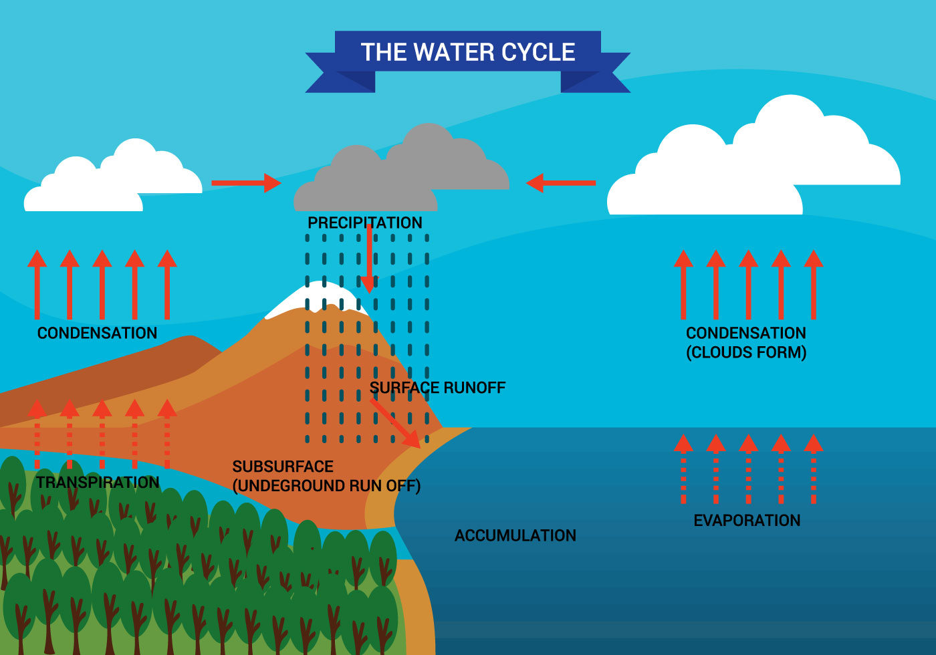

Slide 25
Q9.What is shown in the picture? Ans.WATER- CYCLE
The water cycle, also known as the hydrologic cycle or the hydrological cycle, describes the continuous movement of water on, above and below the surface of the Earth.
The water moves from one reservoir to another, such as from river to ocean, or from the ocean to the atmosphere, by the physical processes of evaporation, condensation, precipitation, infiltration, surface runoff, and subsurface flow. In doing so, the water goes through different forms: liquid, solid (ice) and vapor.

Slide 26
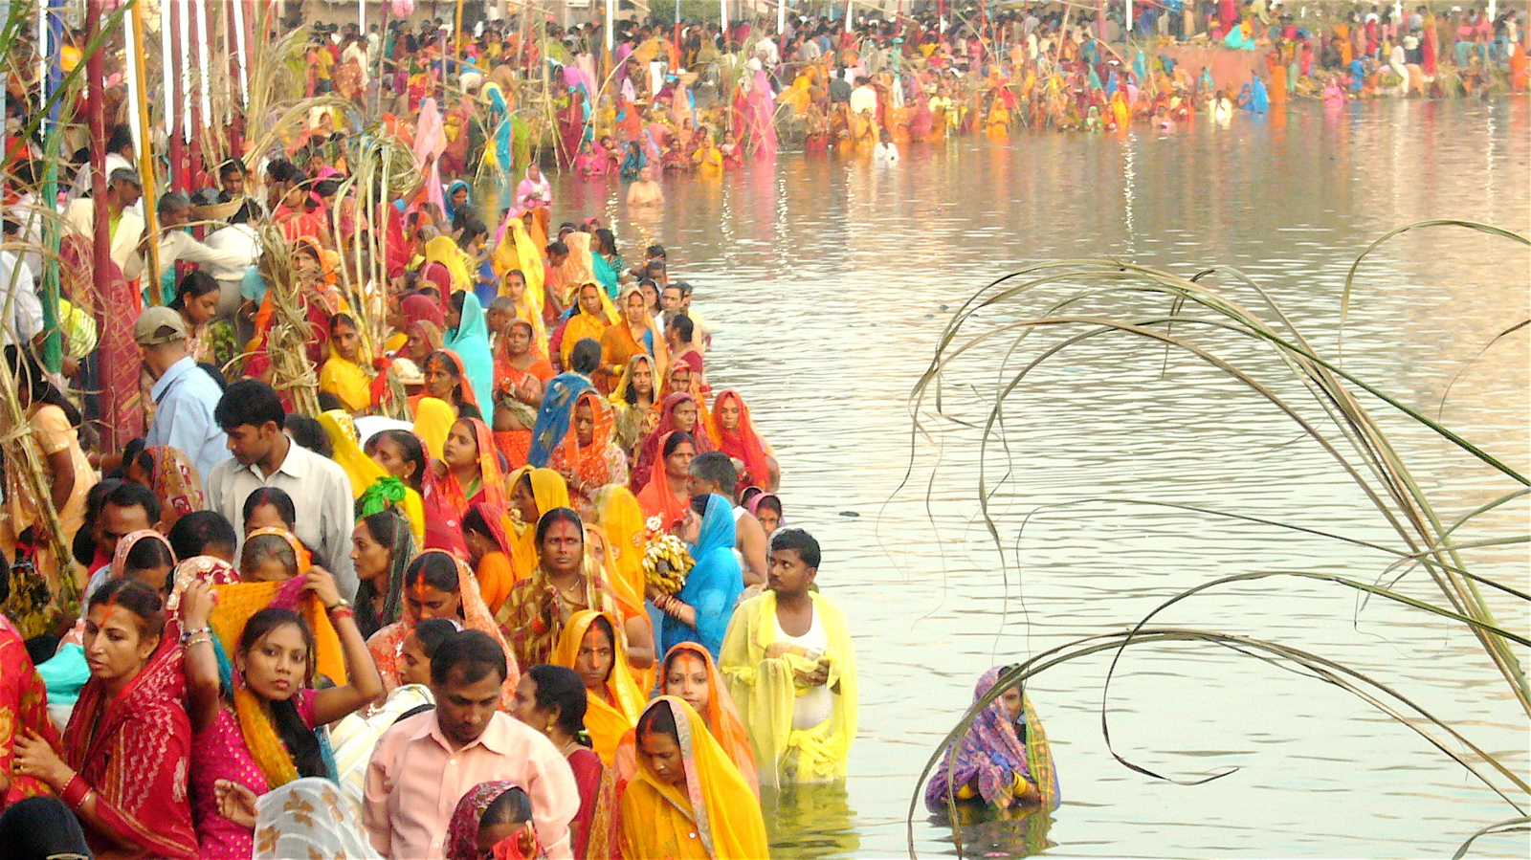

Slide 27
Q10.Which festival is been celebrated in this picture? Ans.CHATH PUJA
The Chhath Puja is dedicated to the Sun and Shashthi devi in order to thank them for bestowing the bounties of life on earth and to request the granting of certain wishes.
In this festival the water plays a vital role as all devotees prays near to river .

Slide 28
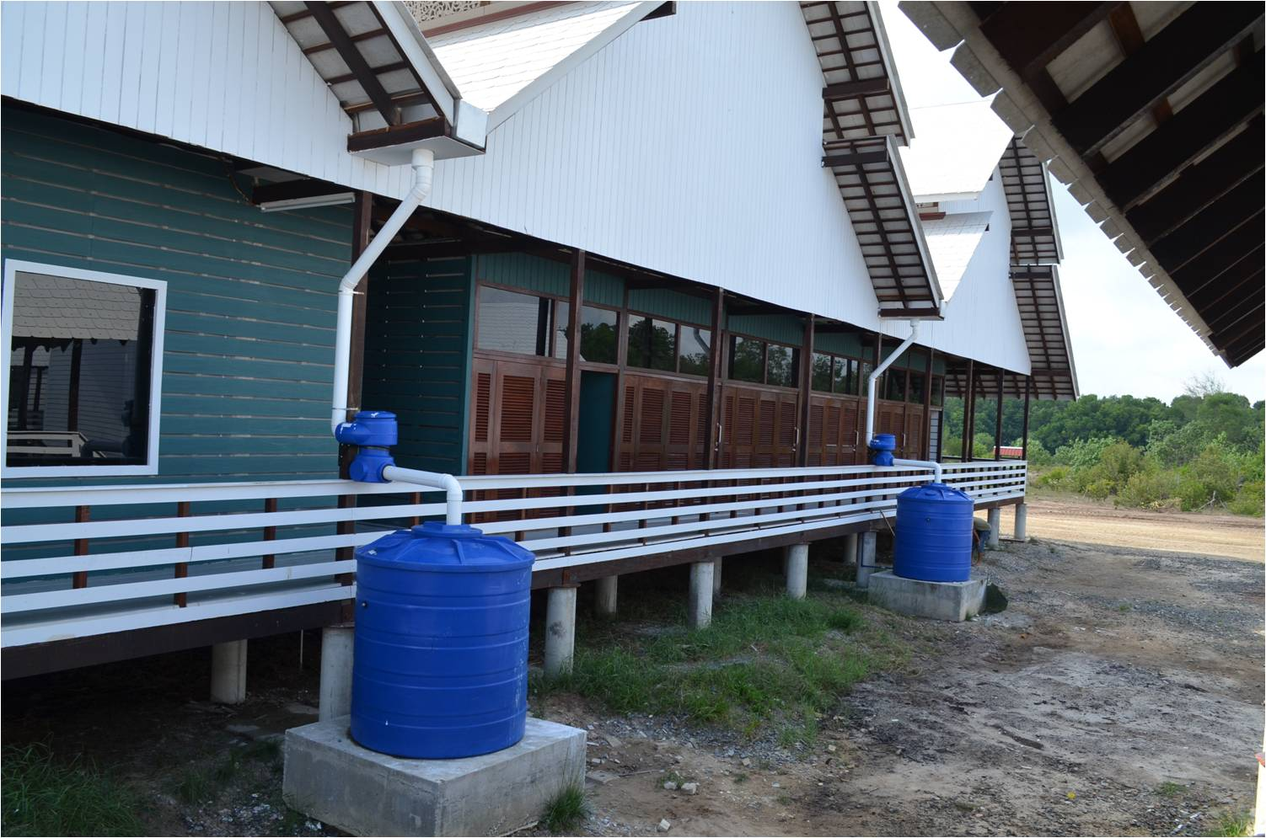

Slide 29
Q11. What is given in the picture? Ans. RAIN WATER HARVESTING
Rainwater harvesting is the process of collection of rainwater from surfaces on which rain falls, filtering it and storing it for multiple uses. Rainwater harvesting puts the supply of water back to normal levels.
As the rain falls, water is directed to a suitable collection point.It can also mean collecting rainwater before it infiltrates into the ground and becomes underground water.

Slide 30
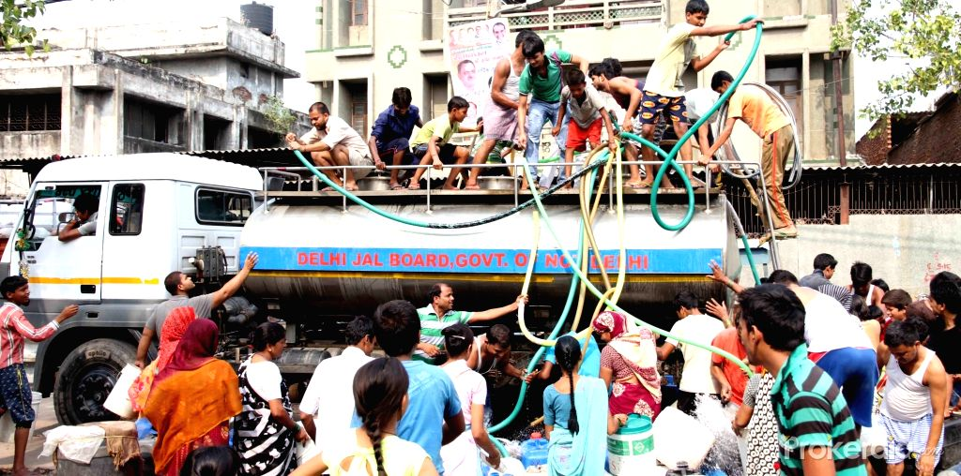

Slide 31
Q12.What are the people doing? Taking water from Delhi Jal Board tanker.
Delhi Jal Board is the government agency responsible for supply of potable water to the most of the National Capital Territory region of Delhi, India.

Slide 32
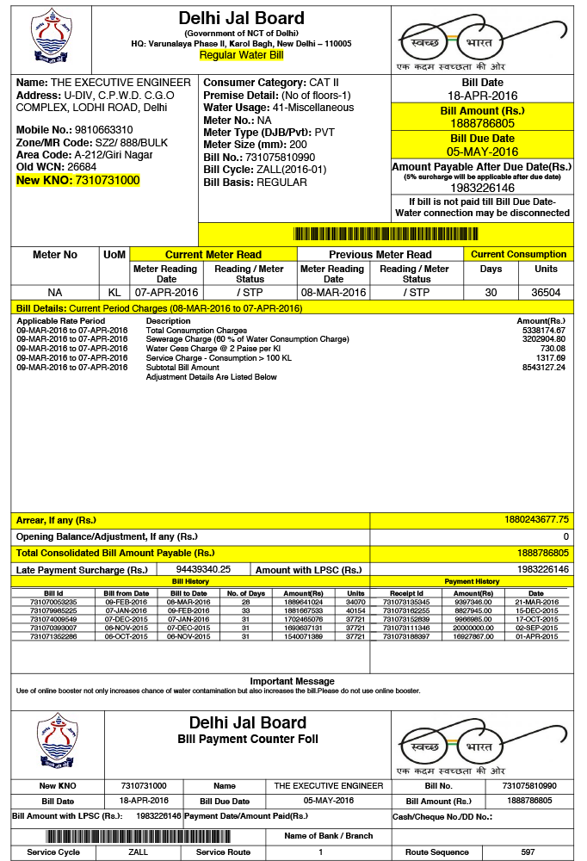

Slide 33
Q13.Which bill is this? Ans. WATER BILL
The first step in changing the way you use water in the future is by understanding how much water you use today. The best place to find this information is on your monthly water bill.

Slide 34
THANK YOU

