Slide 1
In service training (prt) kv delhi cant.2 2020-2021 1st spell
CLASS V – FLASH CARDS
Subject- ENVIROMENTAL STUDIES
BHAVANA KUMARI ( R.K.PURAM,SEC-8) 2nd SHIFT

Slide 2
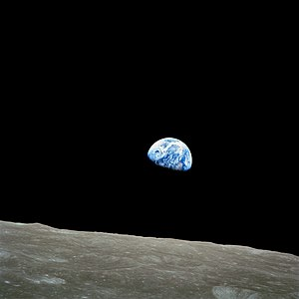
CHAPTER 11- SUNITA IN SPACE
BULLET POINTS
INFORMATION ABOUT EARTH & GLOBE
GRAVITIONAL FORCE
NATURAL SATELLITE & ARTIFICAL SATELLITE
PHASES OF MOON
SPACESHIP/SPACESUITS
INDIAN ASTRONAUNTS

Slide 3
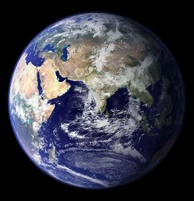

Slide 4
Q1. WHAT IS THIS? ANS. EARTH
Earth is the third planet from the sun, and the only place we know of so far that’s inhabited by living things. It is the only world in our solar system with liquid water on the surface. Slightly larger than nearby Venus, Earth is the biggest of the four planets closest to the sun, all of which are made of rock and metal.

Slide 6
Q2. WHAT IS THIS? ANS. GLOBE
A globe is a spherical model of Earth, of some other celestial body or of the celestial sphere. Globes serve purposes similar to some maps but unlike maps do not distort the surface that they portray except to scale it down. A model globe of Earth is called a globe.

Slide 7
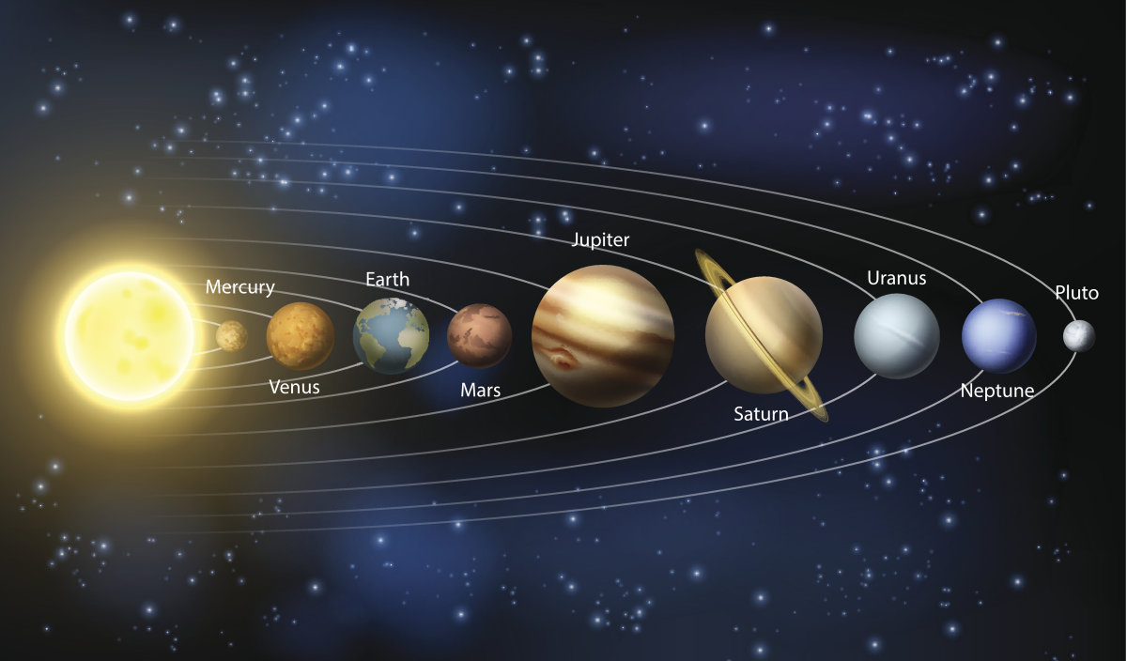

Slide 8
Q3. what is this? Ans. solar system
The collection of eight planets and their moons in orbit round the sun together with smaller bodies in the form of asteroids, meteoroids and comets. The planets of the solar system are (in order of distance from the sun) Mercury, Venus, Earth, Mars, Jupiter, Saturn, Uranus, and Neptune.

Slide 9
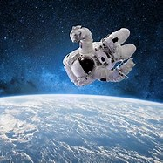

Slide 10
Q4. what is happening in the picture? Ans. astronaut is floating in space
Gravity is the force of attraction by which terrestrial bodies tend to fall toward the center of the earth

Slide 11
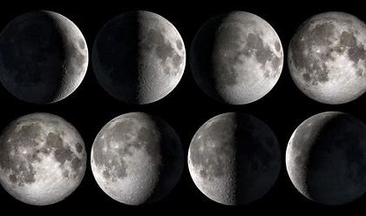

Slide 12
Q5. WHAT IS THIS? ANS. PHASES OF MOON
Moon phases occur at a specific moment in time and the intermediate Moon phases take up the time in between. Opposite phases on the far side of the Moon.

Slide 13
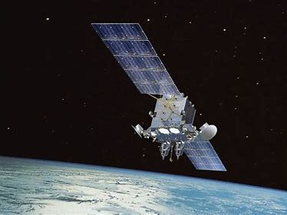

Slide 14
Q6. WHAT IS IT? ANS. SATELLITE/ARTIFICAL SATELLITE
An artificial body placed in orbit round the earth or moon or another planet in order to collect information or for communication.

Slide 15
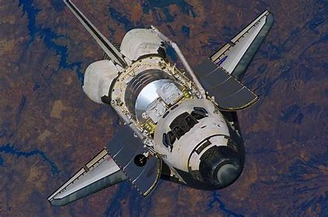

Slide 16
Q7. WHAT IS THIS? ANS. SPACESHIP
A vehicle that flies through space.

Slide 17
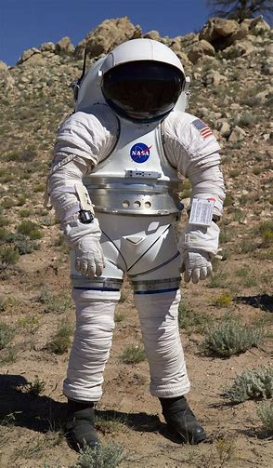

Slide 18
Q8. WHAT IS THIS? ANS. SPACESUIT
A garment designed to allow an astronaut to survive in space.

Slide 19
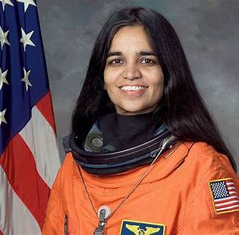

Slide 20
Q9. WHO IS SHE? ANS. KALPANA CHAWLA
Kalpana Chawla was an American astronaut, engineer, and the first woman of Indian descent to go to space. She first flew on Space Shuttle Columbia in 1997 as a mission specialist and primary robotic arm operator. In 2003, Chawla was one of the seven crew members who died in the Space Shuttle Columbia disaster when the spacecraft disintegrated during its re-entry into the Earth's atmosphere

Slide 21
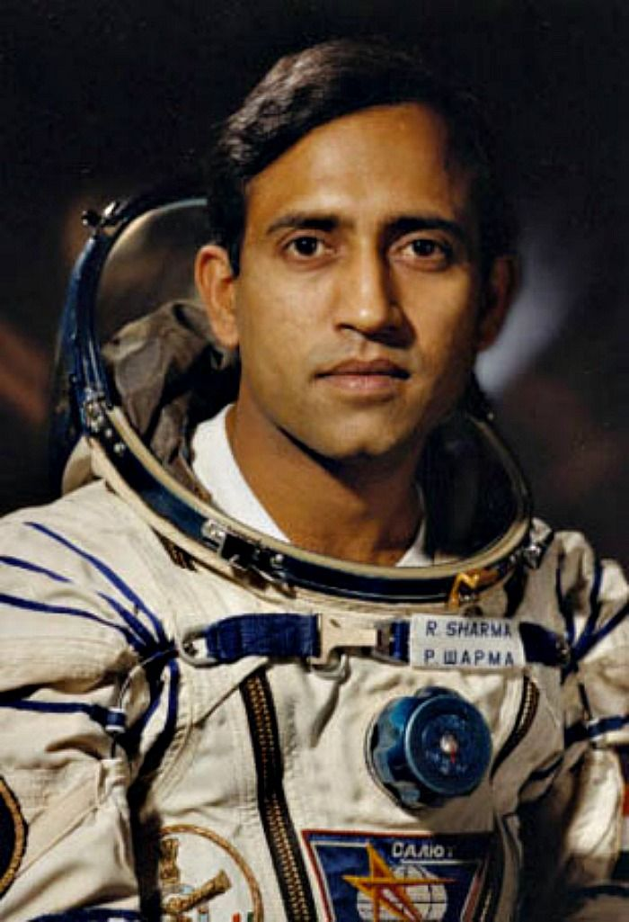

Slide 22
Q10. WHO IS HE? ANS. RAKESH SHARMA
Wing Commander Rakesh Sharma, AC is a former Indian Air Force pilot who flew aboard Soyuz T-11 on 3 April 1984 with the Interkosmos programme. He is the only Indian citizen to travel in space, although there have been other astronauts with an Indian background who were not Indian citizens.

Slide 23
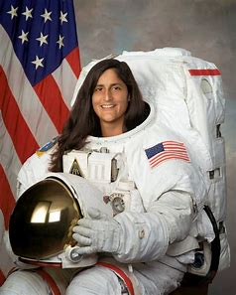

Slide 24
Q11. WHO IS SHE? ANS. SUNITA WILLIAMS
Sunita Williams is an American astronaut and United States Navy officer who formerly held the records for most spacewalks by a woman and most spacewalk time for a woman.

Slide 25
THANK YOU

