Slide 1
IN SERVICE TRAINING PRT 2020-2021 KV DELHI CANTT-2 Ist spell
CLASS V- FLASH CARDS
Subject- Environmental Studies
BHAVANA KUMARI-PRT (R.K.PURAM,SEC-8) 2nd SHIFT

Slide 2
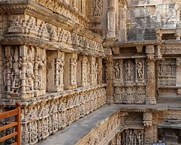
Chapter 10- walls tells stories
BULLET POINTS
HISTORICAL MONUMENTS OF INDIA
BRIEF STRUCTURE ABOUT GOLCONDA FORT
IMPORTANCE OF MUSEUM
TYPES OF METALS
MAP READING

Slide 4
Q1. WHICH MONUMENT IS THIS? ANS. QUTUB MINAR
The Qutub Minar is a minaret and "victory tower" that forms part of the Qutub complex, a UNESCO World Heritage Site in the mehrauli area of New Delhi, India. The height of Qutub Minar is 72.5 meters, making it the tallest minaret in the world built of bricks.
The Qutub Minar is a towering 73 meter high tower built by Qutub-ud-Din Aibak in 1193.

Slide 6
Q2. WHICH MONUMENT IS THIS? Ans. taj mahal
The Taj Mahal is an ivory-white marble mausoleum on the southern bank of the river Yamuna in the Indian city of Agra. It was commissioned in 1632 by the Mughal emperor Shah Jahan to house the tomb of his favorite wife, Mumtaz Mahal, it also houses the tomb of Shah Jahan himself.

Slide 8
Q3. which monument is this? Ans. Golconda fort
Golconda Fort, also known as Golkonda is a fortified citadel and an early capital city of the Qutub Shahi dynasty located in Hyderabad, Telangana,India. Because of the vicinity of diamond mines, especially Kollur Mine, Golconda flourished as a trade center of large diamonds, known as the Golconda Diamonds.
The region has produced some of the world's most famous diamonds including the colorless Koh-i-Noor.

Slide 9
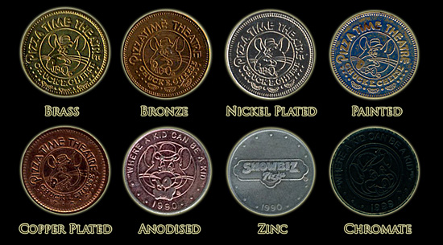

Slide 10
Q4.WHAT ARE THESE ? ANS. METALS/COINS/OLD CURRENCY
Gold, Silver and Copper are all examples of Native metals that naturally occur in a relatively pure state. Ancient man first found and began using Native Metals approximately 5000 years BC.
Cast copper coins along with punch marked coins are the earliest examples of coinage in India.

Slide 12
Q5.WHAT IS THIS? ANS. MUSEUM
A museum is an institution that cares for (conserves) a collection of artifacts and other objects of artistic, cultural, historical or scientific importance. Many public museums make these items available for public viewing through exhibits that may be permanent or temporary.

Slide 14
Q6. who is he? Ans. Aurangzeb
Emperor Aurangzeb of India's Mughal Dynasty was a ruthless leader who despite his willingness to take the throne over the bodies of his brothers went on to create a "golden age" of Indian civilization. An orthodox Sunni Muslim, he reinstated taxes and laws penalizing Hindus and imposing Sharia law.

Slide 16
Q7. WHAT IS THIS? ANS. CANNON
A cannon is a type of gun classified as artillery that launches a projectile using propellant. In the past gunpowder was the primary propellant before the invention of smokeless powder during the late 19th century. Cannons vary in caliber, range, mobility, rate of fire, angle of fire, and firepower; different forms of cannon combine and balance these attributes in varying degrees depending on their intended use on the battlefield.

Slide 17
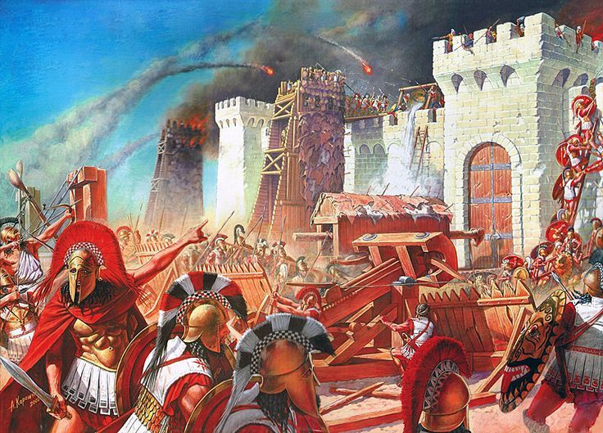

Slide 18
Q8. WHAT IS HAPPENING IN THE PICTURE? ANS. WAR
A state of armed conflict between different countries or different groups within a country.
It is generally characterized by extreme violence, aggression, destruction, and mortality, using regular or irregular military forces. Warfare refers to the common activities and characteristics of types of war, or of wars in general.

Slide 20
Q9. what does this picture depicting? ANS. IT IS SHOWINGN DIRECTIONS
The path along which something moves, lies or points .

