Slide 1
ACTION WORDS
FLASH CARDS
PRESENTED BY JAIBALA PRAKASH

Slide 2
What is the man doing?

Slide 3
The man is walking.

Slide 4
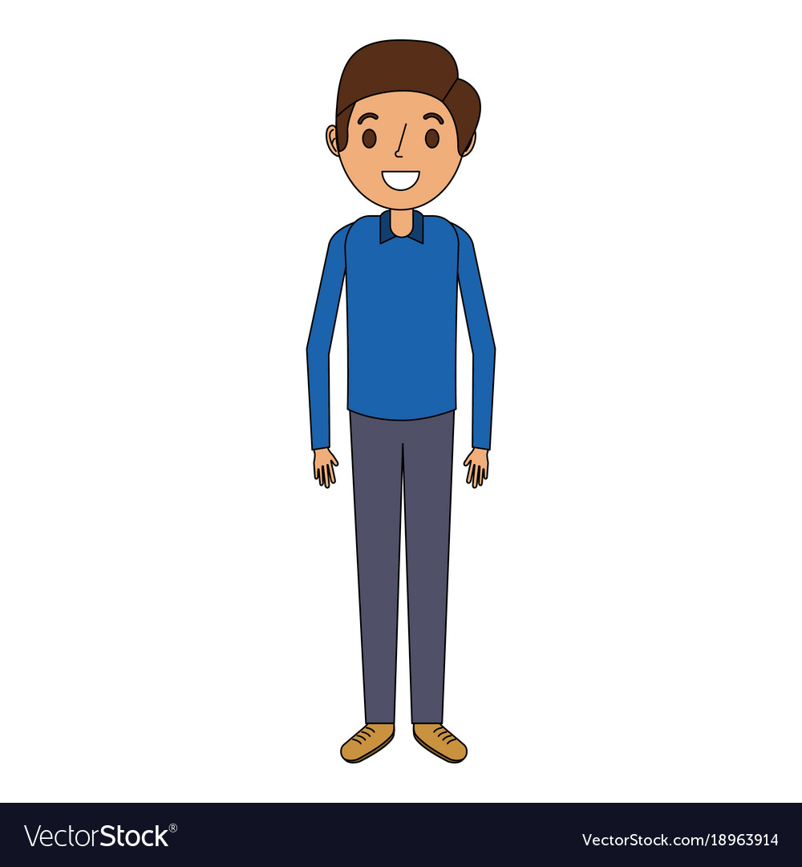
What is the boy doing?

Slide 5
The boy is standing.

Slide 6
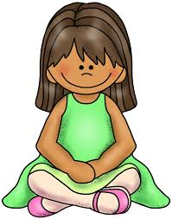
What is the girl doing?

Slide 7
The girl is sitting.

Slide 8
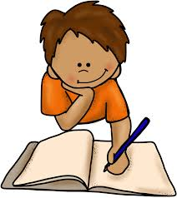
What is the boy doing?

Slide 9
The boy is writing.

Slide 10
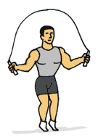
What is the man doing?

Slide 11
The man is skipping.

Slide 12
What is the girl doing?

Slide 13
The girl is reading.

Slide 14
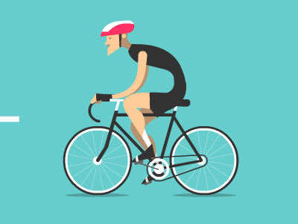
What is the boy doing?

Slide 15
The man is cycling.

Slide 16
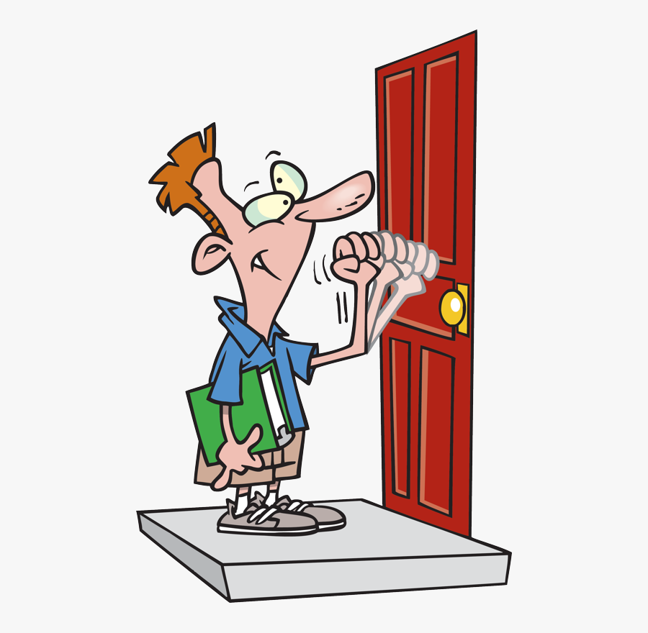
What is the man doing?

Slide 17
The man is knocking.

Slide 18
What is the fish doing?

Slide 19
The fish is swimming.

Slide 20
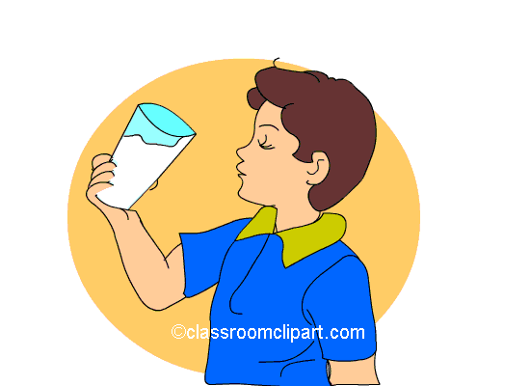
What is the boy doing?

Slide 21
The boy is drinking.

Slide 22
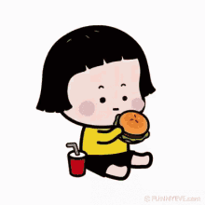
What is the girl doing?

Slide 23
The girl is eating.

Slide 24
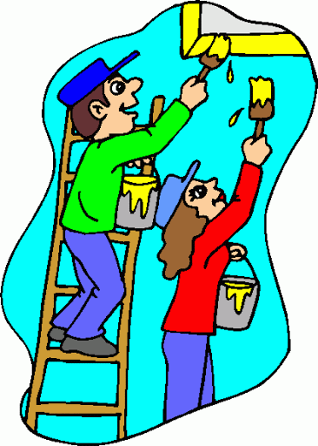
18

Slide 25
They are painting.

Slide 26
What is the monkey doing?

Slide 27
The monkey is laughing.

Slide 28
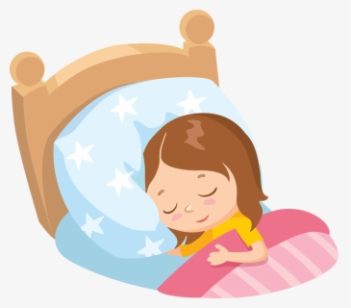
What is the girl doing?

Slide 29
The girl is sleeping.

Slide 30
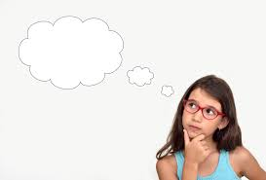
What is the girl doing?

Slide 31
The girl is thinking.

Slide 32
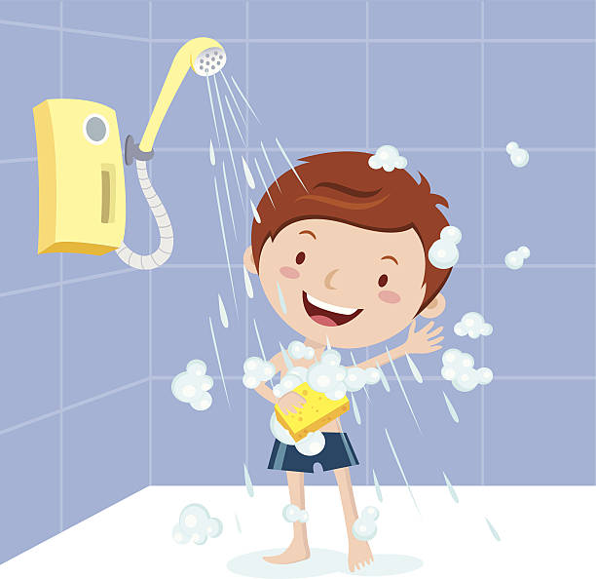
What is the boy doing?

Slide 33
The boy is bathing.

Slide 34
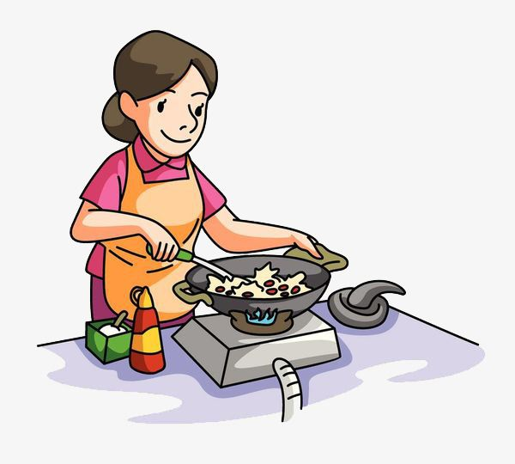
What is the woman doing?

Slide 35
The woman is cooking.

Slide 36
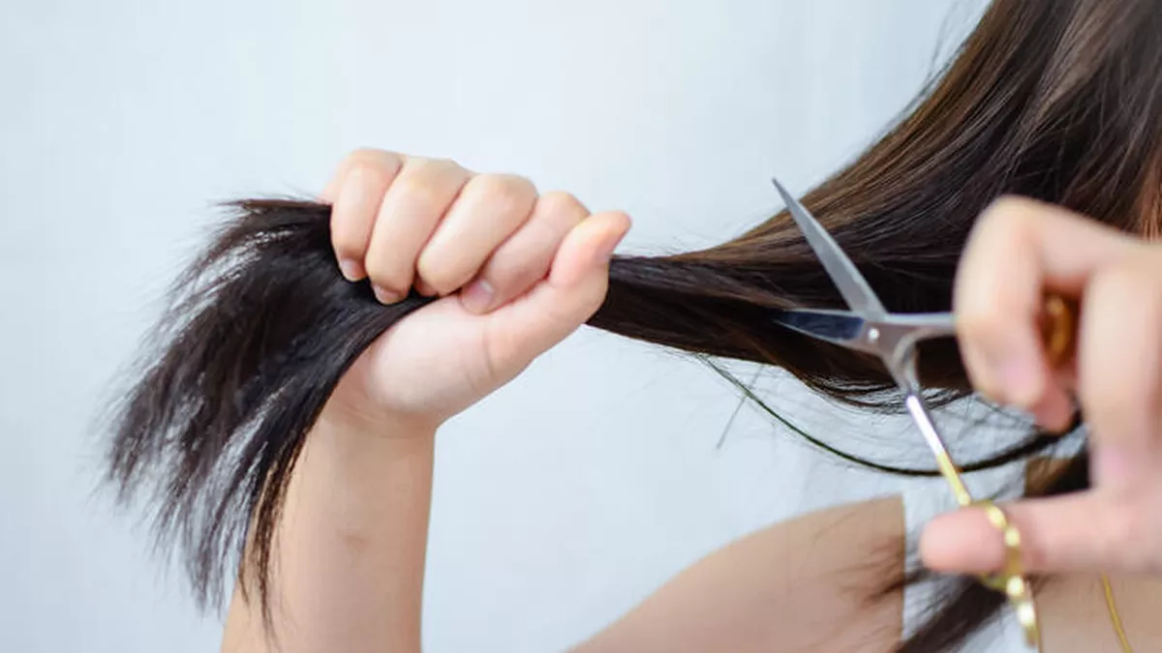
What is the girl doing?

Slide 37
The girl is cutting her hair.

Slide 38
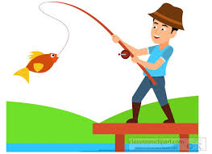
32

Slide 39
What is the man doing?

Slide 40
The man is riding a horse.

Slide 41
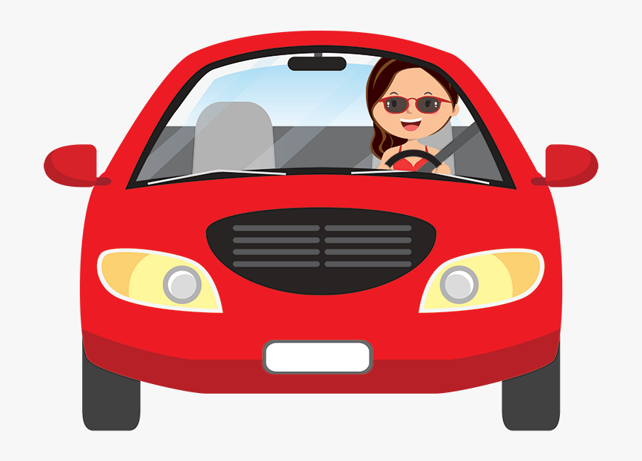
What is the woman doing?

Slide 42
The woman is driving a car.

Slide 43
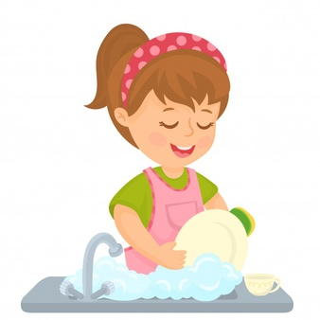
What is the woman doing?

Slide 44
The woman is washing vessels.

